Slide 2
“Then Jesus declared, “I am the bread of life. Whoever comes to me will never go hungry, and whoever believes in me will never be thirsty. But as I told you, you have seen me and still you do not believe. All those the Father gives me will come to me, and whoever comes to me I will never drive away. For I have come down from heaven not to do my will but to do the will of him who sent me. And this is the will of him who sent me, that I shall lose none of all those he has given me, but raise them up at the last day. For my Father’s will is that everyone who looks to the Son and believes in him shall have eternal life, and I will raise them up at the last day.”

Slide 3
“At this the Jews there began to grumble about him because he said, “I am the bread that came down from heaven.”
They said, “Is this not Jesus, the son of Joseph, whose father and mother we know? How can he now say, ‘I came down from heaven’?”
“Stop grumbling among yourselves,” Jesus answered. “No one can come to me unless the Father who sent me draws them, and I will raise them up at the last day. It is written in the Prophets: ‘They will all be taught by God.” Everyone who has heard the Father and learned from him comes to me. No one has seen the Father except the one who is from God; only he has seen the Father. Very truly I tell you, the one who believes has eternal life.”

Slide 4
“I am the bread of life. Your ancestors ate the manna in the wilderness, yet they died. But here is the bread that comes down from heaven, which anyone may eat and not die. I am the living bread that came down from heaven. Whoever eats this bread will live forever. This bread is my flesh, which I will give for the life of the world.”
Then the Jews began to argue sharply among themselves, “How can this man give us his flesh to eat?”
Jesus said to them, “Very truly I tell you, unless you eat the flesh of the Son of Man and drink his blood, you have no life in you.

Slide 5
“Whoever eats my flesh and drinks my blood has eternal life, and I will raise them up at the last day. For my flesh is real food and my blood is real drink. Whoever eats my flesh and drinks my blood remains in me, and I in them. Just as the living Father sent me and I live because of the Father, so the one who feeds on me will live because of me. This is the bread that came down from heaven. Your ancestors ate manna and died, but whoever feeds on this bread will live forever.”
He said this while teaching in the synagogue in Capernaum.”
(John 6:35-59)

Slide 6
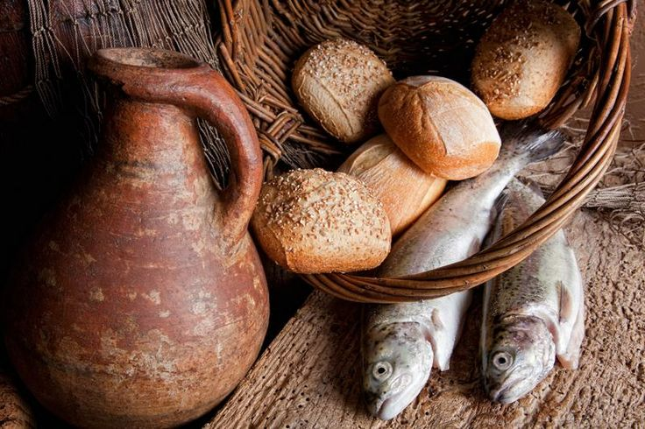
Our passage is preceded by an account of Jesus multiplying bread and fish and filling the empty bellies of a significant crowd

Slide 7
“After the people saw the sign Jesus performed, they began to say, “Surely this is the Prophet who is to come into the world” (John 6:14).
All seemed to be going very well at this precise moment in Christ’s ministry and the swelling crowds appeared to be spiritually discerning something important about Christ’s identity.
The religious leaders desired to do away with Jesus, because they understood His comments calling God His Father as evidence that He was “making Himself equal with God” (John 5:18).
Though on the surface Jesus’ ministry appeared wonderfully accepted, there was a strong undercurrent of opposition generated by the religious leaders of the day.

Slide 8
Jesus begins with an identity statement, but proceeds to comment on both His origin and function or mission.
IDENTITY: “I am the bread of life.” (v.35)
ORIGIN: “… that came down from heaven.” (v.41)
MISSION: In coming to do the Father’s will, He would extend eternal life to all who professed faith in the Son. He was there to “give [of His flesh] for the life of the world” and that “whoever eats this bread will live forever” (v.51).

Slide 9
Jesus called out the crowd on their motivation, saying “you are looking for me, not because you saw the signs I performed but because you ate the loaves and had your fill” (John 8:26).
Pretty simply, they came to Jesus because He had filled their empty bellies.
Jesus is not suggesting in our text an invariable provision of food for the follower of Jesus, but is pointing to a greater provision that is more substantial than physical food.

Slide 10
VERSUS
QUESTION: Is Jesus the bread of life or is He a divine bread maker?
Because of His miraculous feeding of the 5,000, the vast majority of those who followed Him to Capernaum, saw Jesus as a means to fulfilling their physical cravings, rather than as the fulfillment of their cravings.
The desire of the crowd was not actually for Jesus Himself, but it was for the food that they experienced Jesus provide. Jesus had become the means to the bread they craved.

Slide 11
Jesus’ “I am” statement is immensely profound - they did not need bread; they needed Him!
Jesus was not a means to an end, but was the end in itself. He is God’s provision for our survival, both now and into eternity.
“My God will meet all your needs according to the riches of his glory in Christ Jesus.” (Philippians 4:19)
Like the crowds in our text, we can read this verse as suggesting that, through Jesus, all of our needs will be met out of God’s immense riches. We then come to Him expecting Him to provide us this sort of “bread”.
But this is not what Jesus is revealing in His “I am” statement. There is no need that Jesus won’t fill with Himself; there is nothing we truly need that is not found in Christ.

Slide 12
Jesus is not a middleman, serving to provide us means to seeing our needs met. He is the One in whom our all needs are met, the One through whom all things can be accomplished.
We will only find ourselves full, when get our fill of Jesus; everything else will sell us short, and it is only as we eat of the bread of life that we will truly live.
The peace, the joy, the love, and the purpose gifted to the follower of Jesus – the fullness of life offered in Jesus Christ - are the cravings of all humanity, yet those outside of the faith seek to see these cravings met by some other means.

Slide 13
“Do not worry, saying, ‘What shall we eat?’ or ‘What shall we drink?’ or ‘What shall we wear?’ For the pagans run after all these things, and your heavenly Father knows that you need them. But seek first his kingdom and his righteousness, and all these things will be given to you as well”. (Matthew 6:31-33)
When we pursue Christ’s kingdom and His righteousness first, first in priority and first in effort, we can trust Him to give us whatever we need to fulfill His purposes.

Slide 14
Might our proclivity to focus on our needs being met through Jesus – might our tendency to see Jesus as a bread maker - point to the fact that we have yet to fully accept Jesus as the bread of life that came down from heaven?
When we come to Jesus with the expectation that it is through Him – and not in Him – that our cravings will be met, what does this suggest about our understanding of this “I am” statement of Jesus and our ability feed upon Him and find life?

Slide 15
Might we recognize today that Jesus is the bread of life that came down from heaven to grant unto us eternal life.
Might we truly eat of this bread, finding in Him that we truly have all that we need to accomplish His purpose in our lives.
Today, if we find ourselves empty – if we find ourselves lost, purposeless and struggling - might we, by faith in Jesus, feed upon the bread of life that is Jesus Christ and might we be able to declare, along with the Apostle Paul, that all else – all else – is a loss because of the worth of knowing Jesus.
PRAYER

