Slide 1
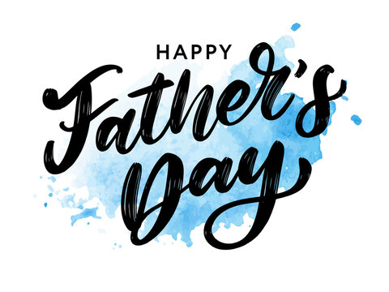

Slide 3
“So I reflected on all this and concluded that the righteous and the wise and what they do are in God’s hands, but no one knows whether love or hate awaits them. All share a common destiny—the righteous and the wicked, the good and the bad, the clean and the unclean, those who offer sacrifices and those who do not. As it is with the good, so with the sinful; as it is with those who take oaths, so with those who are afraid to take them. This is the evil in everything that happens under the sun: The same destiny overtakes all. The hearts of people, moreover, are full of evil and there is madness in their hearts while they live, and afterward they join the dead.”

Slide 4
“Anyone who is among the living has hope—even a live dog is better off than a dead lion! For the living know that they will die, but the dead know nothing; they have no further reward, and even their name is forgotten. Their love, their hate and their jealousy have long since vanished; never again will they have a part in anything that happens under the sun. Go, eat your food with gladness, and drink your wine with a joyful heart, for God has already approved what you do. Always be clothed in white, and always anoint your head with oil. Enjoy life with your wife, whom you love, all the days of this meaningless life that God has given you under the sun—all your meaningless days.”

Slide 5
“For this is your lot in life and in your toilsome labor under the sun. Whatever your hand finds to do, do it with all your might, for in the realm of the dead, where you are going, there is neither working nor planning nor knowledge nor wisdom. I have seen something else under the sun: The race is not to the swift or the battle to the strong, nor does food come to the wise or wealth to the brilliant or favor to the learned; but time and chance happen to them all. Moreover, no one knows when their hour will come: As fish are caught in a cruel net, or birds are taken in a snare, so people are trapped by evil times that fall unexpectedly upon them.”

Slide 6
”I also saw under the sun this example of wisdom that greatly impressed me: There was once a small city with only a few people in it. And a powerful king came against it, surrounded it and built huge siege works against it. Now there lived in that city a man poor but wise, and he saved the city by his wisdom. But nobody remembered that poor man. So I said, “Wisdom is better than strength.” But the poor man’s wisdom is despised, and his words are no longer heeded.”
Ecclesiastes 9:1-16

Slide 7
Our passage today reinforces the earlier idea that death serves as a levelling agent for all humanity in that, eventually, all of us face death.
“A person’s days are determined; [God has] decreed the number of his months and [has] set limits he cannot exceed.” (Job 14:5)
Not only is death common for all, but the Teacher has discovered that death seems to provide an end point for even the produce of one’s life.
“Their love, their hate and their jealousy have long since vanished.” (Ecclesiastes 9:6)

Slide 8
The Teacher concludes that nothing one does under the sun is truly of consequence and he elevates chance to a supreme position.
While we might be familiar with the saying “the end justifies the means”, the Teacher forwards a belief that “the end negates or nullifies the means”.
The Teacher once again focusses the reader on a life spent “[eating] your food with gladness, and [drinking] your wine with a joyful heart”, a life enjoying fine clothing, physical comfort, and spousal bliss “all the days of this meaningless life that God has given you under the sun—all your meaningless days” (vs.9).

Slide 9
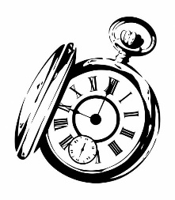
Rather than learning to fear the power of death today, I’d rather we explore the power of seizing the moment.
Culturally, we’ve been taught to have a split relationship with the moment; we have been taught to either fear the moment or to completely disregard the moment.
The former leads to tremendous indecision – “paralysis by analysis” – while the latter leads to destructive and reckless snap decisions.
JUST A M MENT

Slide 10
TWO TRUTHS:
death eventually comes to us all
none knows the time of their death.
There is a world of difference between “it doesn’t matter what you do because you’re going to die” – the Teacher’s position - and “it really matters what you do because you’re going to die” – a New Testament biblical position.
Rather than lives void of intentionality, immediacy and influence then, as followers of Jesus, we are called to lives overflowing with intentionality, immediacy and influence, capturing each moment appropriately.

Slide 11
INTENTIONALITY
“Whatever your hand finds to do, do it with all your might” (v.10)
“So whether you eat or drink or whatever you do, do it all for the glory of God” (1 Corinthians 10:31)
“Whatever you do, work at it with all your heart, as working for the Lord, not for human masters.” (Colossians 3:23)
As followers of Jesus, we live with intention because we understand this as an act of worship that brings glory to God.
Do I live by intentionally using each moment of my day with all of my might to bring glory to God?

Slide 12
IMMEDIACY
We ought not live with immediacy because our death is quickly approaching, but as followers of Jesus, we ought to live with immediacy in our presentation of the gospel because we know that at any moment death might come to those whom we love.
Have you found that gospel seeds are sometimes incredibly, often painfully slow growing in the soil of our culture?
We need to live with immediacy, sharing our knowledge of Jesus with those around us today, right now.
Has the suspected slow growth of planted gospel seeds caused me to live without immediacy?
Am I living with immediacy – with a share today sort of urgency - in regards to my loved ones who do not yet know the saving grace of Jesus?

Slide 13
INFLUENCE
Our legacies – be they of goodness or of evil – will long outlast us.
A life of influence will always outlast the liver of that life and as followers of Jesus, what a joy it is to know that our lives can speak of Jesus even when we are long gone, if only we set about to diligently follow Jesus.
Be assured of this - your life will speak.

Slide 14
M MENTs MATTER
Moments matter, not because missing a moment deprives us of something, but much more so because missing a moment might deprive someone we love of an incredible future.
We have each been allotted a finite number of moments in our life; will you live a life of intention, immediacy and influence or will your settle for the status quo of a life spent living out “all the days of this meaningless life that God has given you under the sun”?

