Slide 1
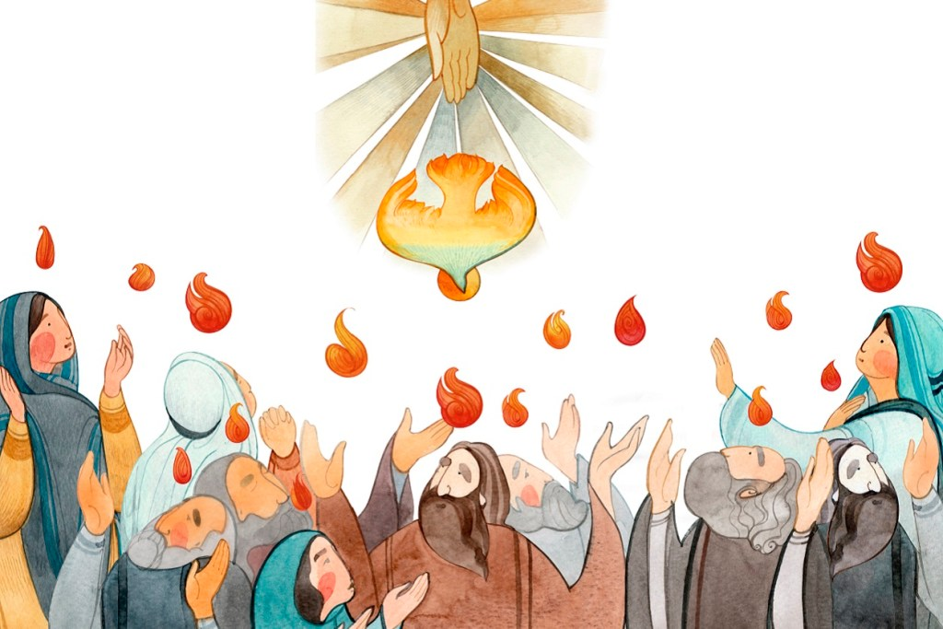

Slide 3
“Guard your steps when you go to the house of God. Go near to listen rather than to offer the sacrifice of fools, who do not know that they do wrong. Do not be quick with your mouth, do not be hasty in your heart to utter anything before God. God is in heaven and you are on earth, so let your words be few. A dream comes when there are many cares, and many words mark the speech of a fool. ”

Slide 4
“When you make a vow to God, do not delay to fulfill it. He has no pleasure in fools; fulfill your vow. It is better not to make a vow than to make one and not fulfill it.” Do not let your mouth lead you into sin. And do not protest to the temple messenger, “My vow was a mistake.” Why should God be angry at what you say and destroy the work of your hands? Much dreaming and many words are meaningless. Therefore fear God.”
- Ecclesiastes 5:1-7

Slide 5
KEY IDEA:
What developed within the people of Israel was an odd understanding that God was nearly completely transcendent – and thereby distant – except when it came to the Temple, where He was immensely immanent – and therefore profoundly present.
Transcendent or “beyond”
Immanent or “near”

Slide 6
“Unknowable” or ineffable
KEY IDEA:
The accepted religious interpretation of scripture leaned heavily towards a distant and unknowable God meaning that not only is God unknowable, but even His activity within creation is also indeterminable.
“Knowable”

Slide 7
If God is primarily transcendent, distant and unknowable, how can one with confidence enter into the immanent presence of God via temple worship?
Is the Teacher calling for “relational reverence” before God or is he intimating “fright before a powerful and dangerous” being?
Though scripture is effusive in its position that God is good, the Teacher of Ecclesiastes is skeptical of God’s goodness, leaving little else in place but fear.

Slide 8
The Teacher instructs that one must approach God with a listening ear and not a babbling mouth.
UNDER THE SUN
UNDER THE SON
Because God is near and known, one need not babble incessantly; the good God of creation already understands the needs of humanity and desires to respond with good, gracious gifts.
Because God is distant and unknowable, one must limit both the frequency and length of one prayers, otherwise they might result in some fearfully terrifying response from a capricious God.

Slide 9
The Teacher instructs that one must refuse to play games by defaulting on a religious obligation.
UNDER THE SUN
UNDER THE SON
The follower of Jesus ensures that their word is their bond, not because they fear reprisal from God, but because they fear that such a lack of integrity might bring disdain upon the name of Jesus.
For the Teacher, the concern is unsurprisingly the worry that through defaulting on a vow, God might get angry and “destroy the work of [one’s] hands”. Don’t’ default on a vow or beware a coming lightning bolt of judgment, goes the teaching.

Slide 10
In both cases then, it is important that we note that the Teacher moves us away from a reverential, yet intimate familiarity with a good God and towards a distant, fear based interaction with an unknown god. His encouragement regarding worship then reflects this reality and so we are left to question whether as followers of Jesus such a fear-based system ought to inform our worship of God.

Slide 11
Let us thank God that we get to worship Jesus:
One who is both transcendent, yet immanent
One who is “the radiance of God’s glory and the exact representation of his being” (Hebrews 1:3)
One who “became flesh and made his dwelling among us” (John 1:14)
and One whom by His Spirit who “dwells in [our] midst” (1 Corinthians 3:16), we are permitted to continually grow in our knowledge of God, increasing in intimacy with One who is infinitely beyond us.

Slide 12
Let us allow this reality to generate in us awestruck reverence for God, but not frightful fear of Him.
Might we understand the transcendent majesty of whom it is that we worship, while we simultaneously enjoy intimate relational knowledge of Him.
Might the terrible fear of God so clearly expressed by the Teacher be far from us as those who live “under the Son”.

Slide 13
In our worship of God, let us not become babbling fools, but let us regularly “approach God’s throne of grace with confidence, so that we may receive mercy and find grace to help us in our time of need” (Hebrews 4:16).
Might we be this sort of a people, not because we are cowering in fear of a lighting bolt of reprisal from heaven, but because we know that our expressed integrity paves the way for others to come to a saving knowledge of Jesus.

Slide 14
A PRAYER
“Out of [God’s] glorious riches [might He] strengthen you with power through his Spirit in your inner being, so that Christ may dwell in your hearts through faith … being rooted and established in love, [might you] have power, together with all the Lord’s holy people, to grasp how wide and long and high and deep is the love of Christ, and to know this love that surpasses knowledge—that you may be filled to the measure of all the fullness of God” (Ephesians 3:16-19).

