Slide 2
Illness and sickness are contrary to God’s original design for humanity and nothing but a by-product of sin in the world; we ought never be comfortable with or accommodating to the idea of illness and sickness.
When Romans 6:23 tells us that “the wages of sin are death”, we ought to acknowledge that part of our earnings is paid out in our experience of sickness and illness.
The second half of Romans 6:23 contains the incredible promise that that “the gift of God is eternal life in Christ Jesus our Lord”. Ultimately, we can have confidence that God addressed the issue of illness and sickness upon the cross and we will fully live out this victory in His restored kingdom.
A dilemma – how can we recognize just how contrary this all is to God’s original design for humanity and yet live faithfully and coherently in a world so touched by illness and sickness?

Slide 3
“Jesus went through all the towns and villages, teaching in their synagogues, proclaiming the good news of the kingdom and healing every disease and sickness.” (Matthew 9:35)
“These twelve Jesus sent out with the following instructions: “Do not go among the Gentiles or enter any town of the Samaritans. Go rather to the lost sheep of Israel. As you go, proclaim this message: ‘The kingdom of heaven has come near.’ Heal the sick, raise the dead, cleanse those who have leprosy, drive out demons. Freely you have received; freely give”. (Matthew 10:5-8)
So closely related are these ideas within the ministry of Jesus and His earliest followers that it is almost impossible to separate the two.

Slide 4
There is a tendency however in modern Christianity to separate these two realities, which manifests in one of two ways: we either become so teaching/preaching focussed that we reject Jesus’ supernatural engagement with the sick or we become so enamoured with His otherworldly healing miracles that we belittle His teaching.
Let us not rush to one extreme or the other, instead holding in balance, as best we can, both Christ’s kingdom proclamation – His teaching and preaching - and His miracle working power to the ill.

Slide 5
“When Jesus had finished saying all this to the people who were listening, he entered Capernaum. There a centurion’s servant, whom his master valued highly, was sick and about to die. The centurion heard of Jesus and sent some elders of the Jews to him, asking him to come and heal his servant.
When they came to Jesus, they pleaded earnestly with him, “This man deserves to have you do this, because he loves our nation and has built our synagogue.”
So Jesus went with them.”

Slide 6
He was not far from the house when the centurion sent friends to say to him: “Lord, don’t trouble yourself, for I do not deserve to have you come under my roof. That is why I did not even consider myself worthy to come to you. But say the word, and my servant will be healed. For I myself am a man under authority, with soldiers under me. I tell this one, ‘Go,’ and he goes; and that one, ‘Come,’ and he comes. I say to my servant, ‘Do this,’ and he does it.”
When Jesus heard this, he was amazed at him, and turning to the crowd following him, he said, “I tell you, I have not found such great faith even in Israel.”
Then the men who had been sent returned to the house and found the servant well.

Slide 7
Soon afterward, Jesus went to a town called Nain, and his disciples and a large crowd went along with him. As he approached the town gate, a dead person was being carried out—the only son of his mother, and she was a widow. And a large crowd from the town was with her. When the Lord saw her, his heart went out to her and he said, “Don’t cry.”
Then he went up and touched the bier they were carrying him on, and the bearers stood still. He said, “Young man, I say to you, get up!” The dead man sat up and began to talk, and Jesus gave him back to his mother. They were all filled with awe and praised God.
“A great prophet has appeared among us,” they said. “God has come to help his people.” This news about Jesus spread throughout Judea and the surrounding country.

Slide 8
A link is sometimes drawn in Christianity between expressed faith and experienced healing that suggest that healing, or a lack thereof, is directly related to one’s expressed faith in Jesus.
Likely from a pagan upbringing, the centurion in our text was a Roman army officer stationed in Capernaum, carrying a reputation for being brutally ruthless with their command and those in servitude to them were often abused and treated inhumanely.
The centurion of our passage seems not only to have had compassion for his servant but also enlisted Jewish elders to approach Jesus with a request for his servant’s healing.
After learning about the befuddling faith expressed by the centurion, we are told that Jesus “was amazed at him, and turning to the crowd following him, he said, “I tell you, I have not found such great faith even in Israel”.
The tendency then is to conclude that it is the great faith of the centurion that secures the miracle of healing.

Slide 9
Quite likely Jewish in background, not even a hint is given as to the widow’s faith in or acknowledgement of Jesus.
Since we see both extremes of expressed faith in regards to healing in back to back passages, I believe we must conclude, though expressed faith can be marvellous and is an ideal for the follower of Jesus, experienced healing, or a lack thereof, is not necessarily tied to one’s expressed faith in Jesus. It is not greater faith that secures for us healing in the name of Jesus, nor is it weakened faith that leaves us unhealed.
The only necessary faith where healing is concerned is the faith that God can heal.

Slide 10
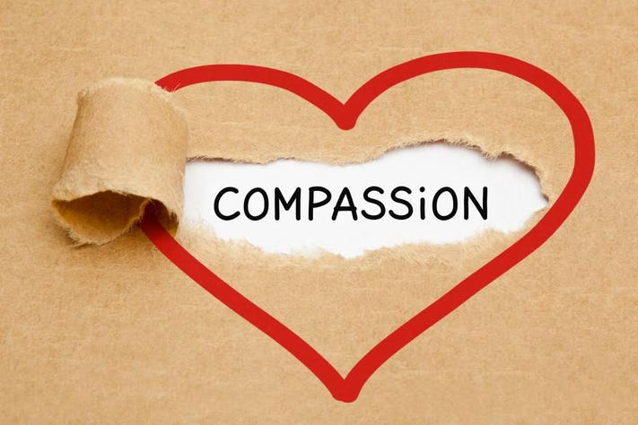
Secondly, Christ’s interaction with both the centurion’s servant and the widow at Nain reveal a specific motivation for His healing work: compassion.
Any ministry to the sick must find its root in compassion, love for the other!
We ought to love those who are ill with Christ-like compassion, even when this is difficult or distasteful.

Slide 11
It is not the ill servant that petitions Christ; it is the centurion who approaches Jesus on behalf of the one who is ill.
Intercessory prayer, sometimes called "standing in the gap," is simply lifting up the needs and concerns of others to God.
“Is anyone among you sick? Let them call the elders of the church to pray over them and anoint them with oil in the name of the Lord. And the prayer offered in faith will make the sick person well; the Lord will raise them up. If they have sinned, they will be forgiven. Therefore confess your sins to each other and pray for each other so that you may be healed. The prayer of a righteous person is powerful and effective.” (James 5:14-16)

Slide 12
Application
Where there is illness among God’s people, we ought to see powerful and effective intercessory prayer for the ill.
When we experience illness, we ought to be humble enough to approach the church family for prayer for healing.
When illness confronts us, let us confess our sin, which stands in the way of healing, and be forgiven, asking for others to pray for us.
We should be praying for one another for healing, forgiveness and restoration, even if no specific request has been given.
We cannot simply approach the church to see our needs for healing met and ignore the potential suffering of those around us; we must be open to the reciprocal ministry of God’s people!

Slide 13
Application
Let’s be a people who actively proclaim “Christ’s kingdom is here”, faithfully expecting that by Christ’s wounds, people are healed.
Let’s be a people who compassionately care for the sick and ill, both in our church family and, more generally, in the community around us. Let us serve out of love!
Let’s be a people who engage in prayer for the sick and ill. Might we readily lift up one another in intercessory prayer regularly.

