Slide 2
As exiles of sorts in this world, have we learned the lesson of the ancient Israelites that we ought to find ourselves dependent upon the leading of the Lord, rather than upon the mechanics of the church for the growth, development and strengthening of our faith?

Slide 3
Longing
By the rivers of Babylon we sat and wept when we remembered Zion. There on the poplars we hung our harps, for there our captors asked us for songs, our tormentors demanded songs of joy; they said, “Sing us one of the songs of Zion!” How can we sing the songs of the Lord while in a foreign land? If I forget you, Jerusalem, may my right hand forget its skill. May my tongue cling to the roof of my mouth if I do not remember you, if I do not consider Jerusalem my highest joy. Remember, Lord, what the Edomites did on the day Jerusalem fell. “Tear it down,” they cried, “tear it down to its foundations!”

Slide 4
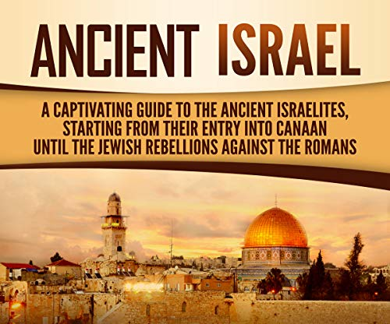
A TUMULTUOUS
HISTORY

Slide 5
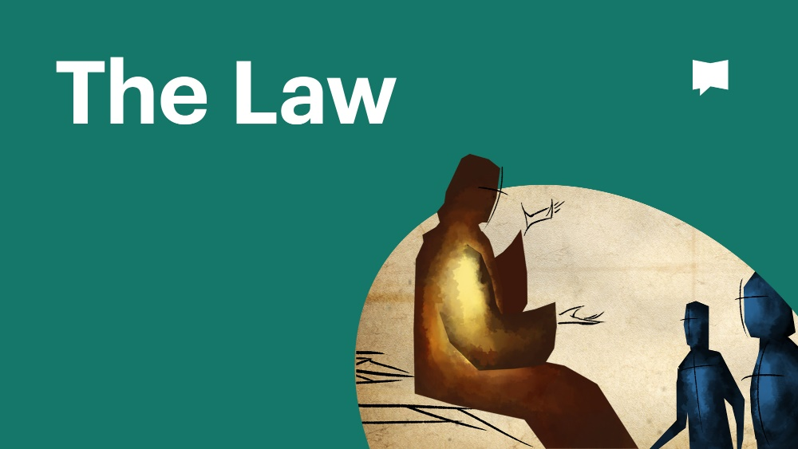
Though the people of Israel had their place and they had their temple, His promised peace was insufficiently experienced.
The Pharisees taught that the longing of Israel would only be met once the people of Israel were ritually compliant with the fullness of the Law.
Rather than languish in brokenheartedness, the Pharisees set out to bring the solution to their longing into being by fierce ritual obedience to the Law.

Slide 6
“It is futile to serve God. What do we gain by carrying out his requirements and going about like mourners before the Lord Almighty?” (Malachi 3:14).
The longing of the people of Israel had gone so long unmet that, on one hand, apathy had become quite common place, while on the other, human effort was trumpeted as the answer to the void being experienced.
An openness to being led by God as a solution was virtually absent from within the people of Israel.

Slide 7
“You do not delight in sacrifice, or I would bring it; you do not take pleasure in burnt offerings. My sacrifice, O God, is a broken spirit; a broken and contrite heart you, God, will not despise” (Psalm 51:16-17).
What peace might have been experienced if rather than striving of their own accord they had instead turned to God, being honest about their longing and brokenheartedness?
“The Lord is close to the brokenhearted and saves those who are crushed in spirit.” (Psalm 34:18)
Might they have found God’s peace as they turned to Him in intimate relationship?

Slide 8
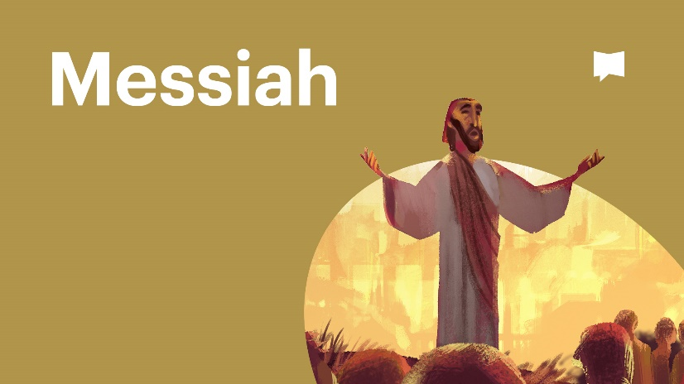
Another shift was experienced within the longing of the people of Israel, a shift from a longing for a place to a longing for a person - a strange, nebulous figure known as the Messiah.
The Messiah envisioned by the people of Israel would be a descendant of King David, who would evidence a particular affinity for the Law of Moses, and who would guide Israel back to the Law, rebuilding the temple to ensure its observance, all while establishing a powerful kingdom in Israel to which all dispersed Israelites might return and experience peace.

Slide 9
The messianic hope during this time period was for a powerful military leader who would expel all foreign oppressors from Israel, but also for one who would exist as a spiritual supporter of the religious leaders of Israel.
There were clearly others, awaiting humbly the arrival of the One who would meet their deepest longings; individuals “waiting for the consolation of Israel [and] looking forward to the redemption of Jerusalem” (Luke 2:25,38), ready to follow at a moment’s notice.

Slide 10
What do we do with our deepest longings?
Perhaps there is/are:
relationships so broken that we cannot even imagine a pathway to seeing them repaired.
physical brokenness that we struggle with on a daily basis that steals from us our peace.
profound spiritual brokenness that leaves us feeling ashamed, abandoned and alone.
“We groan, longing to be clothed instead with our heavenly dwelling.” (2 Corinthians 5:2)
We know that there is a something better, something more than what presently is, a new Jerusalem, if you will.
Our tendency is to either busy ourselves with activity or to stagnate with inactivity.

Slide 11
But there is another way, a kind of waiting
evidenced by the faithful of Israel that permits us to descend neither into inactivity nor to rush into reckless activity.
that begins with a heart posture; a heart ready to act but not to act rashly.
to be led, as sheep await the lead of their shepherd.
It is a waiting to be led and not a waiting for complete resolution to brokenness, for it results in a following with unmet longings in hand and a willingness to be led in one’s brokenness.

Slide 12
Are you willing to allow God to lead you even as you experience unmet longings and brokenness?
To those humble enough to be led by God, they truly found “what is desired by all nations”, encountering One who is called “Wonderful Counselor, Mighty God, Everlasting Father, Prince of Peace” (Isaiah 11:6).
My hope and my prayer is that you too have found this Good Shepherd, Jesus Christ.

