Slide 2
What has been one thing that you’ve learned, or been reminded of again, throughout this series thus far?

Slide 3
QUESTION: If Christ is present among us as we gather in His name, then ought we not expect Him to be leading us in some way as we do so?
One of the ways that Christ continues to lead us and that is by His Holy Spirit as He guides us.
Another way that Christ manifests His leadership among us today and that is by His appointment of specific people as leaders among His people, within the church. Christ continues to lead us today by using spiritually empowered men and women to do so.

Slide 4
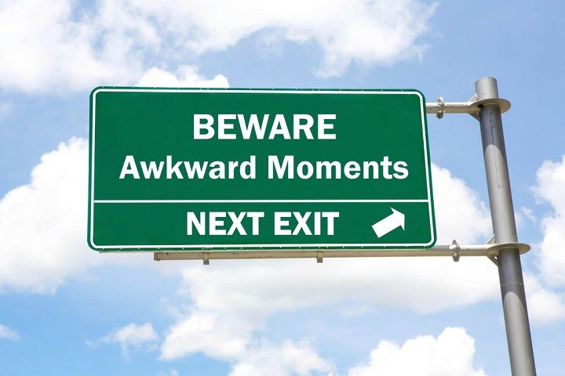

Slide 5
“But to each one of us grace has been given as Christ apportioned it. This is why it says: “When he ascended on high, he took many captives and gave gifts to his people.” (What does “he ascended” mean except that he also descended to the lower, earthly regions? He who descended is the very one who ascended higher than all the heavens, in order to fill the whole universe.) So Christ himself gave the apostles, the prophets, the evangelists, the pastors and teachers, to equip his people for works of service, so that the body of Christ may be built up until we all reach unity in the faith and in the knowledge of the Son of God and become mature, attaining to the whole measure of the fullness of Christ.”

Slide 6
“Then we will no longer be infants, tossed back and forth by the waves, and blown here and there by every wind of teaching and by the cunning and craftiness of people in their deceitful scheming. Instead, speaking the truth in love, we will grow to become in every respect the mature body of him who is the head, that is, Christ. From him the whole body, joined and held together by every supporting ligament, grows and builds itself up in love, as each part does its work.”
(Ephesians 4:7-16)

Slide 7
THREE SECTIONS
“so Christ Himself gave”
“the apostles, the prophets, the evangelists, the pastors and teachers”
“to equip his people for works of service, so that the body of Christ may be built up until we all reach unity in the faith and in the knowledge of the Son of God and become mature, attaining to the whole measure of the fullness of Christ”.

Slide 8
“So Christ Himself gave …”
Jesus Himself – the crucified, resurrected and ascended Son of God – has purposefully given specifically gifted people to the church.
This appointment is not a function of one’s training, knowledge, intelligence, charisma, notoriety or popularity, but is solely a gifting of God’s Spirit.

Slide 9
This is not a one time, first century gift to the developing church in which Christ gave to the church sometime around 35AD certain individuals to create strength within the church, but an ongoing reality experienced today.
It is also not that God has gifted the global church with such individuals, but that such gifting does not actually occur at the local church level. Instead, this passage presents to us a timeless and universal principle revealing that God blesses His body – whenever and wherever it is found – with individuals to lead according to their God-giftedness.

Slide 10
POINT #1: Jesus gave and gives to the church empowered people to lead the church.

Slide 11
The kinds of people gifted to the church
Apostles – those who minister trans-culturally or cross-culturally in pioneer type evangelism.
Prophets - those who correctly communicate the revelation of God.
Evangelists – those who effectively communicate the gospel.
Shepherds/pastors/teachers – those who shepherd the people of God to maturity and Christlikeness and those who clearly explain and effectively apply the truth of God's word.

Slide 12
POINT #2: As a church, we are equipped with apostolic, prophetic, evangelistic, shepherding, pastoral and teaching leaders so that we can move towards “attaining to the whole measure of the fullness of Christ”.

Slide 13
PURPOSEFUL PROVISION
A church leader’s primary job is not to program or perform, but to equip Christ’s people for works of service.
It is the church leader’s responsibility to, in whatever way they can, ensure that a church is corporately accomplishing the “good works, which God prepared in advance for us to do” (Ephesians 2:10).
This means corporate action ought to be at the forefront of the leader’s mind, consistently seeking God’s will for whole church engagement in practical ministry so that the body of Christ might be built up.

Slide 14
POINT #3: Though larger buildings, bigger budgets and more behinds in the seats might point to some level of success, the leaders Christ appoints to a church will assist that church in becoming more greatly unified, more deeply mature, and more functionally loving.

Slide 15
QUESTION: If Christ is present among us as we gather in His name, then ought we not expect Him to be leading us in some way as we do so?
We actually and realistically experience Christ’s leadership among us best within the church when those He has gifted to us actually do their work of equipping and when we, as God’s people, “have confidence in [our] leaders and submit to their authority … [doing] this so that their work will be a joy, not a burden”.

Slide 16
Now we ask you, brothers and sisters, to acknowledge those who work hard among you, who care for you in the Lord and who admonish you. (1 Thessalonians 5:12)
LET US ACKNOWLEDGE THOSE WHOM CHRIST HAS GIFTED TO LEAD US
The elders who are good leaders are to be considered worthy of double honor, especially those who work hard at preaching and teaching. (1 Timothy 5:17)
LET US HONOUR AND APPRECIATE THOSE WHOM CHRIST HAS GIFTED TO LEAD US
Remember your leaders, who spoke the word of God to you. (Hebrews 13:7)
LET US REMEMBER IN PRAYER THOSE WHOM CHRIST HAS GIFTED TO LEAD US

Slide 17
Might we would continue to be transformed into a people primed to be led by God and when He manifests His leadership in whatever way He sees fit, might we be ready to respond immediately.

