Slide 2
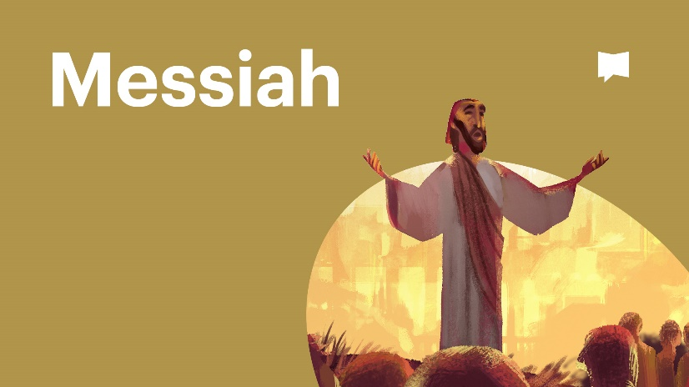
Within the people of Israel two specific expectations came into being; first, the Messiah would be a powerful military leader who would expel all foreign oppressors from Israel, and secondly, he would exist as a spiritual supporter, submissive to the religious leaders of Israel.

Slide 3
Somewhere between 4 BC and 1 AD, God showed up in a whole new, in a way that no one in Israel expected.
EXPECTATION 1: The expectation of those among Israel still awaiting the coming Messiah was that he would arrive as yet another, or perhaps the culminating, human intermediary sent by God.
EXPECTATION 2: Because God was present by His Word among His people, it was not expected that the arrival of the Messiah to herald God’s presence among them in a new way, because He was already with them within the Law and within the intricate religious system of Israel.

Slide 4
The people of Israel certainly did not expect God incarnate to move into the neighbourhood, but that is just what He did.
God’s dwelling with His people is not a foreign concept within Scripture.
The Garden of Eden can be seen as a uniquely created place for dynamic interaction between God and humanity.
When sin mucked this up, God posted cherubim to guard the Garden of Eden. These cherubim serve as a symbol of humanity’s broken relationship with God.

Slide 5
KEY IDEA: The inclusion of cherubim on both the Ark of the Covenant and within the tabernacle served as a reminder that God was ‘planting’ these object as places where He might once again dwell with humanity, and humanity with God. In both the Ark of the Covenant and the tabernacle, God was restoring to humanity the Eden – the intimate relational connection to God - that had been forfeited by human sin.

Slide 6
In Christ, “the Word became flesh and made his dwelling among us” (John 1:14).
Dwelling = to “tabernacle”
The nativity story depicts that as angelic choirs heralded His arrival, the Son of God literally “tabernacled” among us as one of us; He “set up His tent” in our camp. The presence of angelic beings once again reminds us that in this moment, God was restoring the specific connection with humanity that was lost due to our sin.
God would not use an intermediary in this moment, but instead, He would come as Emmanuel, God with us.

Slide 7
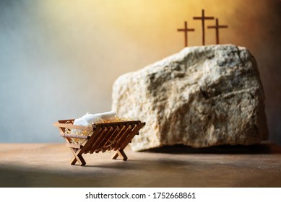
At both His birth and His resurrection, God used specific imagery to reveal that, in Christ, He was restoring to humanity the Eden – the intimate relational connection to God - that had been forfeited through human sin.

Slide 8
Jesus came to lead from alongside humanity.
Though rightfully able to claim such a reality, Jesus did not manifest a head table mentality in His leadership.
In becoming our Good Shepherd, we must recognize that Jesus was willing to tabernacle with us, while His rightful place lay in the glory of heaven.
In Jesus, humanity and divinity perfectly mingled, so that through Jesus, we might experience the restoration of the profound relational connection to God lost so long ago. Because of this, we can now “approach God’s throne of grace with confidence, so that we may receive mercy and find grace to help us in our time of need” (Hebrews 4:16).

Slide 9
Jesus also did not manifest a text book mentality to His leadership either.
In Christ, there is an alongside engagement with humanity so much so that Christ took on humanity through the incarnation leaving us with not only words, but also a powerful example.
Christ’s leadership of us entails an ongoing personal relationship with Him, for we are not just to be led by His teachings, but also by the presence of Christ among us.
Jesus pledged to be present by His Spirit, but this is not some secondary “almost Jesus” presence with us.

Slide 10
“Where two or three gather in my name, there am I with them.” (Matthew 18:20)
“And surely I am with you always, to the very end of the age.” (Matthew 28:20)
Jesus is with us right now; He is present here.
If He is present here, ought we not consider how He might be leading us in these moments we have together?
Should we right now be expecting Christ to lead us?
What might this look like?

Slide 11
Do we truly appreciate the significance of God’s joining of humanity and divinity in Jesus Christ?
The incarnation occurred not only so that we might be led more distinctly by Christ, but so that through it, our historical sinful unwillingness to be led by God might be atoned for in absolute fullness.
Christ did all of this and still desires to be with us, to lead us from alongside, to be One in whom we can commune with God!
If it is true then that Jesus came to be a “place” for humanity to meet with God, what does it means to be led by Christ in a personal, relational manner?
Can we honestly say that we by our faith in Jesus, meet “face to face” with God as did Moses?

Slide 12
Do we fail to engage in this sort of personal, relational manner at times because we know that when we come face-to-face with Christ, not only will our residual sin be exposed, but we’ll be exposed by His holiness?
Rather than pursuing this sort of relationship with God – intimacy with an alongside, relational Jesus – do we often default to a lesser relational connection – a more comfortable affinity with a “head table, textbook” sort of Jesus, because it permits us to be less confronted by our sin?

Slide 13
If it is the shame of sin that is preventing you from engaging in relationship with Jesus, if you are reluctant to be intimately led by Christ because of the disgrace of past or present behaviour, then cling to the truth of 1 John 1:9 - “if we confess our sins, he is faithful and just and will forgive us our sins and purify us from all unrighteousness”. If it is grace and mercy we require, then let us approach God’s throne of grace with confidence, knowing that forgiveness awaits us there.
We ought not wait until we are in a condition of sinless perfection to rush to Jesus, but instead, we ought to be free to run to Him each day because we know that we are not yet there. And the rushing isn’t far since He yet tabernacles among us!

Slide 14
“The Spirit of the Sovereign Lord is on me, because the Lord has anointed me to proclaim good news to the poor. He has sent me to bind up the brokenhearted, to proclaim freedom for the captives and release from darkness for the prisoners, to proclaim the year of the Lord’s favor and the day of vengeance of our God, to comfort all who mourn, and provide for those who grieve in Zion— to bestow on them a crown of beauty instead of ashes, the oil of joy instead of mourning, and a garment of praise instead of a spirit of despair.
(Isaiah 61:1-3)

Slide 15
A PRAYER
Might we encounter the presence of Christ among us today, knowing His transformative power. And might this reality be lived out each time we gather together so that as 1 Corinthians 14:25 suggests, those who do not yet know Jesus might hear of us and “fall down and worship God, exclaiming, “God is really among you!”.

