Slide 2
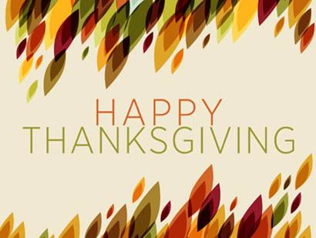

Slide 3
“Sacrifice and offering you did not desire— but my ears you have opened—burnt offerings and sin offerings you did not require. Then I said, “Here I am, I have come— it is written about me in the scroll. I desire to do your will, my God; your law is within my heart.” (Psalm 40:6-8)
The greatest thanksgiving one can give is not one day of finely crafted words of thanks, but a life dedicated to doing God’s will with thanksgiving.

Slide 4
Creation, and more specifically humanity, was created by God with purpose and intention.
Contrary to the random and undirected process of evolutionary theory so popular in our culture, scripture posits that we are “fearfully and wonderfully made”, imbued with divine purpose and intention.
As followers of Jesus, we are to live our lives in such a way that we reach our God-given purpose, which involves bringing Him glory through our createdness, and not so that we make of ourselves all that we might dream we can become.

Slide 5
Failing to follow the lead of another can result in a significant fall and a mucky, embarrassing outcome.

Slide 6
“Now the serpent was more crafty than any of the wild animals the Lord God had made. He said to the woman, “Did God really say, ‘You must not eat from any tree in the garden’?” The woman said to the serpent, “We may eat fruit from the trees in the garden, but God did say, ‘You must not eat fruit from the tree that is in the middle of the garden, and you must not touch it, or you will die.’” “You will not certainly die,” the serpent said to the woman. “For God knows that when you eat from it your eyes will be opened, and you will be like God, knowing good and evil.”

Slide 7
“When the woman saw that the fruit of the tree was good for food and pleasing to the eye, and also desirable for gaining wisdom, she took some and ate it. She also gave some to her husband, who was with her, and he ate it. Then the eyes of both of them were opened, and they realized they were naked; so they sewed fig leaves together and made coverings for themselves.”
(Genesis 3:1-7)

Slide 8
“Trust in the Lord with all your heart and lean not on your own understanding; in all your ways submit to him, and he will make your paths straight. Do not be wise in your own eyes; fear the Lord and shun evil.” (Proverbs 3:5-7)
In this moment, a choice was placed at the feet of humanity:
continue to submit to being led by God
or take alternate action thinking a better way could be discerned and doubt God as God, doubt His sovereignty and doubt His good purpose and intention in us.
After quite literally “walking with God”, the allure to take the lead in such a journey proved too great.

Slide 9
The end result of this interaction was that Adam and Eve chose the break from God’s leading in their life – seizing control of their own destinies as you will – and in very short order, like my friend from Christian Service Brigade, they found themselves looking upward to God from the bottom of a chasm, a chasm created by their sinful actions.

Slide 10
This biblical scene is not just the revelation of an ancient event that defines our current reality, this scene tends to get played out in our lives in a repeating pattern.
“I do not understand what I do. For what I want to do I do not do, but what I hate I do. And if I do what I do not want to do, I agree that the law is good. As it is, it is no longer I myself who do it, but it is sin living in me …What a wretched man I am! Who will rescue me from this body that is subject to death?” (Romans 7:15-17, 24)

Slide 11
“I waited patiently for the Lord; he turned to me and heard my cry. He lifted me out of the slimy pit, out of the mud and mire; he set my feet on a rock and gave me a firm place to stand.” (Psalm 40:1-2)
God saw humanity covered in the muck of our sin, trapped at the bottom of the chasm our failure to be led by God created and He sent us Jesus to provide us rescue. Yet He did not just pull us from the chasm; He also gave us a firm place to stand, a new place to be led forward from, and He has taken our muck covered clothes and replaced them with a new covering

Slide 12
We cannot see the curse reversed or be lifted from the muck our lack of following God has caused or receive His help in following Him if we do not humbly ask. Foundationally, this means we must come to a place where we admit our sin – our lack of being led by God – and accept that Christ’s death and resurrection results in, not only the forgiveness of our sins, but also a new ability to follow God, completely foreign to us previously.
But this also means that when we have placed our faith in Jesus, we need to ask for His help in permitting us to follow Him well. You see, not only must we ask for His rescue, but we must ask for His help in our following.

