Slide 2
In 586 BC, Jerusalem was sacked and burned and the temple was plundered and razed to the ground. Thus began the Babylonian exile.

Slide 3
“I remember the devotion of your youth, how as a bride you loved me and followed me through the wilderness, through a land not sown. Israel was holy to the Lord … What fault did your ancestors find in me, that they strayed so far from me? They followed worthless idols and became worthless themselves. They did not ask, ‘Where is the Lord, who brought us up out of Egypt and led us through the barren wilderness? … I brought you into a fertile land to eat its fruit and rich produce. But you came and defiled my land and made my inheritance detestable. The priests did not ask, ‘Where is the Lord?’ Those who deal with the law did not know me; the leaders rebelled against me …”

Slide 4
“My people have exchanged their glorious God for worthless idols ... Have you not brought this on yourselves by forsaking the Lord your God when he led you in the way? … Long ago you broke off your yoke and tore off your bonds; you said, ‘I will not serve you!’ … Although you wash yourself with soap and use an abundance of cleansing powder, the stain of your guilt is still before me,” declares the Sovereign Lord …”

Slide 5
“They have turned their backs to me and not their faces; yet when they are in trouble, they say, ‘Come and save us!’ Where then are the gods you made for yourselves? Let them come if they can save you when you are in trouble! For you, Judah, have as many gods as you have towns … In vain I punished your people; they did not respond to correction … my people have forgotten me, days without number.”
(Jeremiah 2:2-3,5-8,11,17, 20, 22, 27-28, 30, 32)

Slide 6
Though the people of Israel showed themselves to be more greatly devoted to God as He led them out of captivity in Egypt, in short order, they began to stray from His leading.
They developed their own pathways and fashioned gods after themselves, refusing to serve the God who had saved them.
Even though they engaged in the intricate sacrificial system of Israel, rather than growing in knowledge of and intimacy with God through it, the people of Israel seem to have forgotten Him entirely, simply doing as they pleased.

Slide 7
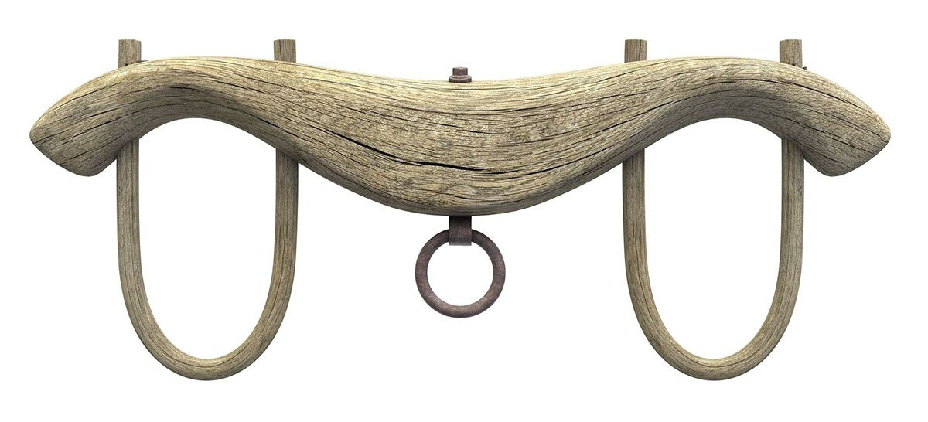
The yoke is a Scriptural symbol of servitude – of going along in submission to another.
The symbolic language referring to Israel breaking their yoke is meant to communicate that they refused to be yoked to God; as the weaker “ox” they refused to be “pulled along” or be led by God.

Slide 8
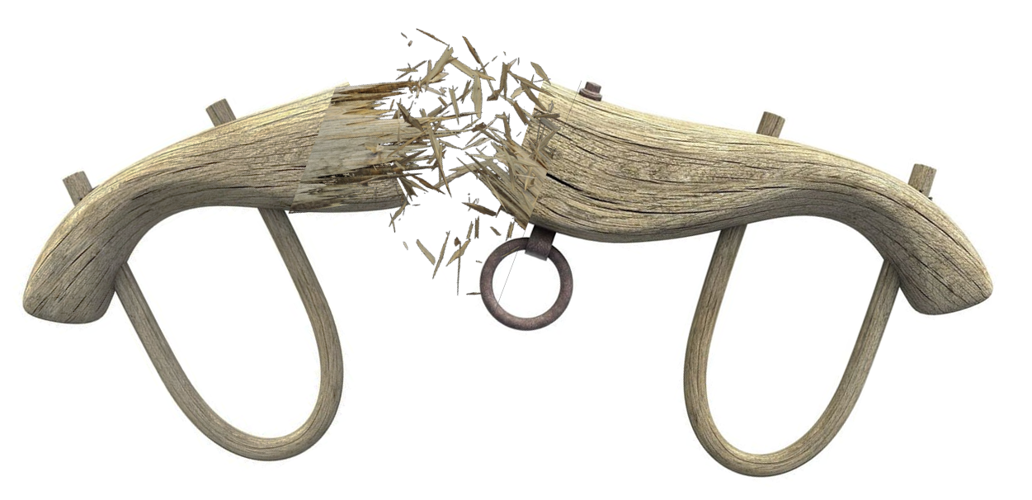
Though Hananiah’s yoke-breaking had been painfully premature, God promised to break the yoke of the Babylonians Himself, causing the people of Israel to once again serve Him. Unyoked from foreign enslavement, the people of Israel would find themselves again in a yoked relationship with God as He led them forward as His people.

Slide 9
“I will discipline you but only in due measure; I will not let you go entirely unpunished” (Jeremiah 30:11)
God had purpose for the people of Israel during the exile to:
execute an act of judgment against the sin of His people
discipline His people in due measure.
Punishment and judgement are past-focussed, inflicting some form of penalty for an offense committed, while discipline is future-focussed - training of a sort that corrects, molds, or perfects character and behaviour.
The exile was purposed not only to address the past sin of the people of Israel, but also to discipline them for a future life.
Specifically, it meant the temporary end of Temple worship and the sacrificial system, which meant that the people had to think about what was really important in their faith.

Slide 10
“Build houses and settle down; plant gardens and eat what they produce. Marry and have sons and daughters; find wives for your sons and give your daughters in marriage, so that they too may have sons and daughters. Increase in number there; do not decrease. Also, seek the peace and prosperity of the city to which I have carried you into exile. Pray to the Lord for it, because if it prospers, you too will prosper … For I know the plans I have for you,” declares the Lord, “plans to prosper you and not to harm you, plans to give you hope and a future. Then you will call on me and come and pray to me, and I will listen to you. You will seek me and find me when you seek me with all your heart. I will be found by you,” declares the Lord.”
(Jeremiah 29:4-7, 11-14)

Slide 11
God’s encouragement was that remaining led by God, even as exiles, did not mean becoming cynical, indifferent or uninvolved until circumstances improved.
The exile therefore would serve as an opportunity to train God’s people on what was truly important in their faith, by stripping away everything else.
God’s promise was that, even under His discipline, if His people sought Him, they’d find Him!

Slide 12
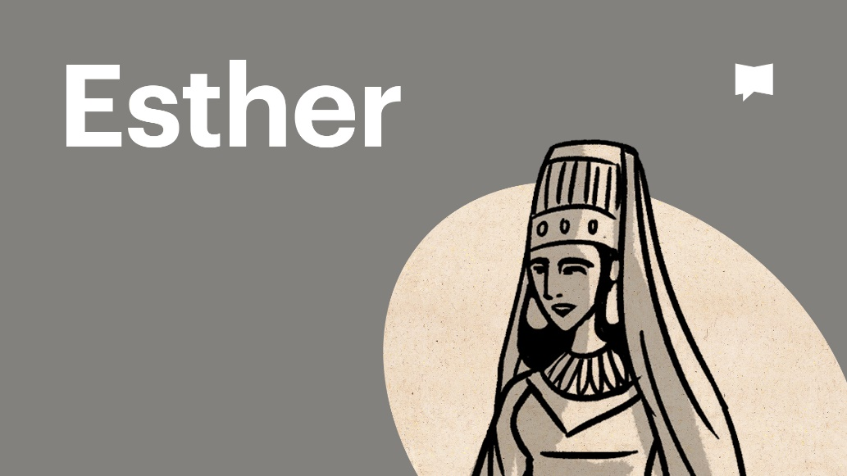
Both exilic books present incredible accounts of God’s people quite literally changing human history by remaining active and faithful, even while God’s hand of discipline rested heavily upon them.

Slide 13
Though we do not find ourselves political exiles in a foreign land anymore, the New Testament firmly indicates that followers of Jesus are aliens, strangers and exiles on the earth and that our “citizenship is in heaven” (Philippians 3:20).
Are we convinced that Christ yet desires we be a people who seek the peace and prosperity of our place of exile?
Are we as exiles from heaven engaged in prospering our place of exile – the world around us - so that those around us might declare “surely your God is the God of gods and the Lord of kings” (Daniel 2:47)?
Is our faith tenuously propped up by religious ritual or are we a people who engage relationally and whole-heartedly with Christ?

Slide 14
Might we:
receive discipline well and that God’s good purposes through it might be fully accomplished in us.
be a people who whole-heartedly engage with Christ, so that if all other religious means were stripped away, our faith would not suffer for a moment.
be a people so yoked to Christ that wherever He leads, we will follow, trusting Christ’s promise that “[His] yoke is easy and [His] burden is light” (Matthew 11:30).

