Slide 2
What has been one thing that you’ve learned, or been reminded of again, throughout this series thus far?

Slide 3
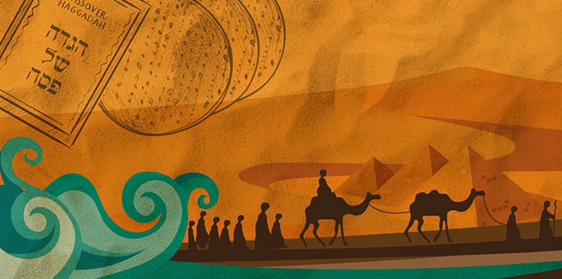
Last Sunday, we discussed how difficult situations can cause circumstantial blindness to God’s leadership. We learned that not even tangible evidence of God’s immanent leadership was enough to enable the Israelites to patiently persevere when tough stuff came their way and that their inability to remain humbly led by God was due in part to the fact that they really did not know the God whom they were following.

Slide 4
At this point, the people of Israel finally began to follow the leading of God more effectively.
This submission to God’s leading occurred in two ways:
by physically following God’s leading towards the Promised Land
by following God’s leading in the reorientation of their hearts and minds towards God and away from false systems of worship

Slide 5
Over a period of about 14 years, the Israelites settled into their land allotments by tribe of birth and they began to enjoy the produce of a land of milk and honey, eventually experiencing rest from enemy attack for close to 30 years.

Slide 6
“After that whole generation had been gathered to their ancestors, another generation grew up who knew neither the Lord nor what he had done for Israel. Then the Israelites did evil in the eyes of the Lord and served the Baals. They forsook the Lord, the God of their ancestors, who had brought them out of Egypt. They followed and worshiped various gods of the peoples around them.”
(Judges 2:10-12)

Slide 7
The people of Israel grew to know both the voice and presence of their Good Shepherd and found submitting to His leadership more easily done.
Though the people of Israel became more lead-able, they required a tangible intermediary to actually follow.
Thee Israelites evidence a proclivity to follow the intermediary, rather than God through His intermediary.
The result of this is that once no longer being led on a wilderness walk and being established in the land, with the visible cloud and fire of God’s presence now absent and God’s intermediary dismissed, a generation emerged that did not know God, nor His guiding presence.

Slide 8
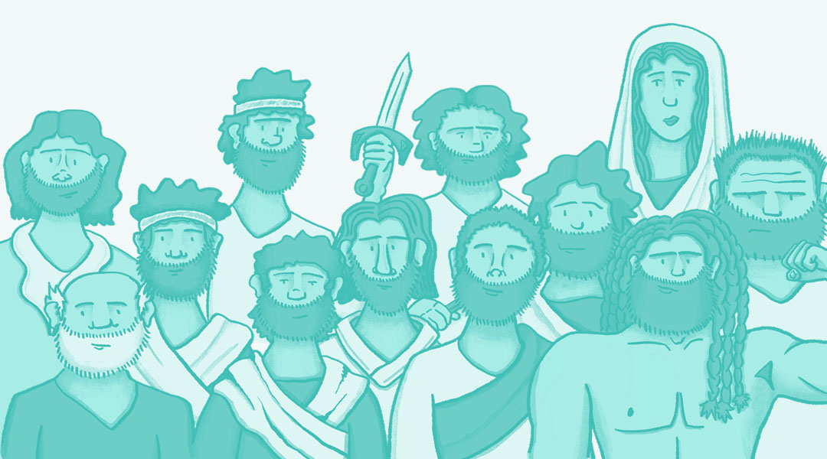
THE PROBLEM
THE JUDGES
“In those days Israel had no king; everyone did as they saw fit” (Judges 21:25).

Slide 9
THEIR SOLUTION
“All the elders of Israel gathered together and came to Samuel at Ramah. They said to him, “You are old, and your sons do not follow your ways; now appoint a king to lead us, such as all the other nations have.” But when they said, “Give us a king to lead us,” this displeased Samuel; so he prayed to the Lord. And the Lord told him: “Listen to all that the people are saying to you; it is not you they have rejected, but they have rejected me as their king. As they have done from the day I brought them up out of Egypt until this day, forsaking me and serving other gods, so they are doing to you. Now listen to them; but warn them solemnly and let them know what the king who will reign over them will claim as his rights.”
(1 Samuel 8:4-9)

Slide 10
THE OUTCOME
After another false start with Saul, David and his son, Solomon, exercised appropriate leadership over God’s people for a period of some 80 years.
This “blessedness” didn’t last, for of the 39 kings who would reign in Judah and Israel, 31 of them “did evil in the eyes of the Lord”, causing Israel to commit great sin. What we encounter is an “as goes the intermediary, so goes the people of Israel” sort of situation.
The “better way” apart from the leadership of God in their lives discerned by the Israelites resulted in nothing but destruction, oppression and exile.

Slide 11
APPLICATION QUESTIONS
Do we experience a blindness to our need for God’s leadership because we live in relative comfort and security?
Is God’s leadership any less required when in a position of comfort than when in a position of challenge?
Here in the relative peace and security of Mount Albert, do we acknowledge in a way that leads to action, the need for God’s immediate and direct leadership?
In what ways might our desire to form our own futures be akin to rejecting God as our king?
In a million little tiny moments of self-assuredness, are we becoming people who reject God as king?

Slide 12
