Slide 2
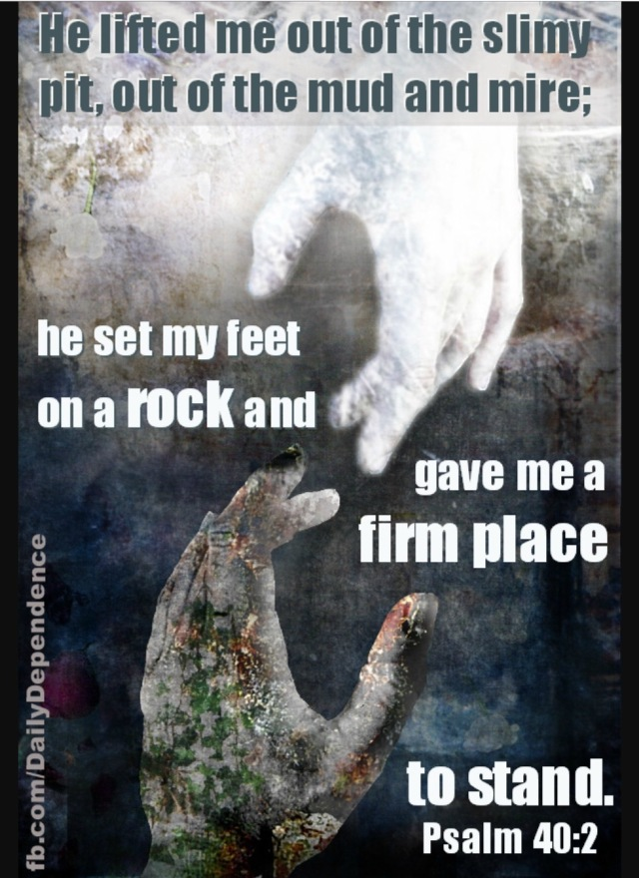
What a blessing it is the know that on both a cosmic and individual level, God has a plan to reverse the curse of Genesis 3, providing us a way to escape the wages of sin – that is death – and to give to us a new ability to follow Him in this world.

Slide 3
THE STORY OF GENESIS 1-11
Despite God’s shown mercy, humanity refused to submit to His leadership in their lives.
Through Abraham, Isaac, Jacob and Joseph, God sought to lead His people toward the future He had originally intended for humanity, establishing them in such a way that rightful glory was brought to God and that all humanity would be blessed by the faithfulness of His people.

Slide 4
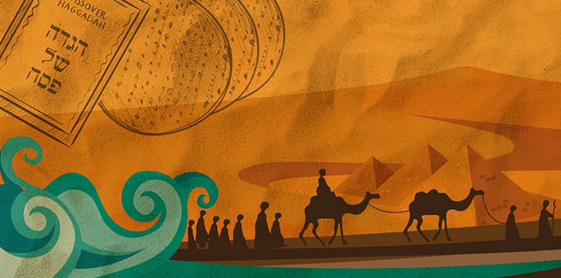
Rather than making God’s glory obvious, the people of Israel followed their own pathway in worshipping false gods, obscuring the knowledge of God from all in Egypt.

Slide 5
“I am the Lord, and I will bring you out from under the yoke of the Egyptians. I will free you from being slaves to them, and I will redeem you with an outstretched arm and with mighty acts of judgment. I will take you as my own people, and I will be your God. Then you will know that I am the Lord your God, who brought you out from under the yoke of the Egyptians. And I will bring you to the land I swore with uplifted hand to give to Abraham, to Isaac and to Jacob. I will give it to you as a possession. I am the Lord.”
(Exodus 6:6-8)

Slide 6
The circumstantial difficulties of the Israelites deafened them to the guiding voice of God, but God kept about His plan for His people.
When a challenging situation befell the people of Israel, even though they had just been recipients of God powerful leading and abundant blessing and even though the smoke and fire of God’s presence billowed and burned around them, their first response was to doubt God’s leading, voicing their preference for their former slavery in Egypt.

Slide 7
Four Miracles, Four Similar Responses
The Red Sea parted and the Egyptian armies destroyed
Bitter water cleansed at Marah
Manna and quail provided in the Desert of Sin
Water provided from a rock near Rephidim
When the Israelites were faced with a circumstantial challenge, they manifested situational doubt in God.

Slide 8
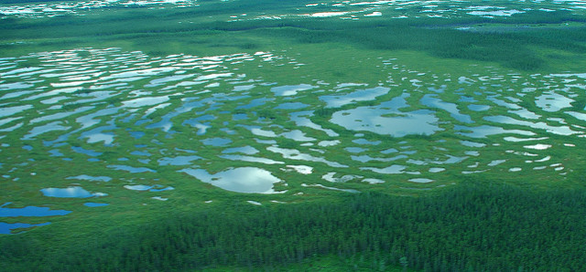
A GOOD REMINDER: In challenging moments, we need to fix our eyes on Jesus, who we know, rather than suffering the circumstantial blindness that often creeps in.

Slide 9
Ultimately, the reason for the circumstantial blindness of the Israelites is that they simply did not know God.
Though they should have known God as the One who miraculously paved a way for the people of Israel by giving Abraham and Sarah a son in their old age, or the One who powerfully led Joseph from the bottom of a cistern to the palaces of Egypt, they simply did not.
And now, faced with troubling circumstances, they did not know that God was entirely trustworthy. For all they knew at a personal level, they might have been being led by a god who desired their destruction, or a god who was cruelly “playing” with humanity, or a charlatan god who would abandon them at the earliest convenience.

Slide 10
What we can learn from the experience of the Exodus is that it is extremely difficult to trust fully in the leading of one whom you do not know, particularly when difficult or challenging circumstances mount against you.
We too must come to know God in a personal and intimate way if we are to ever find ourselves effectively led by Him.
If we do not come to know Him as “gracious and compassionate, slow to anger and abounding in love, [relenting] from sending calamity” then I do not think we will ever trust Him with all our hearts or submit to Him in all our ways.

Slide 11
“Here I am! I stand at the door and knock. If anyone hears my voice and opens the door, I will come in and eat with that person, and they with me”. (Revelation 3:20)
This is a profound invitation to relational connection and intimacy.
Might we be a people in whom God delights as we grow to know Him better, finding greater strength to be led by Him, even if this means navigating difficult waters.
Might our knowledge of God enable us to trust Him with all of our hearts and in all our ways submit to Him.

