Slide 2
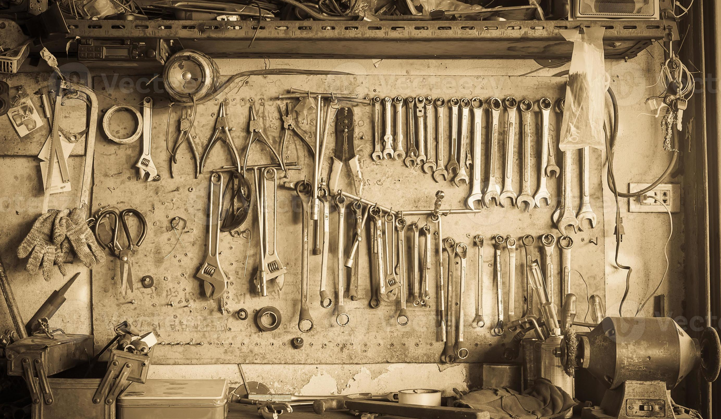

Slide 3
We exist in a culture where an extreme emphasis is placed on a near absolute right and freedom for self-determination.
The most popular form of this philosophical position is likely John Locke’s “table rasa” – or blank slate - theory which posits that all individuals are born empty of any built-in or preprogrammed, if you will, reality. According to this theory, there is nothing inherently implanted in us, but we become who we are by that which the world adds to us, perceptions, experiences and the like.
Whatever we input then, we eventually become, without limit for there is no intended purpose to our existence aside from that which we add ourselves.

Slide 4
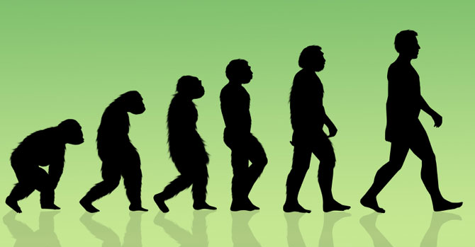
The world around us doesn’t particularly believe that humanity is amazingly intentionally designed, but that all that is around us came into being by a process of random and undirected change.
Essentially then, we see ourselves as masters of our own destiny fully capable of charting our self-determinative course.

Slide 5
“Now the earth was formless and empty, darkness was over the surface of the deep, and the Spirit of God was hovering over the waters … Then God said, “Let us make mankind in our image, in our likeness, so that they may rule over the fish in the sea and the birds in the sky, over the livestock and all the wild animals, and over all the creatures that move along the ground.” So God created mankind in his own image, in the image of God he created them; male and female he created them. God blessed them and said to them, “Be fruitful and increase in number; fill the earth and subdue it. Rule over the fish in the sea and the birds in the sky and over every living creature that moves on the ground.”

Slide 6
Then God said, “I give you every seed-bearing plant on the face of the whole earth and every tree that has fruit with seed in it. They will be yours for food. And to all the beasts of the earth and all the birds in the sky and all the creatures that move along the ground—everything that has the breath of life in it—I give every green plant for food.” And it was so. God saw all that he had made, and it was very good. And there was evening, and there was morning—the sixth day.” (Genesis 1:2, 26-31)

Slide 7
Whereas modern evolutionary theory suggests that the world around us came into being via random and undirected change over millions of years, the creation account reveals to us that there is intentionality in that which was created and purpose placed in creation.
We aren’t blank slates upon which any future imaginable can be written, but we are lovingly and purposefully created to accomplish God’s good will through our lives.
The highest ideal then is not to become all that we think we can become, but instead to become all that God intentionally designed us to become.

Slide 8
rather than being an autonomous leadership role, humanity was divinely given both a stewardship and representative role.
Rather than being created to lead, we were created to be led.
Humanity was intentionally and purposefully designed to be sent into creation “in [God’s] image, in [His] likeness” to serve as representatives of God in creation.
As humanity engaged in this representative task by “subdu[ing creation… ruling] over the fish in the sea and the birds in the sky and over every living creature that moves on the ground”, we would do so under the direction, guidance and leading of God.

Slide 10
God, a loving Heavenly Father, created humanity to represent Him in the world, caring for and nurturing all of creation under His affectionate leadership. God was to remain king over creation and we, humanity, would serve according to our general calling, but also specifically according to God’s unique craftsmanship in us.

Slide 11
QUESTIONS TO CONSIDER
If it is true that I was created with intention and purpose to be led by God as I care for His creation, do I actually live as though this were true?
Do I live my life founded on a desire to be led by God as I steward well God’s gift of creation and as I represent God to the world around me?
How am I specifically created to serve God?

Slide 12
Might the prayer of our hearts over these next weeks become “Father, help me understand how You’ve created me” and “Jesus, lead me according to the way you’ve created me”.

