Slide 2
We know that we are free to obey the Law, not in order to win God's favor, but because we trust that His commandments will lead to full and lasting joy.
We too can fulfill the law when we become great commandment people.
The follower of Jesus is to find motivation for obedience in love and not in the fear of judgment.

Slide 3
“Therefore everyone who hears these words of mine and puts them into practice is like a wise man who built his house on the rock. The rain came down, the streams rose, and the winds blew and beat against that house; yet it did not fall, because it had its foundation on the rock.”

Slide 4
“But everyone who hears these words of mine and does not put them into practice is like a foolish man who built his house on sand. The rain came down, the streams rose, and the winds blew and beat against that house, and it fell with a great crash.” When Jesus had finished saying these things, the crowds were amazed at his teaching, because he taught as one who had authority, and not as their teachers of the law.”
(Matthew 7:24-29)

Slide 6
Sermons on this portion of Scripture key in on the foundation upon which we build our lives and the common interpretation of this text is that it communicates that it is wise to build one’s life upon a rock-like foundation, rather than a shifting sand foundation, permitting us to build a life stable enough to withstand the stormy challenges of life.
“The Lord is my rock, my fortress and my deliverer; my God is my rock, in whom I take refuge, my shield and the horn of my salvation, my stronghold.”(Psalm 18:2)
“For they drank from the spiritual Rock that followed them, and the Rock was Christ.” (1 Corinthians 10:4)

Slide 7
Unsurprisingly, linking the rock with God or Christ encourages us to build a life founded upon Him.
While there is certainly nothing wrong with taking time to determine the foundation upon which one is building one’s life, I’m not sure this is Christ’s point in this passage.
Who can tell me what Jesus is speaking about here?

Slide 8
Jesus is speaking about the failure to put into practice His words.
“Do not merely listen to the word, and so deceive yourselves. Do what it says. Anyone who listens to the word but does not do what it says is like someone who looks at his face in a mirror and, after looking at himself, goes away and immediately forgets what he looks like. But whoever looks intently into the perfect law that gives freedom, and continues in it—not forgetting what they have heard, but doing it—they will be blessed in what they do.” (James 1:22-25)

Slide 9
The result of practicing the words of Christ is a life that withstands the stormy assault of the world.
This teaching is keenly focused on life in the here and now; life in the fourth quadrant of our Gospel Journey; life in victory in the here and now.
As James indicates, when we put into practice Christ’s words, we “will be blessed in what [we] do”.

Slide 10
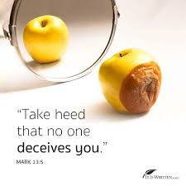
There is a great deception in our world today in this regard from those who teach that it is possible to express a sincere faith in Christ apart from obedience to the word of God; that it is possible to enter the Kingdom of God without doing the will of the Father.
It is my sincere hope and prayer that we are people building on a firm foundation, a community who hears the words of Christ and puts them into practice.

Slide 11
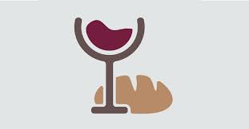
My hope is that as we together hear and put into practice the words of Christ in communion that we, together, will experience His blessing upon us and see our corporate spiritual house strengthened against the storms of culture.

Slide 12
Application
Engage with the words of Jesus, by “hearing” the words of Jesus in the book of John.
Think of a way to ensure that putting into practice Christ’s commands results in love being shown to those around you.

Slide 13
My prayer today is that:
We have been challenged by these words of Jesus and that now, we are encouraged to put them into practice.
We might see increased obedience to the words of Jesus and not only the production of greater fruit, but also lives more firmly built upon the foundation of Christ Jesus.

