Slide 3
“The Son is the image of the invisible God, the firstborn over all creation. For in him all things were created: things in heaven and on earth, visible and invisible, whether thrones or powers or rulers or authorities; all things have been created through him and for him. He is before all things, and in him all things hold together.”

Slide 4
“And he is the head of the body, the church; he is the beginning and the firstborn from among the dead, so that in everything he might have the supremacy. For God was pleased to have all his fullness dwell in him, and through him to reconcile to himself all things, whether things on earth or things in heaven, by making peace through his blood, shed on the cross. Once you were alienated from God and were enemies in your minds because of your evil behavior.”

Slide 5
“But now he has reconciled you by Christ’s physical body through death to present you holy in his sight, without blemish and free from accusation— if you continue in your faith, established and firm, and do not move from the hope held out in the gospel. This is the gospel that you heard and that has been proclaimed to every creature under heaven, and of which I, Paul, have become a servant.”
- Colossians 1:15-23

Slide 6
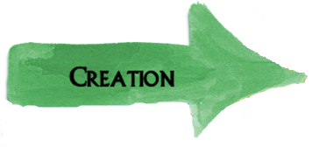
Creation is:
intentional and purposeful. Each human life is intentionally and lovingly created with profound purpose .
declared to be good; the good and holy intention behind God’s creative activity was fulfilled within His creation.
something in which the Son was intimately involved. We were created for active relational engagement with Jesus.
Creation was foundationally a very good thing, created for Christ’s ultimate purpose and pleasure.

Slide 7
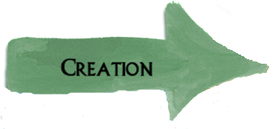
Human sin results in separation from relational intimacy with God, separation from one another, separation from our created purpose and increasing separation from God’s declaration of creation’s goodness.
Tragically, the ultimate end point of this separation is eternal separation from God.
If the Son holds all things together, then human sin is a force that contends against Him, pressing greater and greater separation, until finally the Son honours our wish for separation.

Slide 8
In reconciliation, we understand that God initiated a plan to reduce the separation caused by sin, to bind up the brokenness of humanity, beginning with Abraham.
This movement of God in reconciliation did little to reduce humanity’s separation from God’s declaration of our created goodness. Rather than restore to humanity goodness, this system seemed only to highlight humanity’s lack of inherent goodness.

Slide 9
Jesus came as the promised Messiah and by declaring “it is finished”, He put an end to the perpetual cycle of reconciliation and separation, by “reconcil[ing] to himself all things … making peace through his blood, shed on the cross”. We therefore, by faith in Jesus, can be “reconciled … by Christ’s physical body through death, [presented] holy in his sight, without blemish and free from accusation”.

Slide 10
It was not just an empty tomb that was encountered on that first Easter Sunday, but a risen and living Lord!
The resurrection of Jesus reveals that there is something present about victorious life too.
The resurrection means:
we need not languish in separation from God
we are no longer resigned to live a life trapped in an endless “separation-reconciliation” loop
we can now live with powerful purpose
Because of the resurrection, we can live victoriously right now!

Slide 12
Where within this Gospel journey do I find myself today?
Be reconciled today through faith in Jesus!
If you are falling short, “out of his glorious riches [might God] strengthen you with power through his Spirit in your inner being”.
Praise Jesus … and then invite others in!

Slide 13
My prayer today is that:
over the next months, we begin to better appreciate the fullness of the Gospel Journey before us.
God’s Spirit will powerfully use the whole story of God’s engagement with creation to help us understand how we might live victoriously now.
we, therefore, be an empty tomb, resurrection living sort of people, praising Jesus today and every day for the victory He has won.

Slide 14
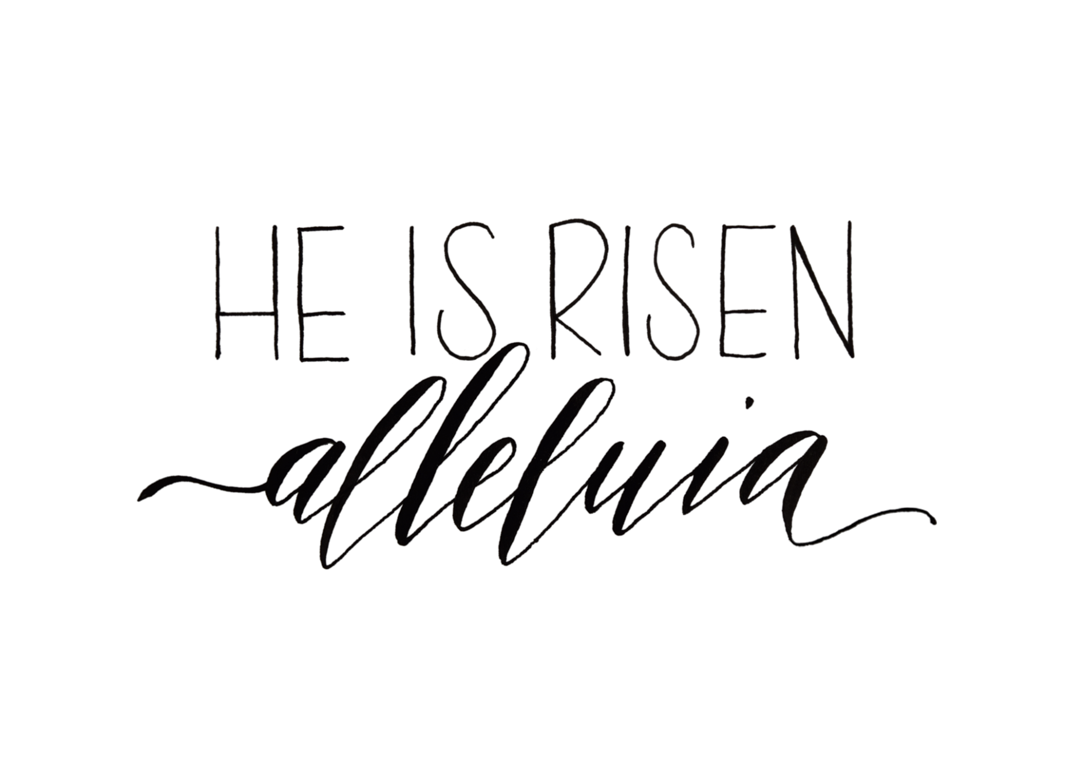
What is the big deal about Easter Sunday?
Christ the Lord is risen today and we live victoriously, because He is risen.

