Slide 2
Because Jesus came not to abolish the Law, but to fulfill it, we know that we are free to obey the Law, not in order to win God's favor, but because we trust that His commandments will lead to full and lasting joy.
We too can fulfill the law when we become great commandment people.
The follower of Jesus is to find motivation for obedience in love and not in the fear of judgment.

Slide 3
“It has been said, ‘Anyone who divorces his wife must give her a certificate of divorce.’ But I tell you that anyone who divorces his wife, except for sexual immorality, makes her the victim of adultery, and anyone who marries a divorced woman commits adultery.”
- Matthew 5:31-32

Slide 4
Let us own a spiritual history that has not always handled the issue of divorce with grace and truth, nor always with kindness, leading to many being hurt by unhelpful responses from the church, but let us commit to aiming for better in our own approach to texts like this, seeking to do so in both grace and truth, ensuring that we truly do love our neighbours as ourselves in this regard.

Slide 5
The ideal portrait of human marriage is a one-flesh, sin-free, indivisible union between husband and wife.
By the time the Law of Moses came around, human sin had created some significant barriers to such an ideal relationship.
What are some barriers of human sin that you suggest might have a bearing on a marriage?
MARRIAGE AND DIVORCE

Slide 6
“If a man marries a woman who becomes displeasing to him because he finds something indecent about her, and he writes her a certificate of divorce, gives it to her and sends her from his house, and if after she leaves his house she becomes the wife of another man, and her second husband dislikes her and writes her a certificate of divorce, gives it to her and sends her from his house, or if he dies, then her first husband, who divorced her, is not allowed to marry her again after she has been defiled. That would be detestable in the eyes of the Lord.”
(Deuteronomy 24:1-4)

Slide 7
Why was divorce permitted in ancient Israel?
A severed marital bond constituted a significant problem for a divorced wife, for in ancient cultures, unmarried women were hard pressed to support themselves financially.
Divorce was then the most effective tool to save a woman from abuse and excess and the issuing of certificate of divorce offered greater protection when a husband was unwilling or unable to provide the protection he ought to.

Slide 8
A certificate of divorce ought to be issued to a wife when a husband found some indecency – or uncleanness – in her.
Interpretation of what “uncleanness” constituted varied greatly.
Conservative position = adultery
Liberal position = a far broader category
Sensing a loophole, the people of Israel began to practice the issuing of certificates of divorce for even the most marginal of things.

Slide 9
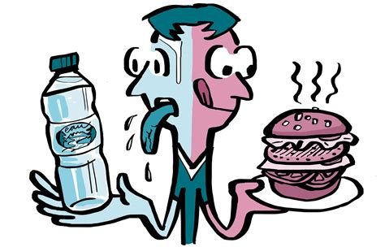
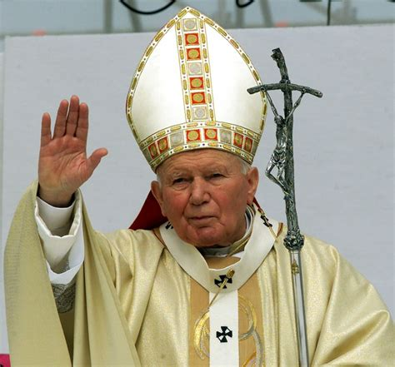
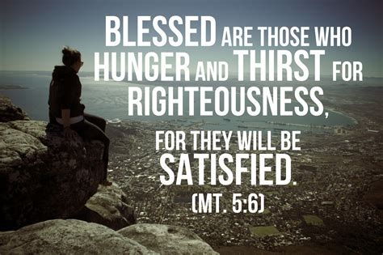
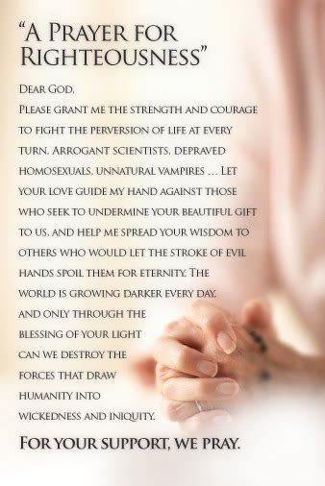
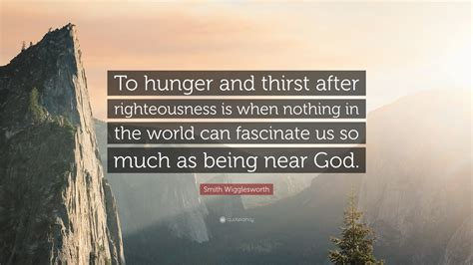
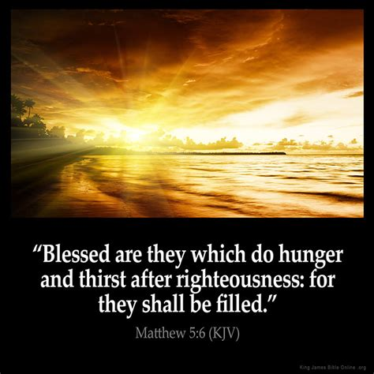
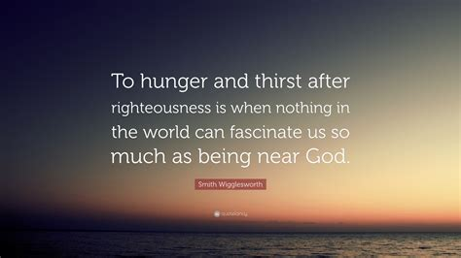
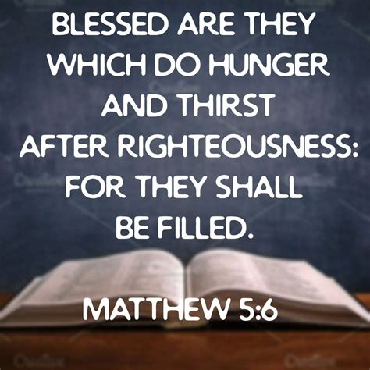
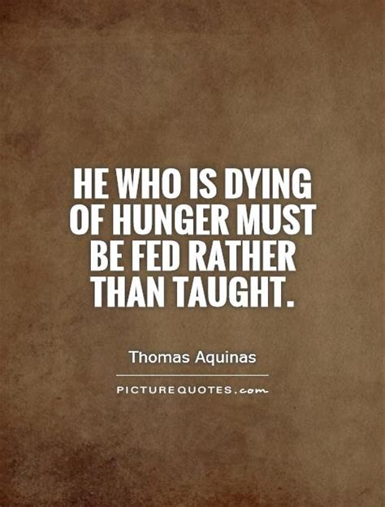
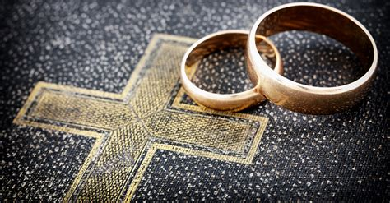
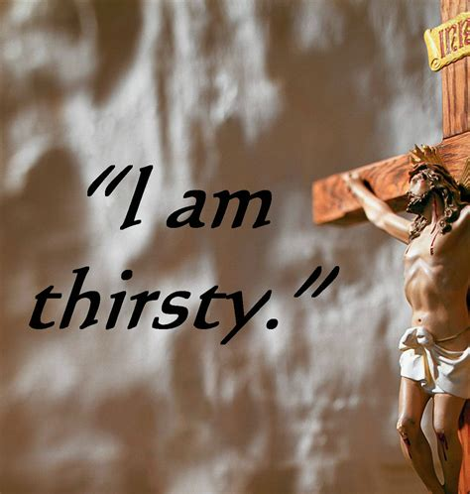
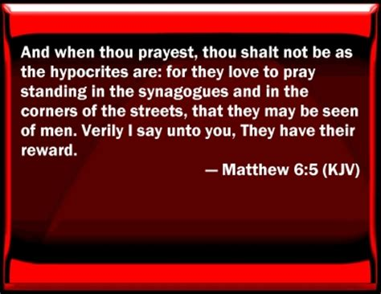
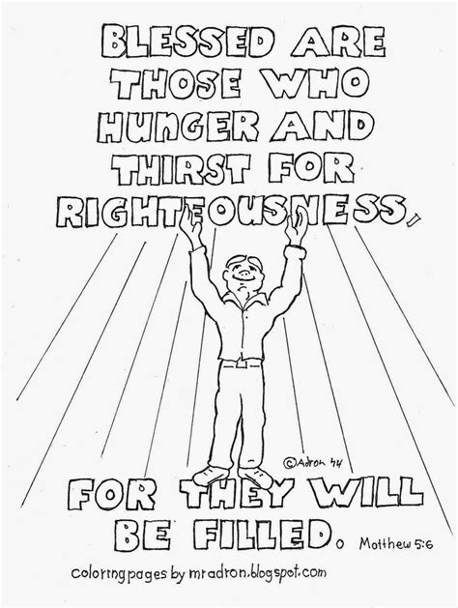
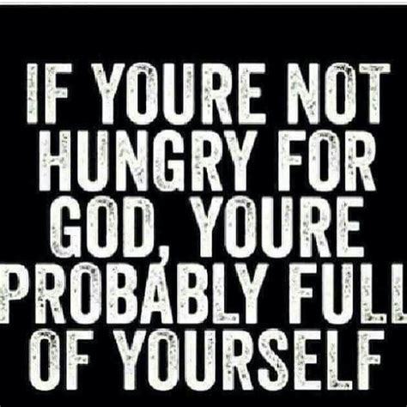
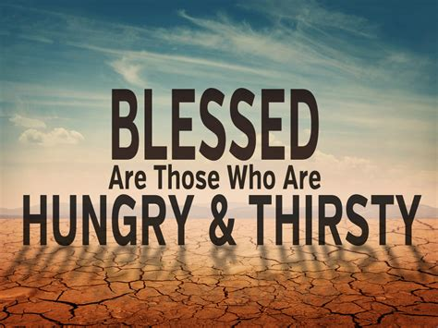
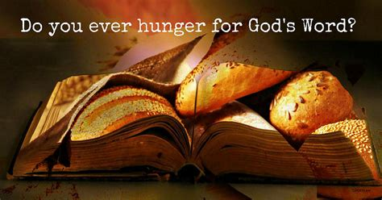
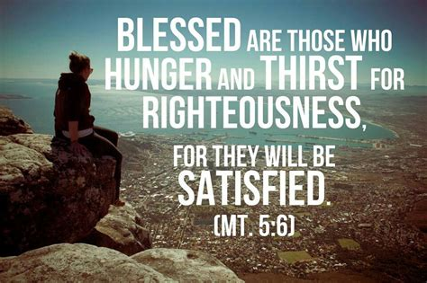
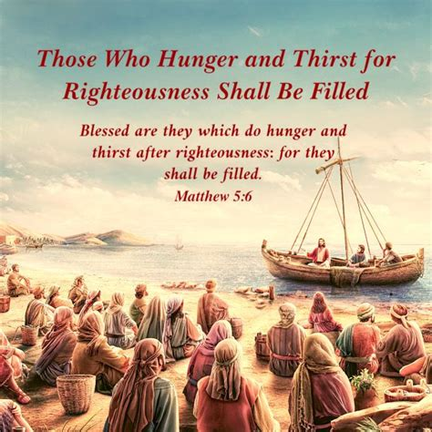
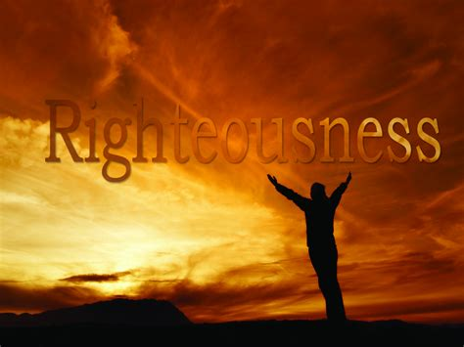
Jesus is far more concerned with getting to the root of things – getting radical – than he is with simply dealing with the eventual outcomes of human sinfulness.
It would be a mistake for us to assume that Jesus is only calling into question the bare practice of divorce within Israel here, failing to account for the attitudes that underlie such an action.

Slide 10
“Some Pharisees came to him to test him. They asked, “Is it lawful for a man to divorce his wife for any and every reason?” “Haven’t you read,” he replied, “that at the beginning the Creator ‘made them male and female,’ and said, ‘For this reason a man will leave his father and mother and be united to his wife, and the two will become one flesh’? So they are no longer two, but one flesh. Therefore what God has joined together, let no one separate.” “Why then,” they asked, “did Moses command that a man give his wife a certificate of divorce and send her away?” Jesus replied, “Moses permitted you to divorce your wives because your hearts were hard. But it was not this way from the beginning. I tell you that anyone who divorces his wife, except for sexual immorality, and marries another woman commits adultery.” (Matthew 19:3-9)

Slide 11
The practice of frivolous divorce that was present in ancient Israel was not only not lawful, but it was a direct assault against God.
There does exist ground for permissible divorce: infidelity, abandonment by an unbelieving spouse (1 Corinthians 7:15) and unrepentant abuse of a spouse (2 Timothy 3:1-5)
Even these grounds for divorce are permitted because of hardened hearts. Divorce is never the preferred option for the follower of Jesus.

Slide 12
For the men: “[always] love your wives and [never once] be harsh with them”. (Colossians 3:19)
For the women: “submit yourselves to your husbands, as is fitting in the Lord”. (Colossians 3:18)
How are we doing in relation to these instructions?

Slide 13
“I will give you a new heart and put a new spirit in you; I will remove from you your heart of stone and give you a heart of flesh. And I will put my Spirit in you and move you to follow my decrees and be careful to keep my laws.” (Ezekiel 26:36)
Not only ought divorce become a thing of the past in Christ’s kingdom, but that the harshness and hard-heartedness that causes divorce ought also have no place in His kingdom or among His followers because of the transformative nature of faith in Jesus.

Slide 14
Part of the good news of Jesus is that He emptied divorce from within; by removing our hardness of heart, Jesus obliterated the allure of and the need for divorce.
Christ’s “divine power has given us everything we need for a godly life through our knowledge of him who called us by his own glory and goodness.” (2 Peter 1:3)

Slide 15
We can harden our hearts against God and one another by permitting sin to be a guiding force in our lives. By the daily encouragement of one another however, the people of God can help one another keep their hearts from becoming hardened against one another.
“Create in me a pure heart, O God, and renew a steadfast spirit within me. Do not cast me from your presence or take your Holy Spirit from me”. (Psalm 51:10-11)

Slide 16
Grace exists to truly live in one-flesh, indivisible unions between husband and wife.
Grace also exists to seek reconciliation with an estranged spouse, or grace to pursue remarriage under the right circumstances, or even grace to remain unmarried and yet fully satisfied in Christ Jesus.

Slide 17
My prayer is that:
we would be a people who are dependent upon Jesus for solid and flourishing marriages; a people among whom all hard heartedness is uprooted.
there would be profound healing among us for the brokenness of divorce already experienced
we would be a people within whom appropriate reconciliation is applied, a people who pursue reconciliation to the greatest possible extent.
we would receive the grace upon grace spoken of in John 1:16, extending it to others.

