Slide 2
Because Jesus came not to abolish the Law, but to fulfill it, we know that we are free to obey the Law, not in order to win God's favor, but because we trust that His commandments will lead to full and lasting joy.
We too can fulfill the law when we become great commandment people.
The follower of Jesus is to find motivation for obedience in love and not in the fear of judgment.
Last week, we explored the commandment to not murder and discussed how anger enters the equation, prompting us to become a people who “in our anger, do not sin”.

Slide 3
“You have heard that it was said, ‘You shall not commit adultery.’ But I tell you that anyone who looks at a woman lustfully has already committed adultery with her in his heart. If your right eye causes you to stumble, gouge it out and throw it away. It is better for you to lose one part of your body than for your whole body to be thrown into hell. And if your right hand causes you to stumble, cut it off and throw it away. It is better for you to lose one part of your body than for your whole body to go into hell.”
- Matthew 5:27-30

Slide 4
We are at a significant, almost impossible to overcome, disadvantage then if as Jesus reveals even looking lustfully at another equates to heart based adultery. What hope do we have in such a depraved world?

Slide 5
The commandment Jesus makes reference to in our passage comes from Exodus 20:14 – “you shall not commit adultery” - and is expanded upon in Leviticus 20:10 with these words - 'if a man commits adultery with another man's wife—with the wife of his neighbor—both the adulterer and the adulteress must be put to death”.
Within Judaism then, adultery was generally understood as sexual relations with someone other than a spouse, as either a married or betrothed person.

Slide 6
There was a tendency among the people of Israel to seek loopholes within the Law to permit them to follow impure impulses, all while ensuring they escaped technical punishment.
Even the most religious of people in Israel started exploiting these reasoned loopholes, leading to all kinds of sexual affairs occurring.
While the religious leaders of Israel were harsh on those caught in the physical act of adultery, the lustful attitudes that lay under such acts were largely ignored.

Slide 7
Jesus gets at the root of things, pointing out that adultery is little more than the product of uncontrolled lust.
Because it is only by Christ’s righteousness shared with us through our faith in Him that we are declared righteous ourselves, let us be clear that it is not by avoiding committing adultery that we are deemed righteous.
Jesus moves us to understand that our need for rescue from sin comes not just from our overt actions, but also from – perhaps even more so from – our more hidden attitudes, which ought to be of significant concern to us too.

Slide 8
Lust is the abstraction or twisting of perfect, God-created sexual desire without consideration of God’s holiness or the honour of others.
Lust is what forms when sexual desire is not governed by the great commandment to love God wholeheartedly and to love one’s neighbour as oneself.
sexual desire is a God-given impulse but how we handle such desire certainly can become sinful.

Slide 9
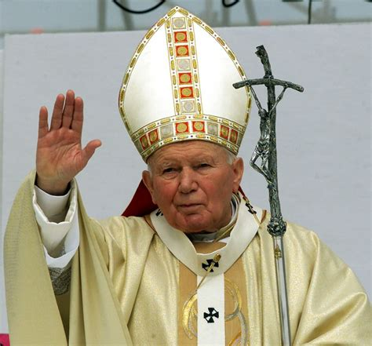
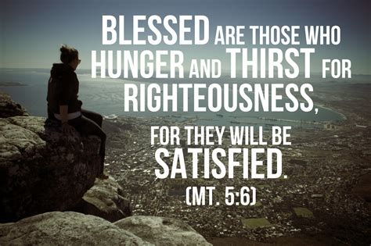
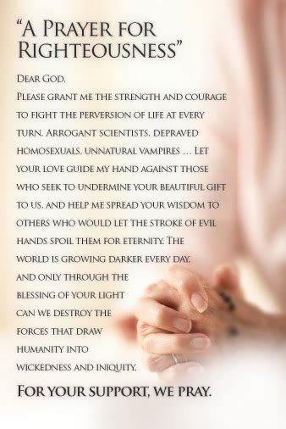
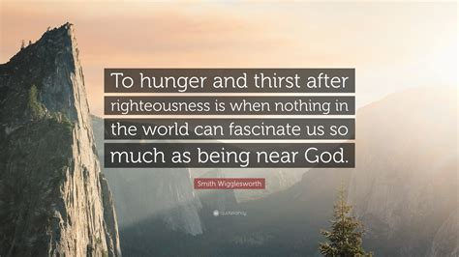
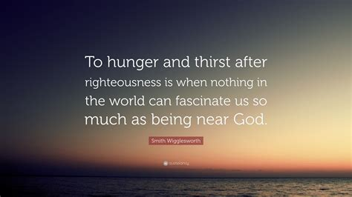
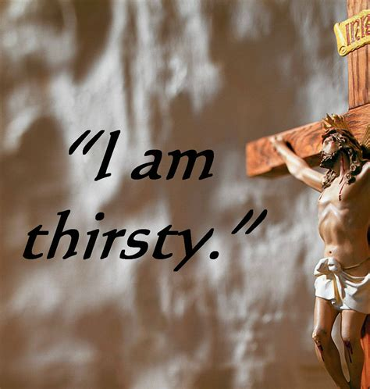
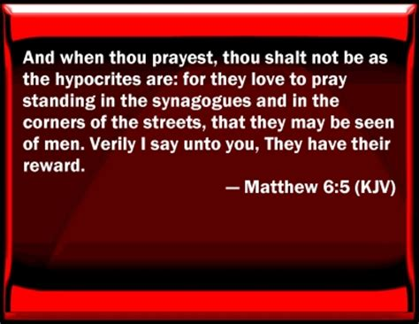
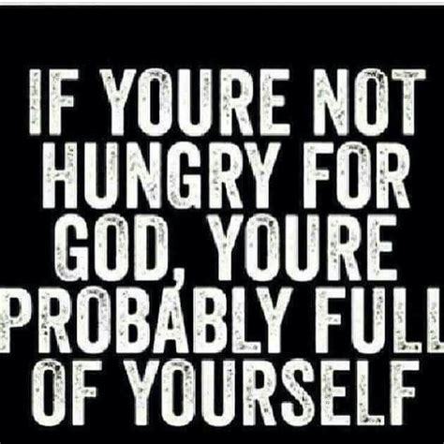
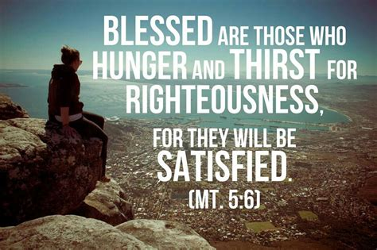
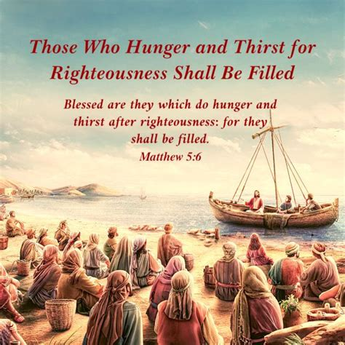
Because people refused to acknowledge God as God, sexual immorality followed and a rejection of God led directly to a misuse of sexuality and to the degrading of one another.
Lust results in the objectifying of others and the using of them for personal pleasure and to objectify others – to dehumanize them to some degree – also amounts to a denial of the image of God in others.
At the very heart of lust is a desire to rebel against God or at the very least, a desire to diminish His reflection in people.

Slide 10
Physical mutilation – a literal gouge out your eye, cut off your hand response - is insufficient and Jesus uses this imagery to reveal the importance of addressing the attitudes that underlie behaviour, rather than to suggest this as a helpful solution.
Lopping off a hand or blinding an eye wouldn’t suffice, because you’d have to remove the heart and mind to get at the source.
A heart and mind transplant is required to fully address this issue.

Slide 11
Here is the incredible hope of Jesus; though we are surrounded by seemingly impossible to avoid lustful temptation, by faith in Jesus, we are given a new heart and a new mind that we might know God rightly and we are blessed with a resolve to experience the transforming of our minds and the purification of our hearts so that we do not permit sexual desire to become sinful lust.

Slide 12
A true knowledge of God made possible through faith in Jesus protects against the misuse of our sexuality; when we come to know God and experience His unfathomable love for us, this relational knowledge helps us to properly respond to sexual desire.
We have been given His Spirit to assist us in the proper response to lustful temptation and we have been given divine power to overcome any slavery to such impulses.
God desires that we live free from the slavery that sinful lust creates. Not only is this God’s desire, but He empowers us – He gives us everything we need - to live this way.

Slide 13
Lust, adultery and sexual desire is an area we’ve got to become more transparent about, not for fodder for gossip, but so that our communal joy and witness is amplified.
“Humble yourselves before the Lord, and he will lift you up.” (James 4:10)
By dispelling our pride, and humbly coming to the foot of the cross with this issue, we will find that Christ begins to lift us up, giving us victory where once slavery reigned supreme.

Slide 14
My prayer is that:
in our humility, Christ might lift us up, permitting us to be a people who live free from the insidious slavery of lust.
His Spirit will teach us how to respond in a godly way to the impulse of sexual desire.
the deep, deep love of Christ for us will transform the love we show to those around us.
we might take a stand against the impulse of our culture, refusing to be conformed to the world in regard to its fascination with lust and sexuality, allowing God to renew our minds and purify our hearts.

