Slide 2
“You are the salt of the earth. But if the salt loses its saltiness, how can it be made salty again? It is no longer good for anything, except to be thrown out and trampled underfoot. You are the light of the world. A town built on a hill cannot be hidden. Neither do people light a lamp and put it under a bowl. Instead they put it on its stand, and it gives light to everyone in the house. In the same way, let your light shine before others, that they may see your good deeds and glorify your Father in heaven.”
(Matthew 5:13 – 16)

Slide 3
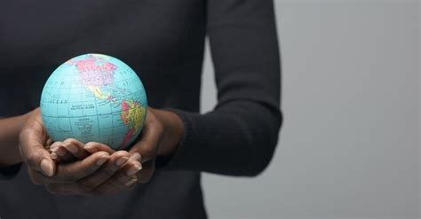
BE IN THE WORLD, BUT NOT OF THE WORLD.

Slide 4
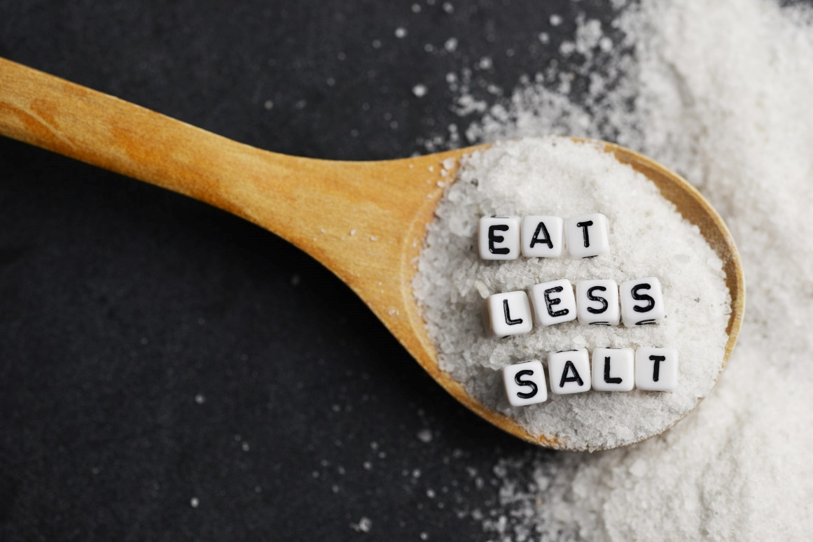
QUESTION
Does it mean we must be offensively odd or ineffectively bland in order to fulfill our call to be salt and light in the world?

Slide 5
TWO SOLUTIONS
“ARE” vs. “WILL BE” - The follower of Jesus need not try to be “odd”; they will be “peculiar” by nature as God’s Spirit indwells them, transforming them in attitude and action.
The point of our oddity or our special nature is not that we simply stand out as followers of Jesus, but that we stand out with beneficial effect in the world around us.

Slide 6
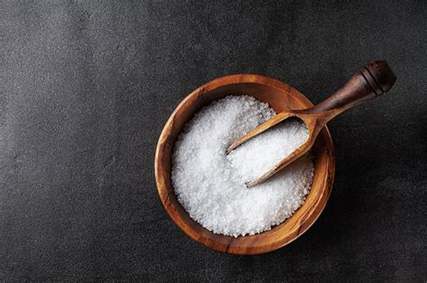
In Christ’s day, salt was used:
to add flavour to meals
as a food preservative
as a fertilizer enhancer
to help cleanse wounds and fend off infections
to increase one’s thirst
Rather than encouraging saltiness as a metaphor for being peculiar, it’s probably best that we understand saltiness as referring to an apparent beneficial prominence in the world.

Slide 7
The distinction we see in our text is not about a difference in lumens, light colour, or light quality, but a difference between being “of light” and being “of darkness”.
Light can:
help one “see”
help us discern possible dangers or items that need our immediate attention
bring peace
help us discern instruction better

Slide 8
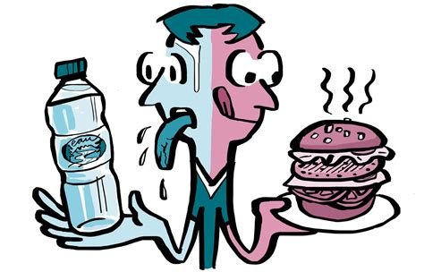
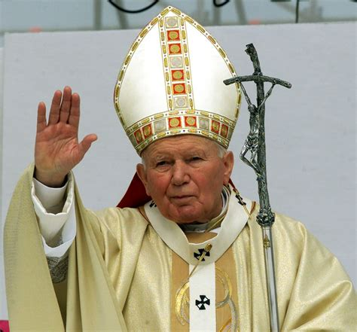
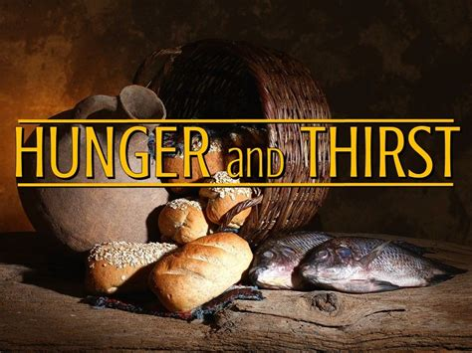
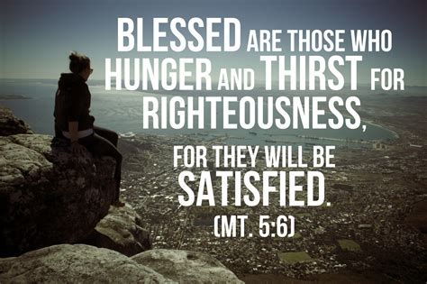
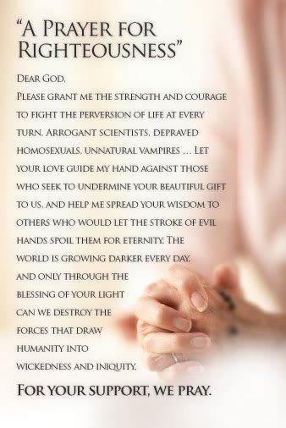
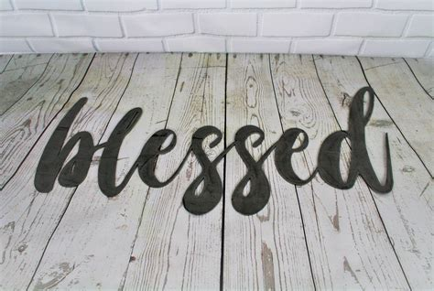
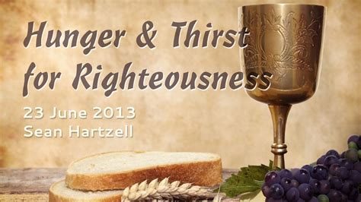
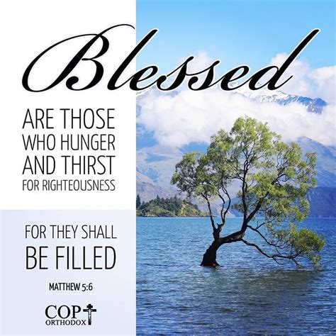
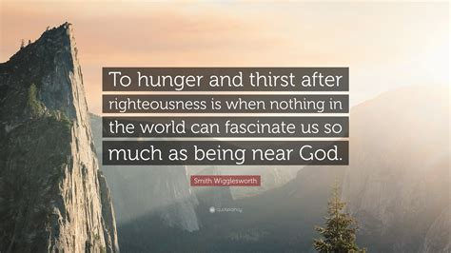
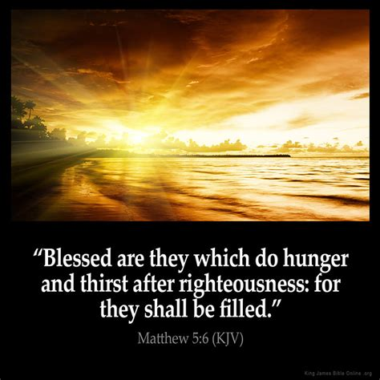
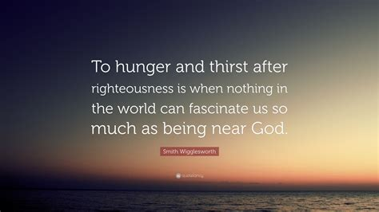
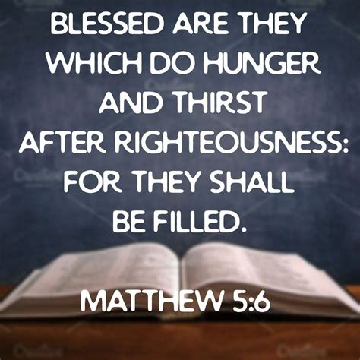
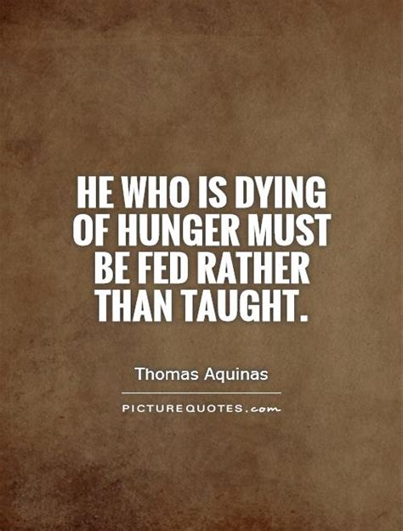
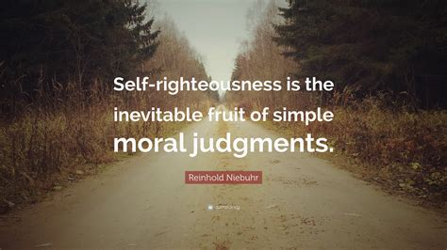
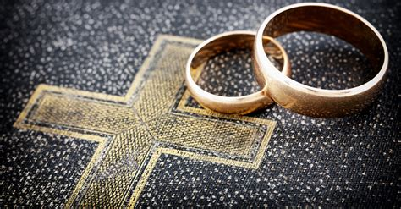
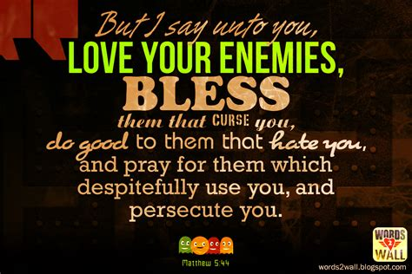
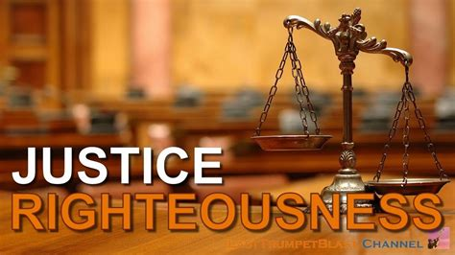
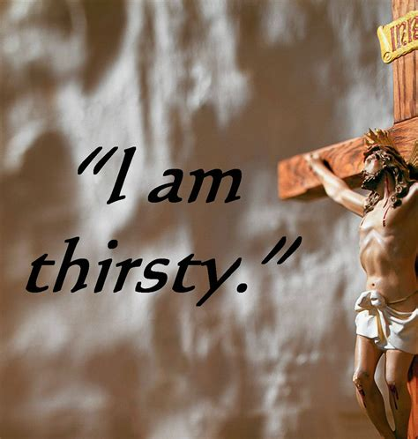
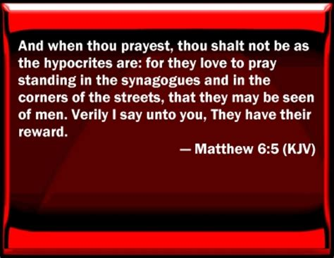
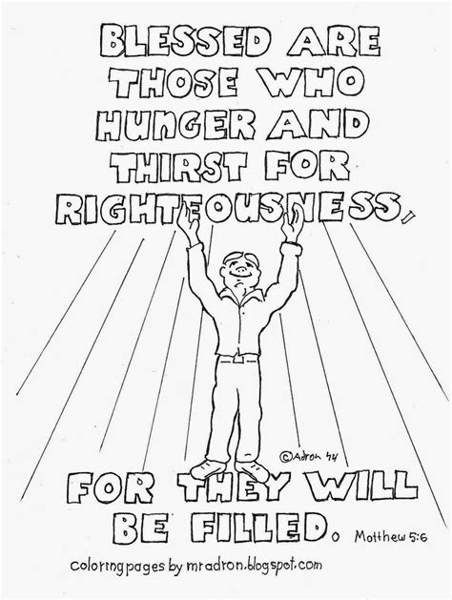
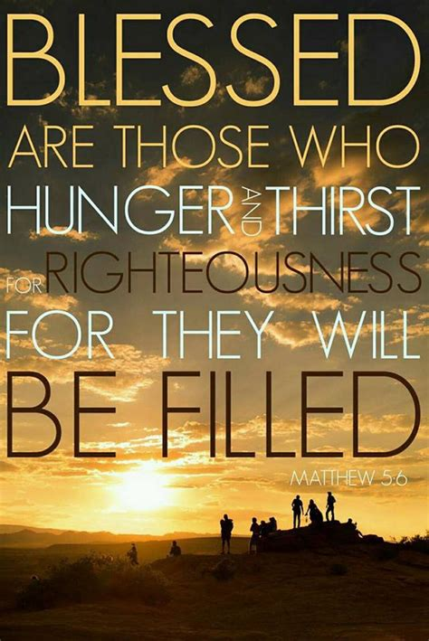
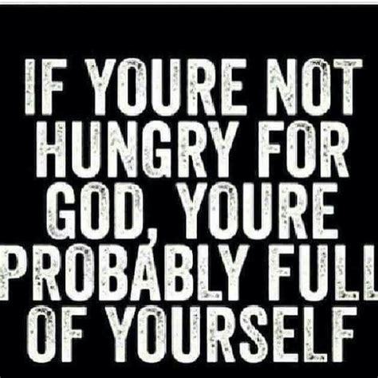
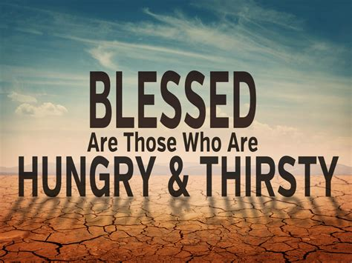
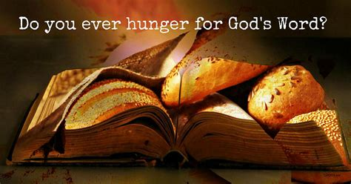
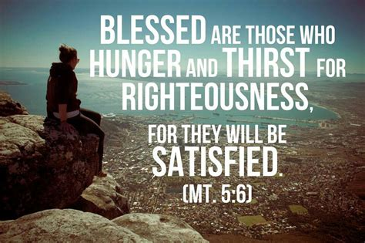
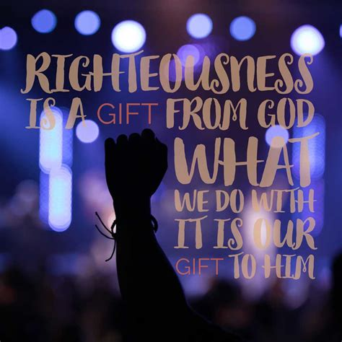
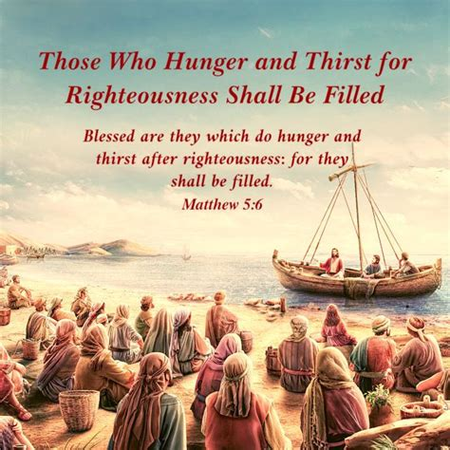
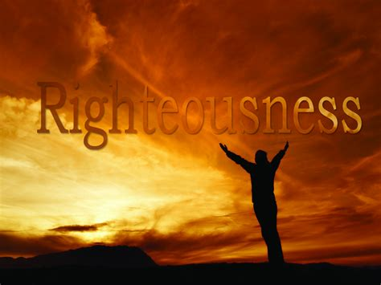
Followers of Jesus ought to:
live like light standards in our community, dispelling the darkness of the world and providing the light of Jesus Christ which is lacking in the world
illuminate cultural dangers or items that might require attention
bring peace amidst the fear of darkness
reveal important instruction on how to live

Slide 9
Followers of Jesus ought to:
season the world, bringing the flavour of Jesus Christ to a world sorely missing it
serve a preservative function, existing as a symbol of God’s lasting covenant
serve as fertilizer, increasing the fruitfulness of the message of Jesus Christ through our changed lives
serve an antiseptic function, working as agents of healing in a wounded world
bring a thirst for God to the world

Slide 10
By the power of the Holy Spirit in us, we cannot help be salt and light in the world, but our passage today also issues us some caution.
By incorrect living, we can lose our saltiness or cover our brightness.
Salt can't stop being salt, but of course if it were to do so, it would no longer be of any value as salt.
Light enlightens, but if it were to somehow not be permitted to shine, it would no longer be of value as light.
We must ensure we do not become hidden light or unsalty salt as followers of Jesus.

Slide 11
QUESTION
What might it mean for a follower of Jesus to become unsalty or to hide their light under a bowl?
We become unsalty salt or place a bowl over our lamp when we fail to live according to our calling, when we don’t live up to our incredible nature as followers of Jesus.

Slide 12
“As a prisoner for the Lord, then, I urge you to live a life worthy of the calling you have received ... You were taught, with regard to your former way of life, to put off your old self, which is being corrupted by its deceitful desires; to be made new in the attitude of your minds; and to put on the new self, created to be like God in true righteousness and holiness”. (Ephesians 4:1, 22-24)
To prevent ourselves from becoming unsalty salt or hidden light, we are to:
put off the old self
allow God’s Spirit to renew our minds
put on the new self

Slide 13
Might we be a people who actually are salt and light in the world around us.
Might we reject both bland tastelessness and off-putting oddity, instead becoming a people of whom the community around us would say “Oh, you’re of Christ … praise God for the presence of His people in the world!”.
Might we stand out because of the incredibly amazing things that God is doing both within and through us.
Might we therefore be open to the work of His Spirit both within us and through us.

