Slide 2
“Blessed are the poor in spirit, for theirs is the kingdom of heaven. Blessed are those who mourn, for they will be comforted. Blessed are the meek, for they will inherit the earth. Blessed are those who hunger and thirst for righteousness, for they will be filled. Blessed are the merciful, for they will be shown mercy. Blessed are the pure in heart, for they will see God. Blessed are the peacemakers, for they will be called children of God. Blessed are those who are persecuted because of righteousness, for theirs is the kingdom of heaven. Blessed are you when people insult you, persecute you and falsely say all kinds of evil against you because of me. Rejoice and be glad, because great is your reward in heaven, for in the same way they persecuted the prophets who were before you.” (Matthew 5:1 – 12)

Slide 4
QUESTION
If I were to ask you to describe how our culture envisions “the happy life” or “a #blessed life”, how might you respond?

Slide 5
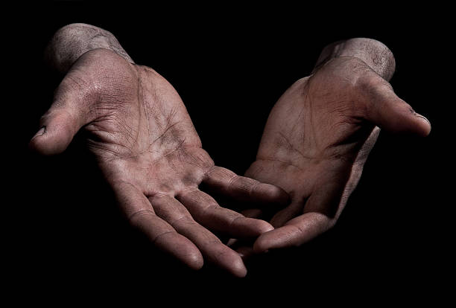
Blessed are the Poor in spirit
Humility helps us to reject the radical entitlement of our culture – the pervasive “I deserve” so rampant in our world – which only really focusses us on that which is lacking, instead permitting us to rest content in our relational connection with Jesus.

Slide 6
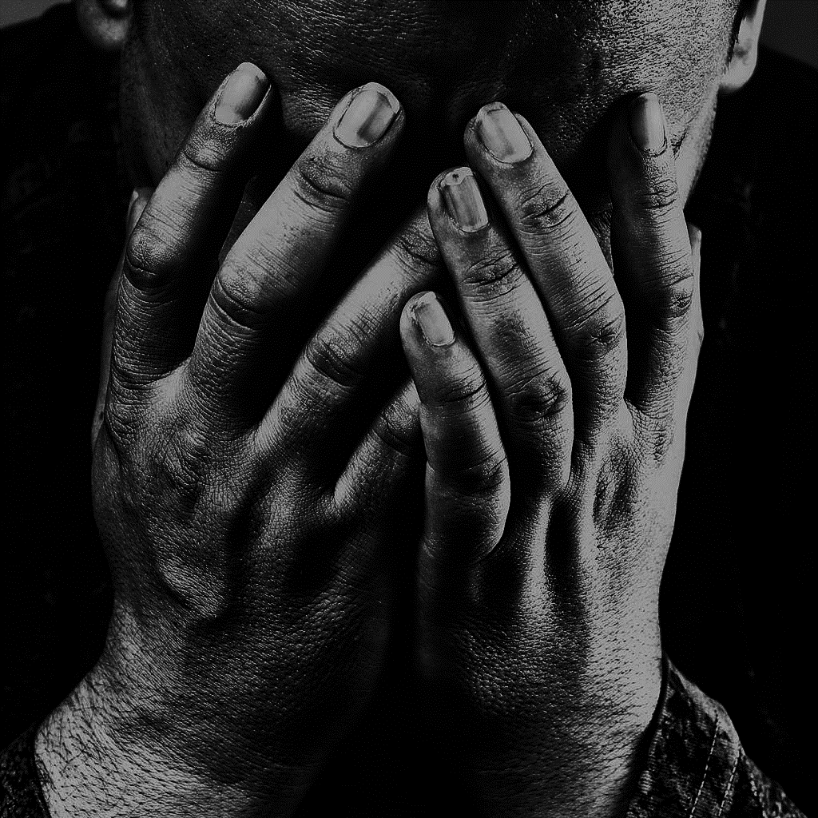
Blessed are those who mourn
When we really mourn all that this severed relationship with God entails, and when we experience the reconnection made possible through Jesus, we find ourselves in a place of joy brought about by sincere thanksgiving.

Slide 7
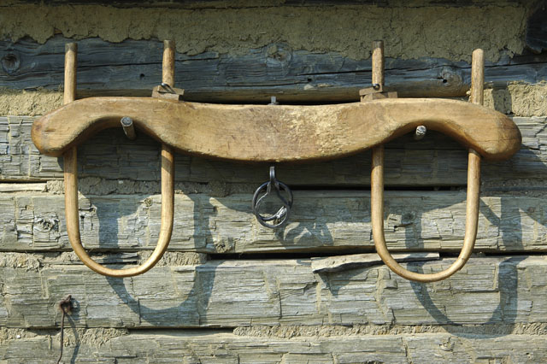
Blessed are the meek
When we do not have to focus on unravelling mercy-justice paradoxes in our lives, which often serve to do little more than depress and consume us, we can simply trust God’s perfect judgement and His perfect mercy, being thankful in our standing as those who have received great mercy through Jesus!

Slide 8
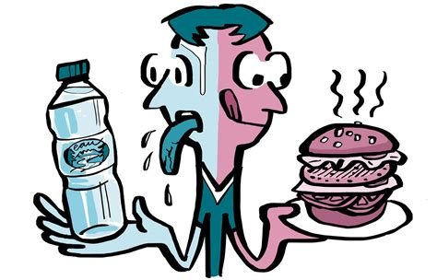
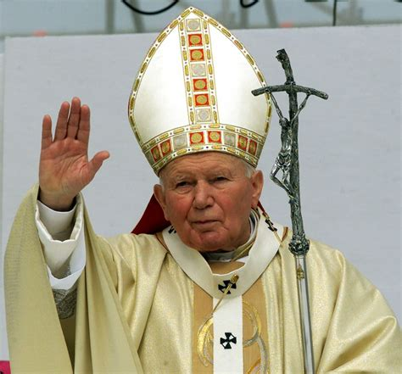
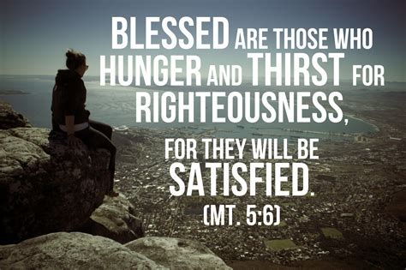
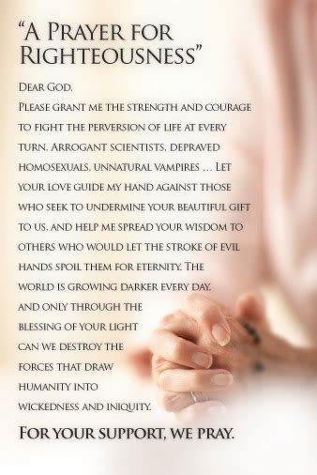
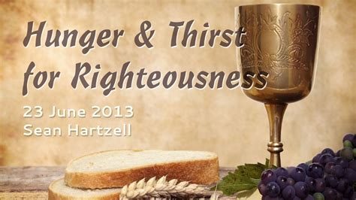
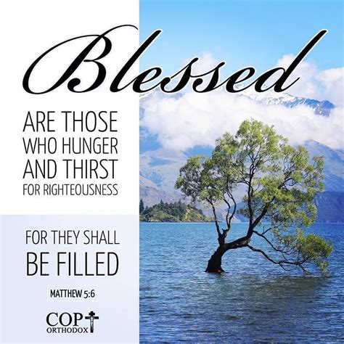
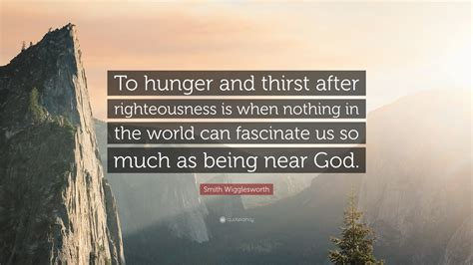
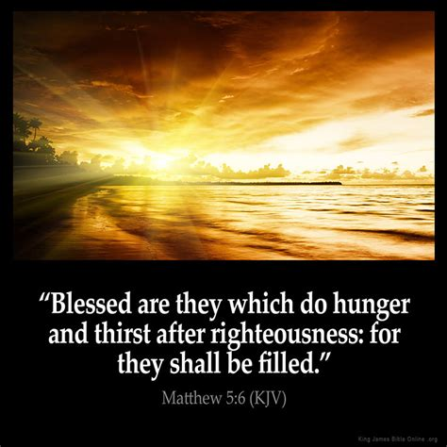
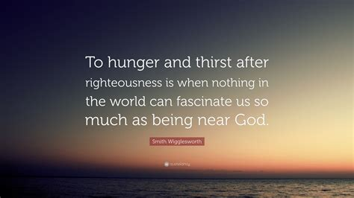
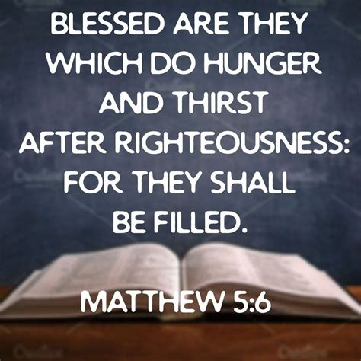
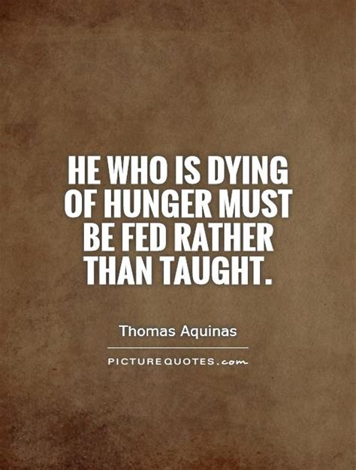
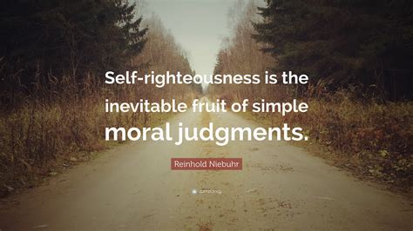
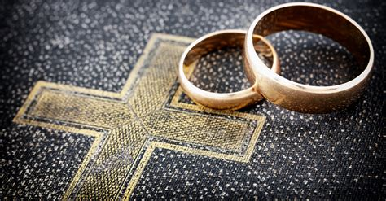
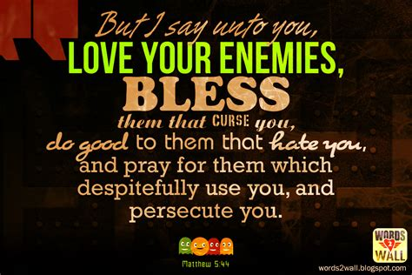
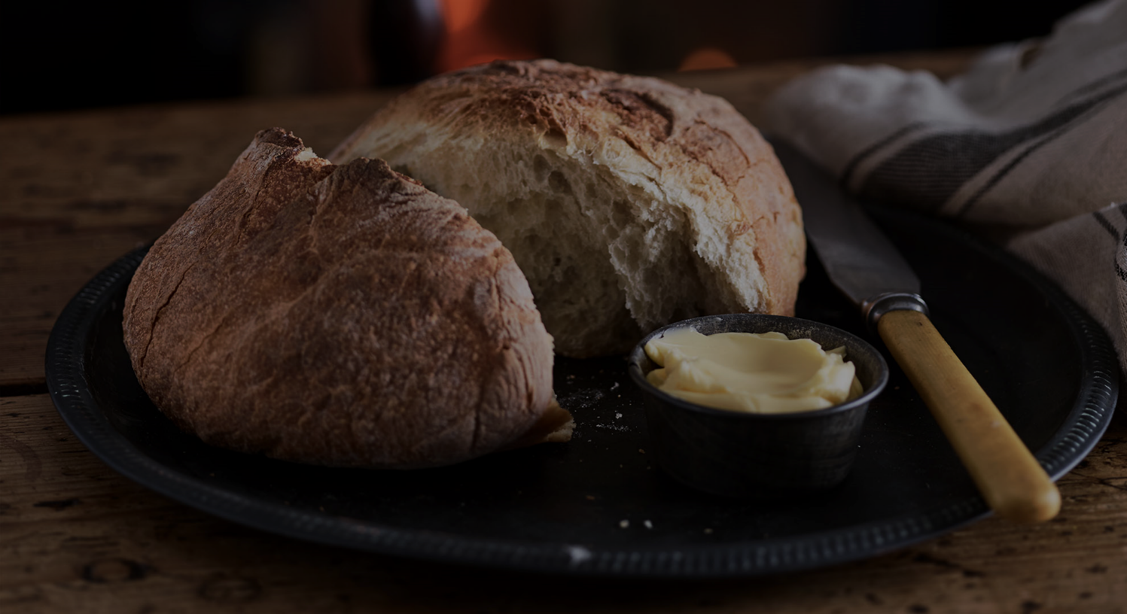
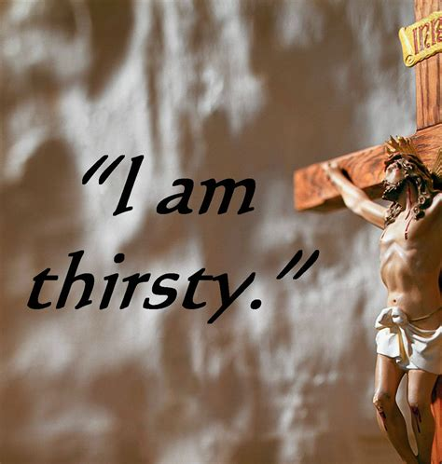
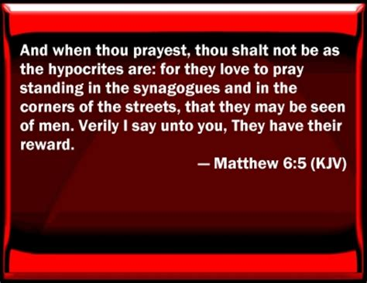
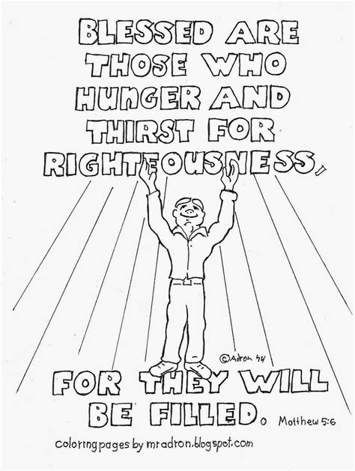
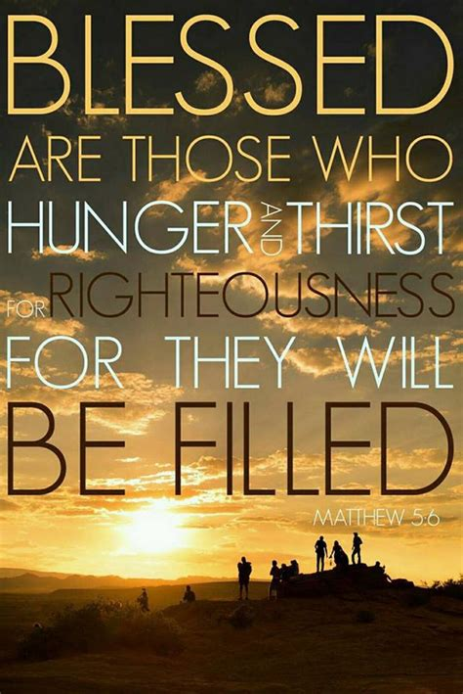
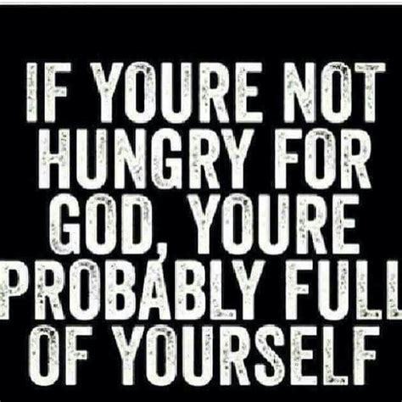
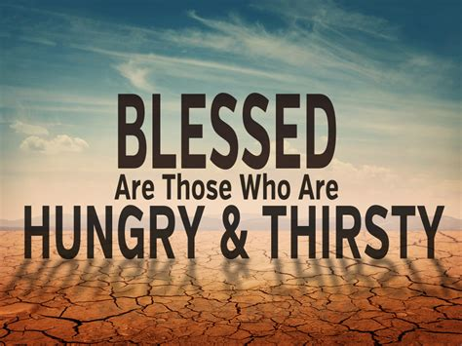
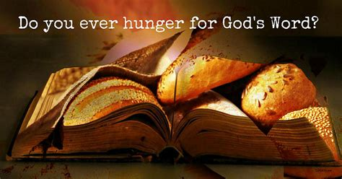
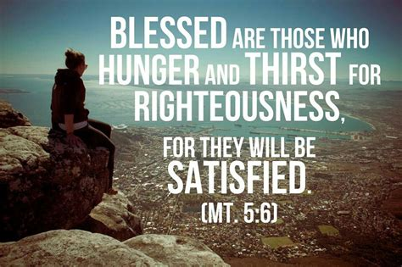
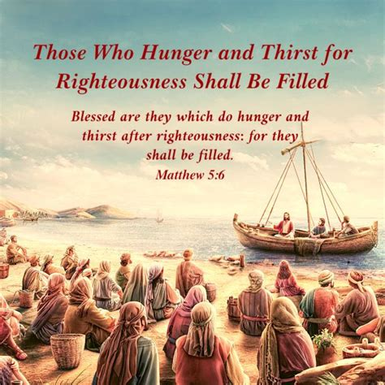
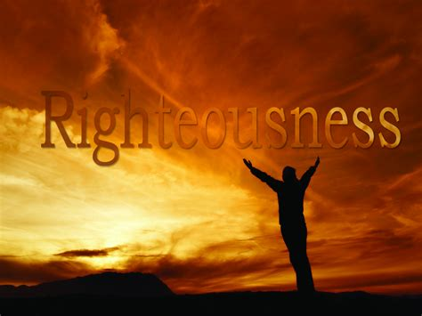
Blessed are those who hunger and thirst for righteousness
We can only be truly satisfied when we hunger and thirst to know Jesus while we also seek to be like Jesus to the world, because a hunger and thirst for righteousness manifests itself in both attitude and action.

Slide 9
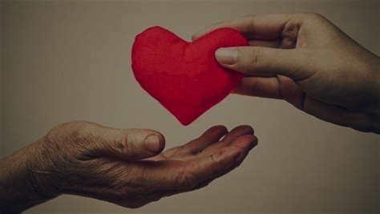
Blessed are the merciful
Because we are freed by faith in Jesus to focus on extending mercy rather than enacting punishment, meaning that we can find ourselves living in blessed happiness.

Slide 10
Blessed are the pure in heart
Those who have permitted Jesus access to their deceitful hearts will see them purified and transformed, yet with hearts purified, right action and right thinking will follow accordingly, overflowing from us to the world around us. We will find joy and happiness as others then come to see God as we do.

Slide 11
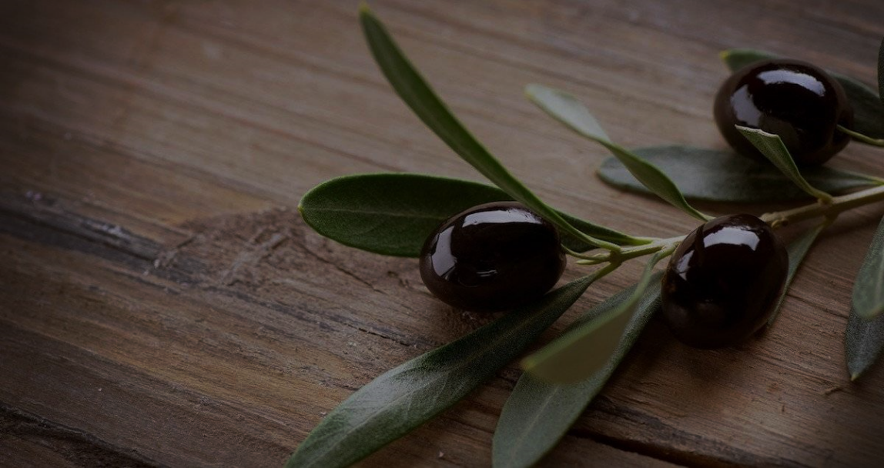
Blessed are the peacemakers
As followers of Jesus then, we are to be those who aim to see that last puzzle piece fall into place in whatever puzzle of broken reality we are dealing with in that moment. Knowing ultimately that peace is possible in Jesus, we can reap the blessedness that comes by seeing His peace extended to others.

Slide 12
Blessed are the persecuted
When persecution comes our way because of our faith in Jesus, we can find joy that we are on the right track, knowing also that the persecution we face – light and momentary troubles according to the Apostle Paul – is preparing or bringing about an eternal glory.

Slide 13
When our target in life becomes a “Great Commandment” target – to love God and love others - understanding that the intimacy with God and other that such a life generates leads to incredible happiness and blessedness, we can stop wasting ill-aimed shots.
Using the eight Beatitudes as adjustments to the aim of our lives, we can be more greatly assured that our lives will be on target and our actions taken productive of blessedness.

Slide 14
Might our target in life be more clearly established and our eight aims adjusted appropriately, so that we become a “blessed” people.
Might we together know a fullness of life enjoyed in the very presence of God, a blessed reality that we can invite those around us to enjoy as well.

