Slide 1
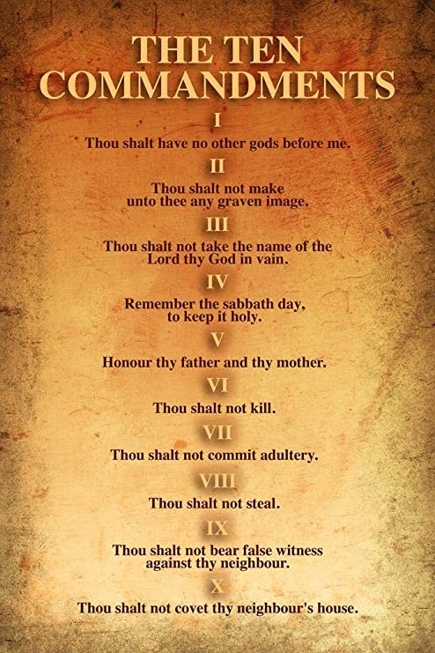
A Great Commandment Christian or a Ten Commandment Christian????

Slide 2
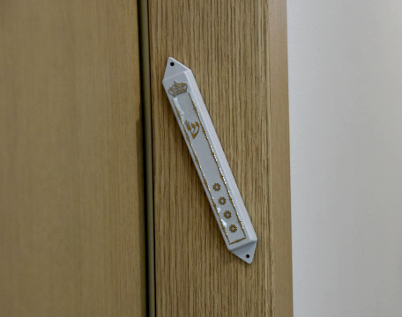
Mezuzah on Door

Slide 3
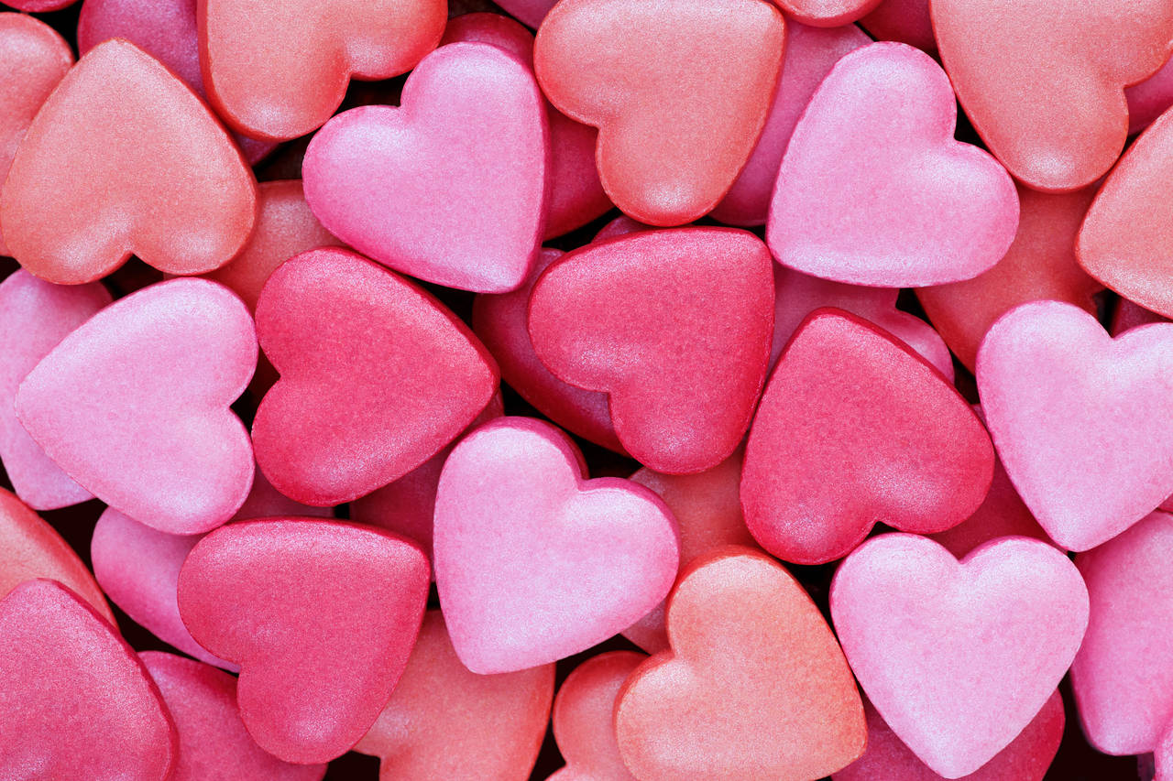
Heart…..

Slide 4
Soul…..

Slide 5
Mind
Tradition, Reason, Experience or….. Sola Scriptura????

Slide 6
Strength

Slide 7
Neighbour

Slide 8
Self…..

