Slide 2
“Now for the matters you wrote about: “It is good for a man not to have sexual relations with a woman.” But since sexual immorality is occurring, each man should have sexual relations with his own wife, and each woman with her own husband. The husband should fulfill his marital duty to his wife, and likewise the wife to her husband. The wife does not have authority over her own body but yields it to her husband. In the same way, the husband does not have authority over his own body but yields it to his wife.”

Slide 3
“Do not deprive each other except perhaps by mutual consent and for a time, so that you may devote yourselves to prayer. Then come together again so that Satan will not tempt you because of your lack of self-control. I say this as a concession, not as a command. I wish that all of you were as I am. But each of you has your own gift from God; one has this gift, another has that. Now to the unmarried and the widows I say: It is good for them to stay unmarried, as I do. But if they cannot control themselves, they should marry, for it is better to marry than to burn with passion.”

Slide 4
“To the married I give this command (not I, but the Lord): A wife must not separate from her husband. But if she does, she must remain unmarried or else be reconciled to her husband. And a husband must not divorce his wife. To the rest I say this (I, not the Lord): If any brother has a wife who is not a believer and she is willing to live with him, he must not divorce her. And if a woman has a husband who is not a believer and he is willing to live with her, she must not divorce him. For the unbelieving husband has been sanctified through his wife, and the unbelieving wife has been sanctified through her believing husband.”

Slide 5
“Otherwise your children would be unclean, but as it is, they are holy. But if the unbeliever leaves, let it be so. The brother or the sister is not bound in such circumstances; God has called us to live in peace. How do you know, wife, whether you will save your husband? Or, how do you know, husband, whether you will save your wife?
Nevertheless, each person should live as a believer in whatever situation the Lord has assigned to them, just as God has called them. This is the rule I lay down in all the churches.”
(1 Corinthians 7:1-17)

Slide 6
KEY THOUGHT
Reading 1 Corinthians is like reading someone’s mail as opposed to a formulated treatise on faith.

Slide 7
In this passage, Paul focused much of his response on the following question: how does faith in Jesus – and more specifically newfound faith in Jesus - impact a marriage?
We must understand that Paul’s words are at least to some degree targeting a misunderstanding of freedom, physicality, marriage and faith – the teaching of the “eschatological women”.
Paul’s personal opinion regarding the intersection between marriage and faith was to prefer singleness and this portion of Scripture is unique because it proposes a lot of biblical guidelines rather than mandates.

Slide 8
Our passage opens with a contrast between the:
Corinthian opinion of marriage and sexuality - “it is good for a man not to have sexual relations with a woman”
Jewish heritage opinion - “it is not good for man to be alone”.
The ancient Jews would have said it was advantageous to engage in marital sexual relations, while Paul and the Corinthians would have supported the idea that it was advantageous not to do so.
Paul conceded that marriage and marital sexual relations are both blessings of God upon humanity and ought to be received as such, in order to protect against our enemy getting a foothold in the believer’s life via sexual desire.

Slide 9
Paul sees celibacy as a gift of the Spirit, given to some, but not all.
If a married couple is gifted with such a gift then they ought to employ it with joy, but if not, then Paul urges caution in the temporary practice of celibacy within a marriage, ensuring it is used for the purpose of greater focus on God through prayer and from a place of mutual agreement.
Though Paul preferred the unmarried and widowed to remain unmarried, he ensured that if sexual desire was proving a breeding ground for sin in the life of an unmarried believer, then marriage and resultant sexual expression within a marriage is a fitting and permissible outcome.

Slide 10
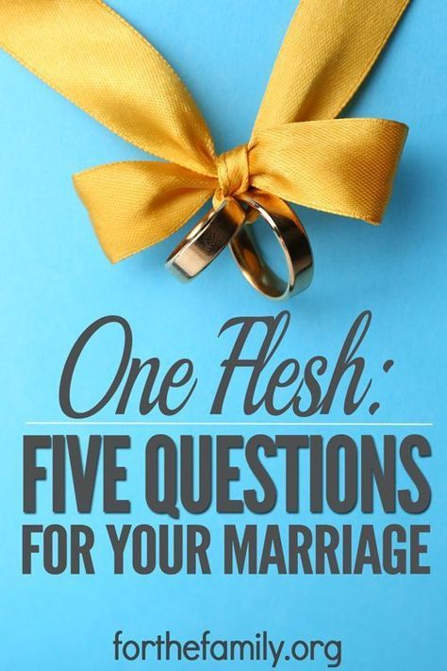
Paul emphasizes the importance of mutuality – of physically belonging to each other – within Christian marriage.

Slide 11
Christian husbands and wives were to aim to foster their one-flesh relationship, just as they sought to foster their one-flesh relationship with Christ Jesus and the Christian community. Where this proved difficult, divorce was not a permissible option.
Our default position as followers of Jesus is always towards reconciliation. If separation from one’s spouse is unavoidable, Paul directs us not to simply become serial monogamists – moving from one marriage to the next - but to aim for reconciliation with a believing spouse or else remain unmarried.

Slide 12
In the case of a marriage with an unbelieving spouse, the follower of Jesus, whether man or woman, should not initiate divorce proceedings, instead understanding that their presence in a “one-flesh” relationship with their unbelieving spouse performs an unbelievable and undefinable sanctifying function within the family.
Divorce is permissible in the case of:
marital unfaithfulness
abandonment by an unbelieving spouse
Divorce is potentially permissible in the case of prolonged and unrepentant instances of abuse.

Slide 13
“Live as a believer in whatever situation the Lord has assigned to [you], just as God has called [you].” (1 Corinthians 7:17)
The Corinthians taught that seeking a change in status had some religious significance, but Paul had always taught that the only significant change in status is the movement from being one without the Spirit to, by faith in Jesus, becoming one in whom the Spirit dwelt.

Slide 14
Does your faith influence your parenting, your marriage, your work life, your finances, your understanding of your sexuality?
Might those of you who are married find your marriages profoundly impacted by your faith in Jesus, pressing ever more greatly into the complicated “one-flesh” relationship established through your marriage.
Might those of you who are unmarried find your singleness profoundly impacted by your faith in Jesus, pressing fully into the “one-flesh” relationship established with Him and His people.

Slide 15
Might we learn what it means to follow Jesus within our present circumstances, might our relationship with Jesus bear impact upon all areas of our lives, and might our example in these relationships speak powerfully to those around us about Jesus and His love.

