Slide 2
1 Corinthians 1:18 – 2:5 (ESV)
For the word of the cross is folly to those who are perishing, but to us who are being saved it is the power of God. For it is written,
“I will destroy the wisdom of the wise, and the discernment of the discerning I will thwart.”
Where is the one who is wise? Where is the scribe? Where is the debater of this age? Has not God made foolish the wisdom of the world?

Slide 3
For since, in the wisdom of God, the world did not know God through wisdom, it pleased God through the folly of what we preach to save those who believe. For Jews demand signs and Greeks seek wisdom, but we preach Christ crucified, a stumbling block to Jews and folly to Gentiles, but to those who are called, both Jews and Greeks, Christ the power of God and the wisdom of God. For the foolishness of God is wiser than men, and the weakness of God is stronger than men.

Slide 4
For consider your calling, brothers: not many of you were wise according to worldly standards, not many were powerful, not many were of noble birth. But God chose what is foolish in the world to shame the wise; God chose what is weak in the world to shame the strong; God chose what is low and despised in the world, even things that are not, to bring to nothing things that are, so that no human being might boast in the presence of God. And because of him you are in Christ Jesus, who became to us wisdom from God, righteousness and sanctification and redemption, so that, as it is written, “Let the one who boasts, boast in the Lord.”

Slide 5
We want to answer two major questions from this text:
1. How do we come to believe in the Gospel?
2. How do we share the Gospel?

Slide 6
The Corinthian church was dividing over who the best preacher or church leader was.
Paul answers that the Corinthians have missed the point entirely, that the Church should not be divided between followers of various teachers because Christ is not divided;
Also, that our salvation is not brought about by the abilities of preachers as the culture of their day would have them believe.

Slide 7
Paul argues that human wisdom and ability is of no use in bring about faith in Jesus because when he preachers about the crucifixion it is a: “…stumbling block to Jews and folly to Gentiles.” v. 23
But there is a third group, “those who are called.”

Slide 8
The Called
Jews
Greeks

Slide 9
What does it mean to be Called? Romans 8:29-3 For those whom he foreknew he also predestined to be conformed to the image of his Son, in order that he might be the firstborn among many brothers. And those whom he predestined he also called, and those whom he called he also justified, and those whom he justified he also glorified.”

Slide 10
What does it mean to be Called?
The Father chose those he loved ahead of time and calls them. (Foreknew) The ones he calls are the ones he justifies: he saves them or buys them out of their slavery to sin
He then glorifies them: they are with Him forever in Heaven. Loved and Chosen. Called and Saved.

Slide 11
Who is paying for all of this? Romans 6:23 “The wages of sin is death but the gift of God is eternal life through Christ Jesus our Lord.” 1 Corinthians 1:24 “but to those who are called, both Jews and Greeks, Christ the power of God and the wisdom of God”

Slide 12
By Jesus’ death on the cross for your sins, as someone who is called by God, you understand who God is and what he has done for you.
Because Jesus died on the cross for you, you respond to God’s call and have knowledge of who he is and are saved.

Slide 13
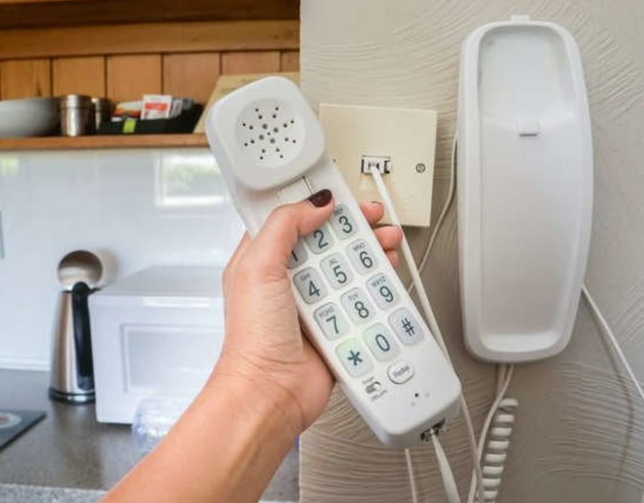
Who’s on the phone?

Slide 14
It is not about our salvation, it is about God’s glory.
The Jews demand a sign and the Greeks search of wisdom but God does not allow either of these things to call anyone to himself. “For since, in the wisdom of God, the world did not know God through wisdom.” v21
John 12:37 “Though he had done so many signs before them, they still did not believe in him,”
Apart from the power of God, expressed through the Cross of Christ, there is no way for us to obtain saving faith in God.

Slide 15
God used little David and a small rock to defeat Goliath.
He used trumpets to tear down the fortified walls of Jericho.
He told Gideon that there were too many men in his already grossly out-numbered army.
He did this so that everyone would know who brought the victory
Consider your calling. What brought you to faith?

Slide 16
For consider your calling, brothers: not many of you were wise according to worldly standards, not many were powerful, not many were of noble birth. But God chose what is foolish in the world to shame the wise; God chose what is weak in the world to shame the strong; God chose what is low and despised in the world, even things that are not, to bring to nothing things that are, so that no human being might boast in the presence of God. And because of him you are in Christ Jesus, who became to us wisdom from God, righteousness and sanctification and redemption, so that, as it is written, “Let the one who boasts, boast in the Lord.” 1 Corinthians 1:26-31

Slide 17
Stephen’s Creed
The Creator God of the Universe chose to reveal himself to humanity through the Jewish people thousands of years ago as a way of revealing humanity’s need and complete dependence on himself to be made worthy of even being in his presence, and the way that he chose to pay the price of the deficiency in our character is by being born as a human baby 2000 years ago to a virgin teenage girl, then living a sinless life, being crucified on a Roman cross only to be brought back from the dead three days later and then ascending into heaven. The Holy Spirit of God then descended onto the Church made up of the chosen people of God, causing miracles and life transformation and inspiring the writing and preservation of the Holy Word of God which we read today to learn about who God is, how he loves us, and how we can live and serve him with the hope that we will one day be with him in perfect eternity worshipping and rejoicing among the saints.

Slide 18
People do not come to faith through philosophies, reasoning, and arguments.
“For Christ did not send me to baptize but to preach the gospel, and not with words of eloquent wisdom, lest the cross of Christ be emptied of its power.” (ch. 1, v. 17)
The more we try to save people with our own intelligence, the more we are trying to save them to something that is not the Gospel of Jesus.
The preaching of the Gospel is the most powerful and effective when it is simple, humble, and clear.

Slide 19
How we are called to share the Gospel:
“And I, when I came to you, brothers, did not come proclaiming to you the testimony of God with lofty speech or wisdom. For I decided to know nothing among you except Jesus Christ and him crucified. And I was with you in weakness and in fear and much trembling, and my speech and my message were not in plausible words of wisdom, but in demonstration of the Spirit and of power, so that your faith might not rest in the wisdom of men but in the power of God.”
1 Corinthians 2:1-5

Slide 20
LET JESUS BE YOUR ANSWER TO EVERYTHING. “I know that Jesus loves me and he died for my sins.”
Do not let your desire to prove how much you know, or the fear of not knowing enough keep you from sharing the only important truth: that Jesus died for our sins, defeated death, and is Lord overall.

