Slide 2
“During that long period, the king of Egypt died. The Israelites groaned in their slavery and cried out, and their cry for help because of their slavery went up to God. God heard their groaning and he remembered his covenant with Abraham, with Isaac and with Jacob. So God looked on the Israelites and was concerned about them. Now Moses was tending the flock of Jethro his father-in-law, the priest of Midian, and he led the flock to the far side of the wilderness and came to Horeb, the mountain of God. There the angel of the Lord appeared to him in flames of fire from within a bush. Moses saw that though the bush was on fire it did not burn up. So Moses thought, “I will go over and see this strange sight—why the bush does not burn up.”

Slide 3
When the Lord saw that he had gone over to look, God called to him from within the bush, “Moses! Moses!”
And Moses said, “Here I am.”
“Do not come any closer,” God said. “Take off your sandals, for the place where you are standing is holy ground.” Then he said, “I am the God of your father, the God of Abraham, the God of Isaac and the God of Jacob.” At this, Moses hid his face, because he was afraid to look at God. The Lord said, “I have indeed seen the misery of my people in Egypt. I have heard them crying out because of their slave drivers, and I am concerned about their suffering. So I have come down to rescue them from the hand of the Egyptians and to bring them up out of that land into a good and spacious land, a land flowing with milk and honey—the home of the Canaanites, Hittites, Amorites, Perizzites, Hivites and Jebusites.

Slide 4
“And now the cry of the Israelites has reached me, and I have seen the way the Egyptians are oppressing them. So now, go. I am sending you to Pharaoh to bring my people the Israelites out of Egypt.”
But Moses said to God, “Who am I that I should go to Pharaoh and bring the Israelites out of Egypt?”
God said, “I will be with you.
Moses said to God, “Suppose I go to the Israelites and say to them, ‘The God of your fathers has sent me to you,’ and they ask me, ‘What is his name?’ Then what shall I tell them?”
God said to Moses, “I am who I am. This is what you are to say to the Israelites: ‘I am has sent me to you.’” …

Slide 5
“(3:16) Go, assemble the elders of Israel and say to them, ‘The Lord, the God of your fathers—the God of Abraham, Isaac and Jacob—appeared to me and said: I have watched over you and have seen what has been done to you in Egypt. And I have promised to bring you up out of your misery in Egypt into the land of the Canaanites, Hittites, Amorites, Perizzites, Hivites and Jebusites—a land flowing with milk and honey.’ The elders of Israel will listen to you…”
(Exodus 2:23 -3:18)

Slide 6
God likely used Moses’ Midian experience as an opportunity for reorientation and course correction in his life, 40 years of life spent in Egyptian opulence.
How long do you think Moses’ Midian experience lasted?
a) 5 years | c) 40 years
b) 20 years | d) 10 years

Slide 7
God likely used Moses’ Midian experience as an opportunity for reorientation and course correction in his life, 40 years of life spent in Egyptian opulence.
How long do you think Moses’ Midian experience lasted?
c) 40 years
a) 5 years | c) 40 years
b) 20 years | d) 10 years
God’s work of reorientation and correction in the life of Moses lasted 40 years, all while the people of Israel experienced oppression and abuse at the hands of the Egyptians.

Slide 8
This seeming 40 years of inaction on God’s behalf, however, is not due to the fact that He was unaware or unconcerned about the suffering of the people of Israel.
As God revealed to Moses, He certainly did see the misery of the people of Israel and was concerned about them – vs. 9 of our text is the first time God had ever called Israel “my people” in scripture - but there are certain things that had to be prepared - people to be equipped – in order for God to “come down to rescue them from the hand of the Egyptians and to bring them up out of that land into a good and spacious land” (v.8).
Moses lived a humbling shepherd life as God did a work in his life to prepare him to be a different kind of shepherd.

Slide 9
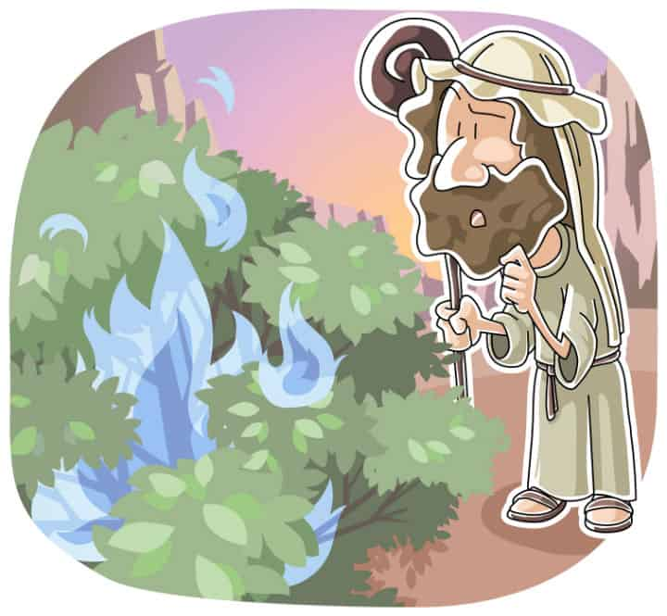
God’s use of a common and insignificant object as a source of His revelation is significant in that prior to investing in Moses for some very significant ends, he chose to reveal himself through a small and irrelevant thing to gauge Moses’ sensitivity to the humble things in life.
Moses was directed to remove his sandals, not because he now stood upon a perfect, heavenly tract of dirt beside a thorn bush of the highest quality imaginable, but because God’s presence there made it an extraordinary place. When God is present in any place, it can no longer be a common or ordinary location.

Slide 10
Holiness refers to the active setting apart of something for divine or uncommon use.
In our text, even the dust of the ground and the thorn bush, very common items, were transformed by God’s holiness.
The burning bush that remained alit symbolizes God’s intent not to consume or destroy His people, but to be their savior, to lead them out of bondage in Egypt and into the Promised Land
After 40 years of mundane, ordinary and common purpose, God was setting him apart – making him holy – for God’s incredible salvation purposes.

Slide 11
Whereas Moses might have earlier believed that he had it within himself to be the deliverer of Israel, God makes it abundantly clear that He is coming to deliver Israel, but He’s also going to use Moses.
In his own hands, Moses acted ordinarily, profanely, but in God’s hands Moses would be an instrument of God’s special purpose.
Moses’ initial response to this call is telling of his preparation, a recognition that in Midian God had created in him a clean heart and a right spirit.
God takes the common and makes them uncommon by His presence and this is exactly the promise He makes to Moses - you might be common, ordinary, perhaps even broken from misuse, but I will make you holy, giving you uncommon purpose to accomplish my will.

Slide 12
Three Questions
Am I open to being prepared for God’s use – willing to be reoriented and course corrected?
Am I getting about the things that God has called me – created me, prepared me - to accomplish on His behalf?
Do I still think that I can fix my lot and set my course in life all on my own or am I modelling a radical trust in Jesus? How many of us are still walking around in our sandals with a staff in our hands?

Slide 13
Might we be a people who echo the plea of Psalm 51:10-12 – “create in me a pure heart, O God, and renew a steadfast spirit within me. Do not cast me from your presence or take your Holy Spirit from me. Restore to me the joy of your salvation and grant me a willing spirit, to sustain me”.
Might we actively seek Christ’s presence, so that we might be uncommonly equipped for His purposes in and through us.
Might we become a “no sandals, no staff” sort of people and might the outcome of doing so help clarify God’s call upon our lives and permit us to be a part of the great work of salvation that God is initiating in our time, for His glory and His glory alone

