Slide 2
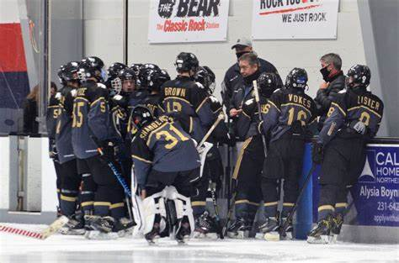
KEY IDEA:
Sometimes before one reaches a destination, it is necessary and beneficial to experience a layover or intermission in order to not only rest, but also receive required reorientation and correction.

Slide 3
“One day, after Moses had grown up, he went out to where his own people were and watched them at their hard labor. He saw an Egyptian beating a Hebrew, one of his own people. Looking this way and that and seeing no one, he killed the Egyptian and hid him in the sand. The next day he went out and saw two Hebrews fighting. He asked the one in the wrong, “Why are you hitting your fellow Hebrew?”
The man said, “Who made you ruler and judge over us? Are you thinking of killing me as you killed the Egyptian?”
Then Moses was afraid and thought, “What I did must have become known.”

Slide 4
“When Pharaoh heard of this, he tried to kill Moses, but Moses fled from Pharaoh and went to live in Midian, where he sat down by a well.
Now a priest of Midian had seven daughters, and they came to draw water and fill the troughs to water their father’s flock. Some shepherds came along and drove them away, but Moses got up and came to their rescue and watered their flock. When the girls returned to Reuel their father, he asked them, “Why have you returned so early today?”

Slide 5
They answered, “An Egyptian rescued us from the shepherds. He even drew water for us and watered the flock.” “And where is he?” Reuel asked his daughters. “Why did you leave him? Invite him to have something to eat.”
Moses agreed to stay with the man, who gave his daughter Zipporah to Moses in marriage. Zipporah gave birth to a son, and Moses named him Gershom, saying, “I have become a foreigner in a foreign land.”
(Exodus 2:12-22)

Slide 6
How do you think Moses came to this knowledge of his Hebrew lineage?
“These were the children of Pharaoh’s daughter Bithiah, whom Mered had married.” (1 Chronicles 4:18)
It could be that as Moses was being “was educated in all the wisdom of the Egyptians”, his adoptive mother with a soft spot for the people of Israel, was also ensuring that he was educated on his Hebrew lineage.
God did not abandon Moses to the Egyptian courts, but remained an active presence in his life.

Slide 7
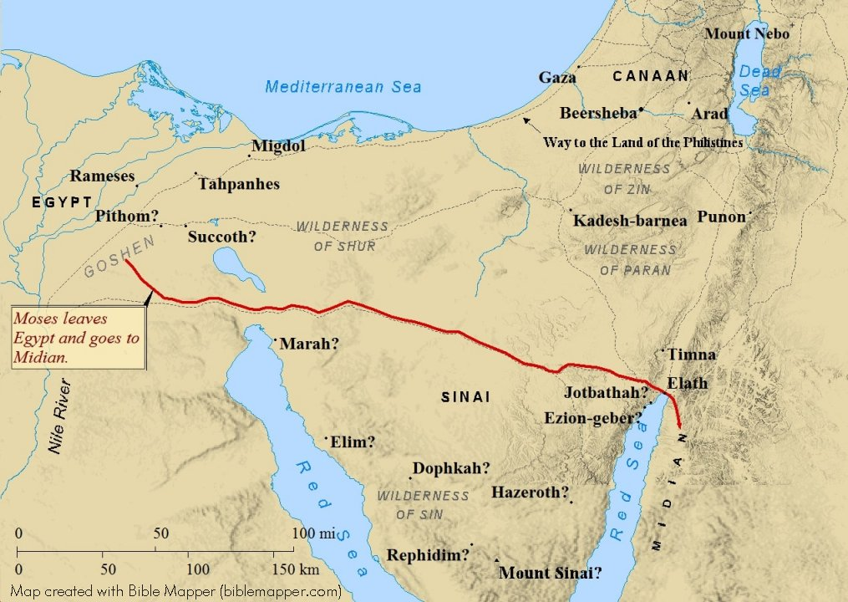
Having observed the Israelites’ hard labor, Moses felt compelled to intervene in an abusive circumstance between a Hebrew slave and an Egyptian overlord.
Moses’ actions are not the righteous actions of a justice-fuelled deliverer, but the uncontrolled actions of a murderer.
In response, Moses decided to flee to Midian to avoid Pharaoh’s coming wrath, eventually encountering Reuel, a priest of Midian, who ensured the continued worship of God among his people.

Slide 8
Seeing this injustice between some shepherds and a group of women, Moses intervened again, but this time, he showed restraint and fought a good fight, protecting this group of women and then drawing water for them and watering their flock.
The result of this good fight was that Moses found a home, a family and a life among Reuel’s family where he might continue to grow in his knowledge of the God of Abraham, Isaac and Jacob.

Slide 9
In our text, while a wrongly motivated and wrongly contested fight led to flight, a rightly motivated and rightly contested fight led to blessing.

Slide 10
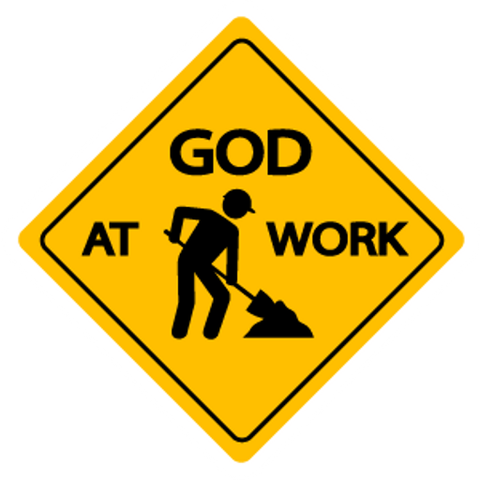
When Moses arrived in Midian, he had some significant problems in his life; some internal, spiritual issues to address and some key external matters of judgement to which to attend.
Rather than seeing Moses’ time in Midian as punitive, what if his journey to Midian is in fact a layover, an intermission between the second and third periods of his life? What if God is going to use this time to re-orient and redirect Moses’ passions in a more godly direction?
Jacob’s layover/intermission (Genesis 32:24-31)

Slide 11
God used this sojourn to Midian to teach Moses the importance of not contending against God by pursuing his will in difficult circumstances, but rather to submit to His leading.
In Midian, God did a great work in Moses before He did a great work through Moses.
By all intents and purposes, Moses should have been disqualified from leading the people of Israel, and yet God had resolved to work through Moses.

Slide 12
“God doesn't call the qualified, He qualifies the called.” - author Mark Batterson, The Circle Maker: Praying Circles Around Your Biggest Dreams and Greatest Fears .
Moses fit the “deliverer of Israel” bill pretty well, but the salvation God intended to bring was not one accomplished through human charisma and eloquence. It was a divinely provided salvation and required a divinely gifted and guided leader to bring it to fulfillment, and so God pulled Moses to the bench for some reorientation between periods.

Slide 13
It might be of great benefit for us to ask ourselves, “what fight are we presently fighting?”.
Personally, we might ask, “am I fighting fights of my own making, by means I deem necessary or am I fighting the fight God has called me to fight in the way He has called me to battle?”.
It is important that we are following the Spirit’s lead in all of this and so, let’s ensure we are!

Slide 14
If you conclude that you’ve been involved in fighting the wrong fights, perhaps to significantly negative outcomes, might you recognize that no matter how badly you’ve messed things up, God can still transform you into a person whom He can use to accomplish great things for His glory!

Slide 15
Let us ask: “what if our present experience is a layover, what if we are in between periods, during which God is qualifying the called?”.
What if God is using our pandemic experience to qualify the called for His next great work of salvation?
If our qualifying has left us with a limp, might it be an opportunity to hear God whisper “my grace is sufficient for you, for my power is made perfect in weakness” (2 Corinthians 12:9).

Slide 16
Might we be a people who are so in step with the Spirit of God that our fights are always the fights He leads us into and might we fight them in a way that honours Christ.
Might we be a people who know the incredible transforming power of God in our lives to such a degree that we do not doubt that He can use us to accomplish His purposes.
Might we be a people who use the layover/ intermission periods God brings into our lives to the fullest of their potential; might we be open to the qualifying of the called in our individual and corporate lives.
Might we know that the salvation that God still provides to us is by grace alone through faith in Jesus Christ, based on the power of God and not the work of humanity!

