Slide 2
The Process of Forgiveness
Confession
Repentance
Forgiveness
Last week, we learned of the need for regular confession of sin and understood that there exists a process of forgiveness that involves both confession and repentance. Today we are going to examine a Psalm that centres in on the practice of repentance.

Slide 3
“Have mercy on me, O God, according to your unfailing love; according to your great compassion blot out my transgressions. Wash away all my iniquity and cleanse me from my sin. For I know my transgressions, and my sin is always before me. Against you, you only, have I sinned and done what is evil in your sight; so you are right in your verdict and justified when you judge. Surely I was sinful at birth, sinful from the time my mother conceived me. Yet you desired faithfulness even in the womb; you taught me wisdom in that secret place. Cleanse me with hyssop, and I will be clean; wash me, and I will be whiter than snow. Let me hear joy and gladness; let the bones you have crushed rejoice. Hide your face from my sins and blot out all my iniquity.”

Slide 4
“Create in me a pure heart, O God, and renew a steadfast spirit within me. Do not cast me from your presence or take your Holy Spirit from me. Restore to me the joy of your salvation and grant me a willing spirit, to sustain me. Then I will teach transgressors your ways, so that sinners will turn back to you. Deliver me from the guilt of bloodshed, O God, you who are God my Savior, and my tongue will sing of your righteousness. Open my lips, Lord, and my mouth will declare your praise. You do not delight in sacrifice, or I would bring it; you do not take pleasure in burnt offerings. My sacrifice, O God, is a broken spirit; a broken and contrite heart you, God, will not despise. May it please you to prosper Zion, to build up the walls of Jerusalem. Then you will delight in the sacrifices of the righteous, in burnt offerings offered whole; then bulls will be offered on your altar.”
- Psalm 51

Slide 5
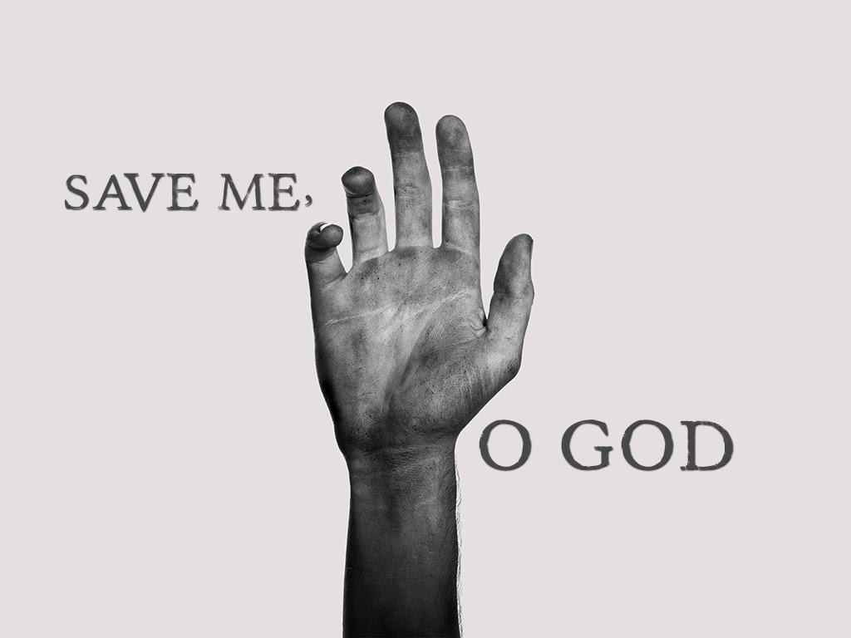
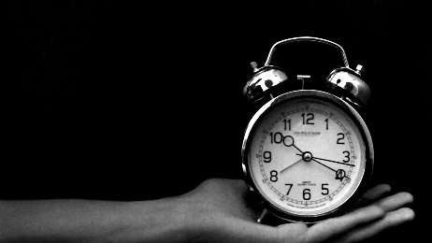
In our Psalm for the day, David is not asking for a rescue from difficult circumstances, but is asking for a rescue from self-destructive patterns of sinful behaviour – almost a save-me-from-myself sort of plea.

Slide 6
Rather than faithfully fulfilling his regular kingly responsibilities out on the battlefield, his attention drifted to a young woman named Bathsheba, who was married to Uriah, a soldier in David’s army.
Effectively caught in his sin, David devised a number of solutions to deftly wiggle out from underneath the consequences.
David arranged for Uriah to be placed at the front lines of the armies of Israel – where the fighting was most fierce - where he died in battle.
David took Bathsheba as his wife, expecting that all of this – both the adultery and the murder of Uriah - was now water under the bridge.

Slide 7
God sent the prophet Nathan to David to lay bare before David his guilt and sin.
Immediately recognizing the gravity of his sin, David confessed it to Nathan and before God and, incredibly, Nathan informs David that “the Lord has taken away [his] sin” (2 Samuel 12:13).

Slide 8
REPENTANCE
Repentance involves a complete turning to God and a full 180 degree spin away from sin.

Slide 9
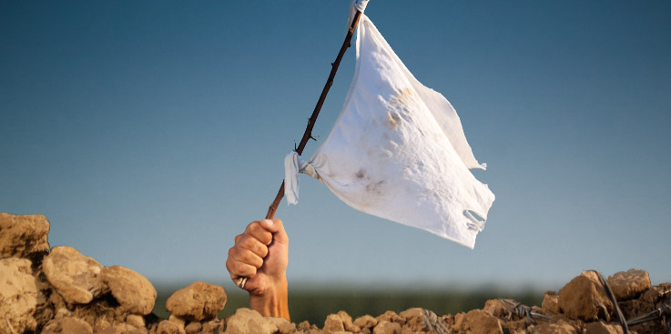
THE CHALLENGE OF SURRENDER
All of the language of Psalm 51 is surrender language; these are the words of a man who has completely placed himself in the hands of God.

Slide 10
“Create in me a pure heart, O God, and renew a steadfast spirit within me. Do not cast me from your presence or take your Holy Spirit from me. Restore to me the joy of your salvation and grant me a willing spirit, to sustain me.” (Psalm 51:10-12)
The words – create, renew, restore, and grant – all suggest divine action and acknowledgement that none of this can be accomplished from human striving.
True repentance acknowledges our absolute insufficiency and powerlessness in the face of our sin instead requiring a complete reliance upon God’s grace and mercy.

Slide 11
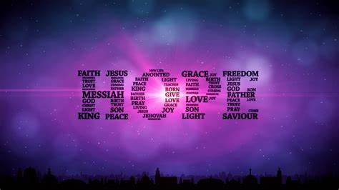
“All have sinned and fall short of the glory of God, and all are justified freely by his grace through the redemption that came by Christ Jesus … he did it to demonstrate his righteousness at the present time, so as to be just and the one who justifies those who have faith in Jesus”. (Romans 3:23-26)
“God made him who had no sin to be sin for us, so that in him we might become the righteousness of God” (2 Corinthians 5:21).

Slide 12
Have I made a 180 degree turn from sin? Am I fully oriented towards Christ and away from sin?
Have truly I, in repentance, surrendered to God? Have I, as did David, asked God to create in me a new heart, to renew a perseverant spirit in me, to restore my joy, to give me His near presence, and to grant me a willing spirit?
Do I live in repentant surrender to Jesus, following His lead in my life or do I drag Jesus around like my spiritual errand boy expecting Him to act in my best interest?
Does the knowledge of my deliverance from guilt, enable my tongue to sing of God’s righteousness? Has an experience of God’s re-creative work in my life opened my lips to declare His praise?

Slide 13
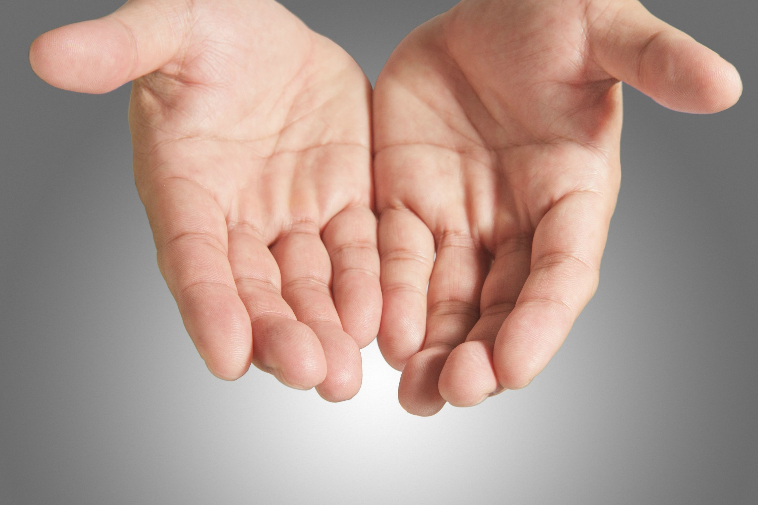

Slide 14
Discussion Questions
Is the idea of a repentance as a 180 degree spin toward God and away from sin helpful? Why or why not?
Why do you think that the idea of repentant surrender is waning in our understanding of forgiveness?
When you think of the phrase “create in me a pure heart, O God, and renew a steadfast spirit within me”, what images come to mind?

