Slide 1
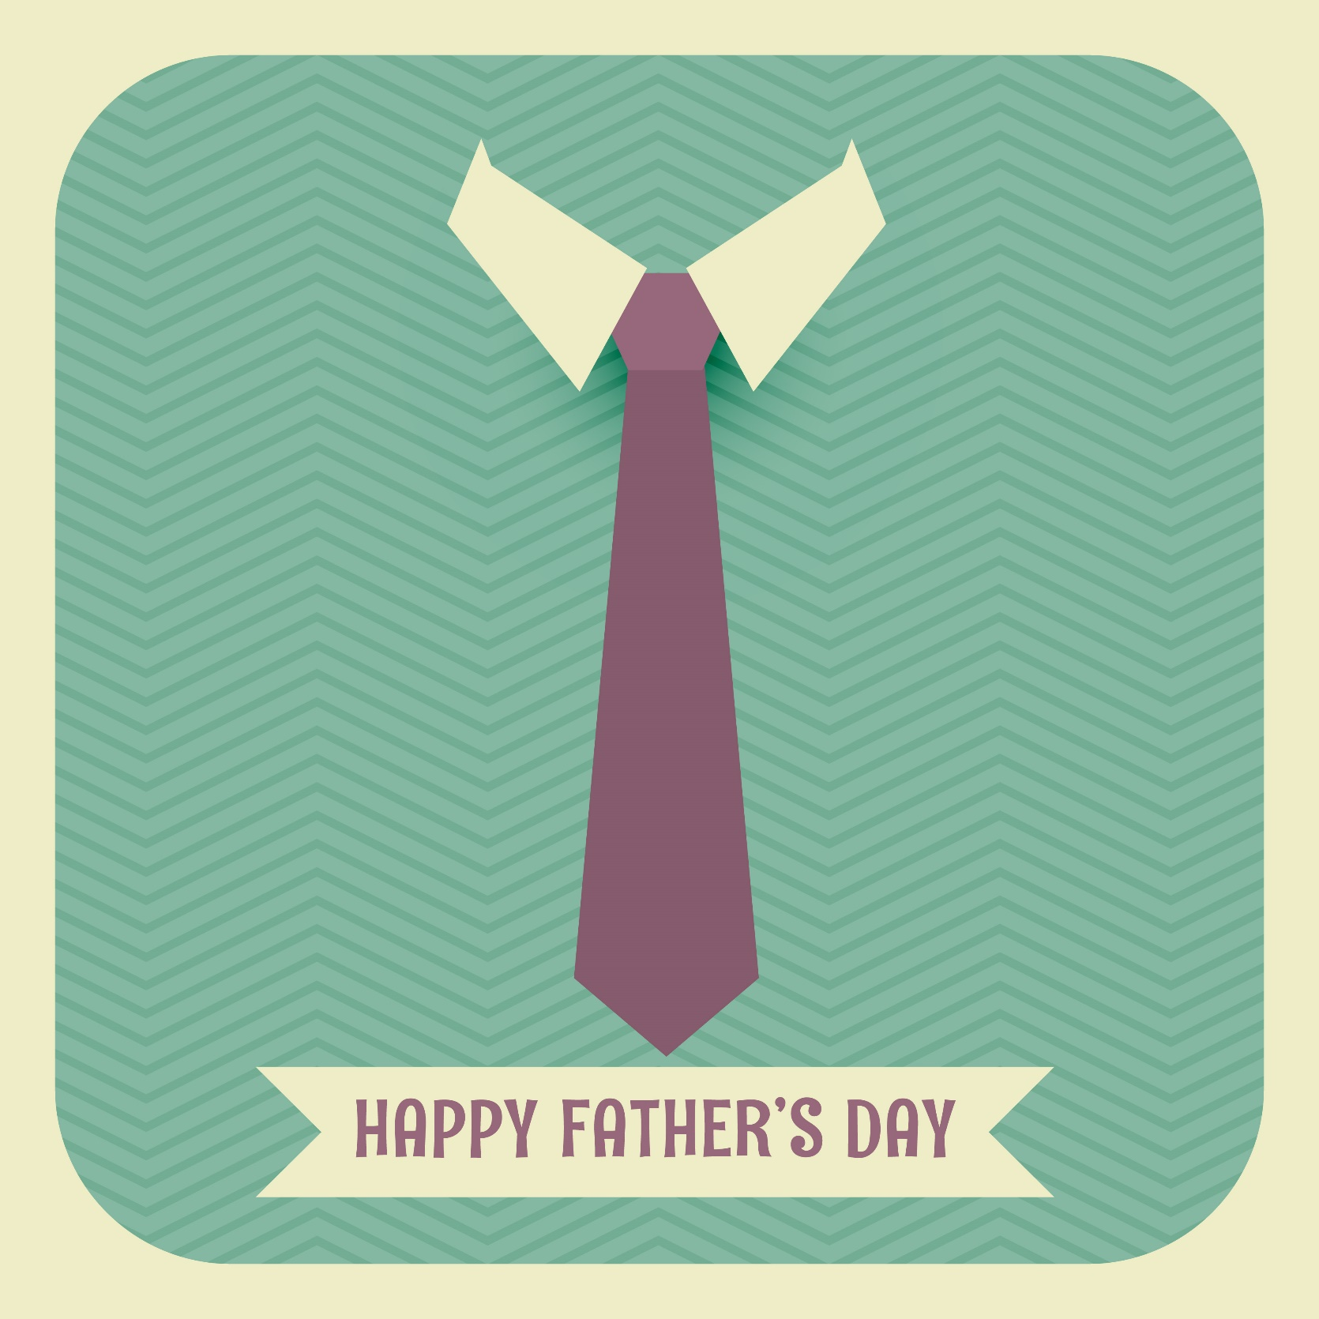

Slide 2
perseverance

Slide 3
“Some time later God tested Abraham. He said to him, “Abraham!” “Here I am,” he replied. Then God said, “Take your son, your only son, whom you love—Isaac—and go to the region of Moriah. Sacrifice him there as a burnt offering on a mountain I will show you.” Early the next morning Abraham got up and loaded his donkey. He took with him two of his servants and his son Isaac. When he had cut enough wood for the burnt offering, he set out for the place God had told him about. On the third day Abraham looked up and saw the place in the distance. He said to his servants, “Stay here with the donkey while I and the boy go over there. We will worship and then we will come back to you.”

Slide 4
“Abraham took the wood for the burnt offering and placed it on his son Isaac, and he himself carried the fire and the knife.” As the two of them went on together, Isaac spoke up and said to his father Abraham, “Father?” “Yes, my son?” Abraham replied. “The fire and wood are here,” Isaac said, “but where is the lamb for the burnt offering?” Abraham answered, “God himself will provide the lamb for the burnt offering, my son.” And the two of them went on together. When they reached the place God had told him about, Abraham built an altar there and arranged the wood on it. He bound his son Isaac and laid him on the altar, on top of the wood. Then he reached out his hand and took the knife to slay his son. But the angel of the Lord called out to him from heaven, “Abraham! Abraham!” “Here I am,” he replied.

Slide 5
“Do not lay a hand on the boy,” he said. “Do not do anything to him. Now I know that you fear God, because you have not withheld from me your son, your only son.” Abraham looked up and there in a thicket he saw a ram caught by its horns. He went over and took the ram and sacrificed it as a burnt offering instead of his son. So Abraham called that place The Lord Will Provide. And to this day it is said, “On the mountain of the Lord it will be provided.”
- Genesis 22:1-14

Slide 6
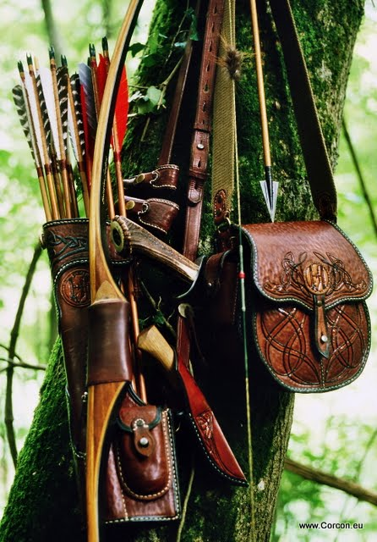
Archery: An Analogy of Fatherhood
“Children are a heritage from the Lord, offspring a reward from him. Like arrows in the hands of a warrior are children born in one’s youth” (Psalm 127:3-4)

Slide 7
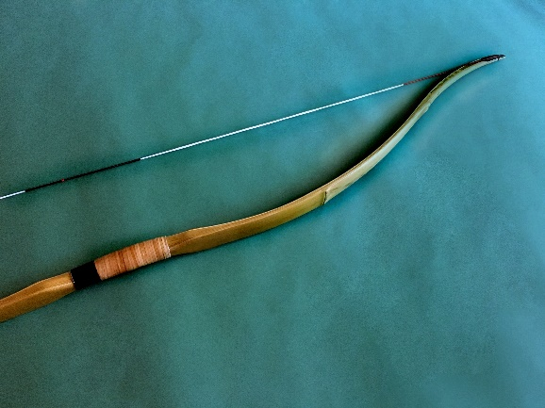
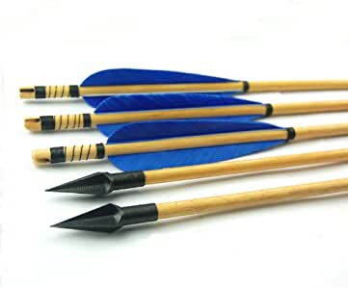
In many ways, you and I are little more than sticks on the ground until God imbues us with purpose and fashions us for His purposes. Like a master bowyer, by His Spirit, God begins making us a useful weapon in His hands. We cannot permit ourselves to be too rigid in God’s hands, otherwise we’ll simply snap when it comes time for God to use us.
Though our children belong ultimately to God, for a period of time, we support, uphold and sustain our children. We provide a structure and place for them to fit.
Our ultimate function as fathers is not to hold our children safe and sound, but under God’s empowerment, to help launch them towards the target God has prepared for them. In a significant way, we are gifted our children for but a moment, but used mightily by God to propel them towards His target for their lives.

Slide 8
A Straight as an Arrow Truth
As followers of Jesus, we ought to manifest a spiritual flexibility rooted in a sincere acknowledgement of and trust in God’s cosmic sovereignty.

Slide 9
Abraham’s trust was so fully placed in God that he was confident that God’s direction to him would be of blessing not only to him, but also to Isaac, even when that seemed counterintuitive. He trusted the archer’s aim so implicitly that he remained flexible under strain, even though he might have questioned God’s aim.
“By faith Abraham, when God tested him, offered Isaac as a sacrifice. He who had embraced the promises was about to sacrifice his one and only son, even though God had said to him, “It is through Isaac that your offspring will be reckoned.” Abraham reasoned that God could even raise the dead, and so in a manner of speaking he did receive Isaac back from death.“ (Hebrews 11:17-19)

Slide 10
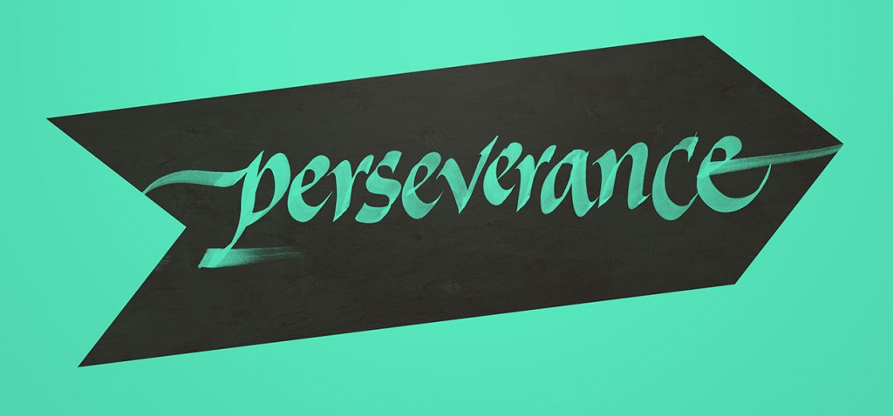
The Need for Perseverance
“The Lord makes firm the steps of the one who delights in him; though he may stumble, he will not fall, for the Lord upholds him with his hand” (Psalm 37: 23-24)
Our ability to trust that “the Lord will provide” in our parenting that enables us to become better fathers. We can trust in God that though we stumble, He will right our footing as we try to be faithful in stewarding the children we have been blessed with.

Slide 11
Reflection Questions
What is my prized “possession” and, in faith, could I sacrifice it if required by God?
Do I see my role as being used by God to launch my kids towards God’s goals for them? Do I hold my “possessions” lightly that they might be used by God for His glory?
Is my fathering built upon a foundation of trust in God?
Am I willing to persevere in faith – to submit to stretching and strain at the hand of God – as I follow Jesus?
What kind of a bow am I – a flexible one bending dynamically under God’s hand or an inflexible, rigid one set to break under pressure?

Slide 12
Might we become fathers who help our children fly straight and true towards the incredible target that God has for each one of them.
Might we be a people who understand our purpose to use that with which God has blessed us for His glory and honour.
Might we persevere under strain – might we be relationally flexible in our faith - that we might become an effective weapon in God’s hand.
Might we be a “Jehovah Jireh”, “the Lord will provide” kind of people.

