Slide 2
“Simon Peter asked him, “Lord, where are you going?” Jesus replied, “Where I am going, you cannot follow now, but you will follow later.” Peter asked, “Lord, why can’t I follow you now? I will lay down my life for you.” Then Jesus answered, “Will you really lay down your life for me? Very truly I tell you, before the rooster crows, you will disown me three times!
Again Peter denied it, and at that moment a rooster began to crow.

Slide 3
“When they had finished eating, Jesus said to Simon Peter, “Simon son of John, do you love me more than these?” “Yes, Lord,” he said, “you know that I love you.”
Jesus said, “Feed my lambs.”
Again Jesus said, “Simon son of John, do you love me?”
He answered, “Yes, Lord, you know that I love you.”
Jesus said, “Take care of my sheep.”
The third time he said to him, “Simon son of John, do you love me?”
Peter was hurt because Jesus asked him the third time, “Do you love me?” He said, “Lord, you know all things; you know that I love you.”

Slide 4
Jesus said, “Feed my sheep. Very truly I tell you, when you were younger you dressed yourself and went where you wanted; but when you are old you will stretch out your hands, and someone else will dress you and lead you where you do not want to go.” Jesus said this to indicate the kind of death by which Peter would glorify God. Then he said to him, “Follow me!”
(John 13:36-38, 18:27, 21:15-19)

Slide 5
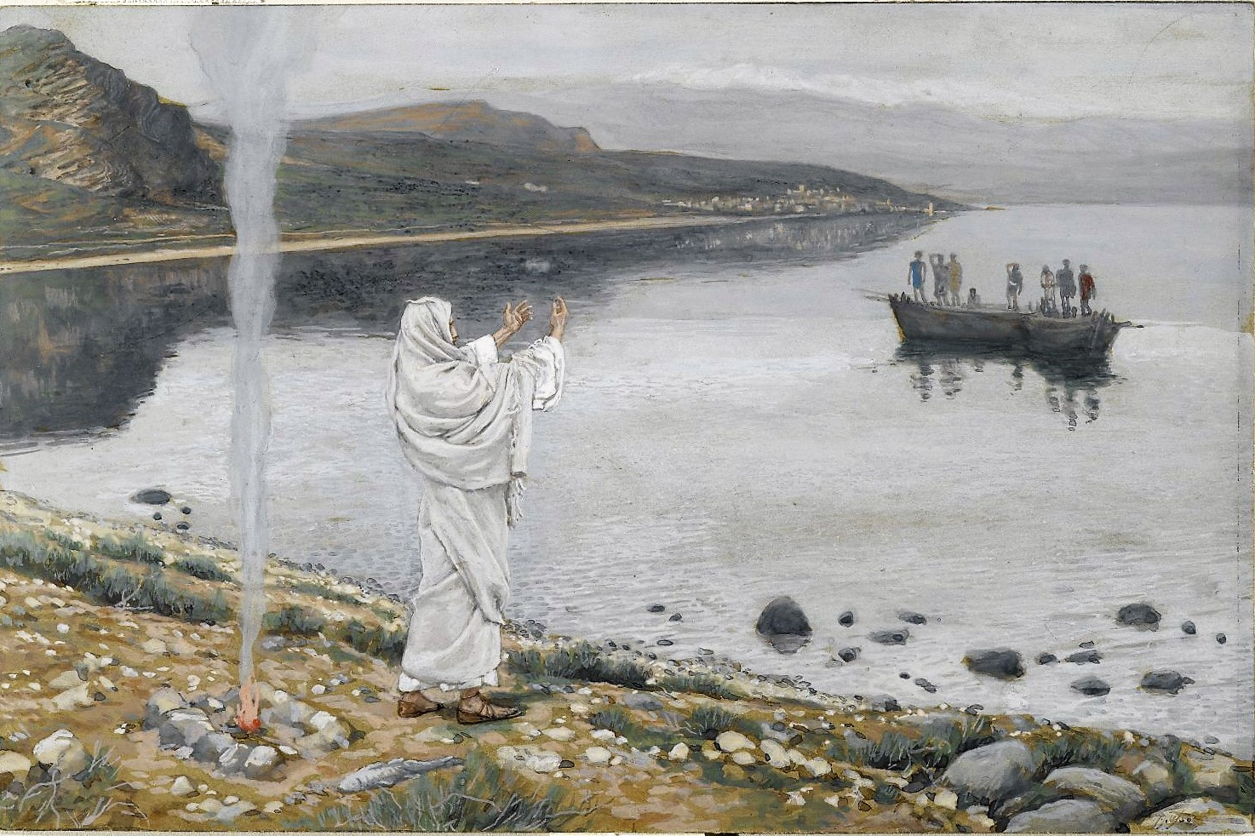
Our main passage today picks up the experience of the disciples a number of days after the Resurrection with a night of fishing failure, a miraculous morning haul of fish and an amazing encounter with Jesus.

Slide 6
During the Last Supper, Jesus indicated to Peter that “where I am going, you cannot follow now, but you will follow later” (John 13:36).
“Very truly I tell you, when you were younger you dressed yourself and went where you wanted; but when you are old you will stretch out your hands, and someone else will dress you and lead you where you do not want to go.” (John 21:18).
Jesus revealed that Peter, and by extension us, are to follow Him on a path marked by pain and suffering … but one that leads also into His kingdom, His glory and His Father’s eternal presence.

Slide 7
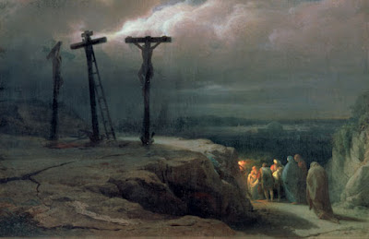
The writer of the letter to the Hebrews urges followers of Jesus “go to Jesus outside the camp, bearing the disgrace he bore” (Hebrews 13:13).
By choosing mission over comfort, Jesus opted for a road of disgrace and suffering, but also a road of victory and glory. Jesus invited Peter, and us, to walk this same road of suffering and disgrace, victory and glory.

Slide 8
Why did Jesus suggest that Peter could not yet follow Him on this road of suffering in John 13 and yet now, in John 21, invite Peter to follow Him?

Slide 9
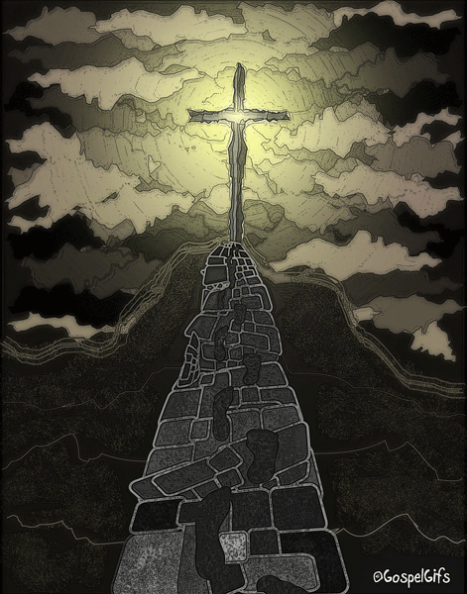
Jesus did not invite Peter to follow Him on the path of suffering leading to glory in John 13 because:
the path was yet unprepared
the Holy Spirit had not yet been given
his manner of walking the path was yet undefined

Slide 10
Are we aware that Jesus has blazed a path for us to follow or are we more interested in blazing our own path?
Are we prepared to follow Jesus through suffering and disgrace and into victory and glory?
Do we recognize that:
we have been given the presence of the Spirit with us to empower us to walk this path?
we have been given a calling and a mission to motivate us along this path?
and we’ve been given a community to support us in our times weakness along this path?

Slide 11
My prayer today is that “out of his glorious riches, [God would] strengthen [us] with power through his Spirit in [our] inner being”, enabling us, like Peter, to bring glory to God both in life and in death!

