Slide 2
“To the Jews who had believed him, Jesus said, “If you hold to my teaching, you are really my disciples. Then you will know the truth, and the truth will set you free.”
They answered him, “We are Abraham’s descendants and have never been slaves of anyone. How can you say that we shall be set free?”
Jesus replied, “Very truly I tell you, everyone who sins is a slave to sin. Now a slave has no permanent place in the family, but a son belongs to it forever. So if the Son sets you free, you will be free indeed.”

Slide 3
“I know that you are Abraham’s descendants. Yet you are looking for a way to kill me, because you have no room for my word. I am telling you what I have seen in the Father’s presence, and you are doing what you have heard from your father.”
“Abraham is our father,” they answered.
“If you were Abraham’s children,” said Jesus, “then you would do what Abraham did. As it is, you are looking for a way to kill me, a man who has told you the truth that I heard from God. Abraham did not do such things. You are doing the works of your own father.”

Slide 4
“We are not illegitimate children,” they protested. “The only Father we have is God himself.”
Jesus said to them, “If God were your Father, you would love me, for I have come here from God. I have not come on my own; God sent me. Why is my language not clear to you? Because you are unable to hear what I say. You belong to your father, the devil, and you want to carry out your father’s desires. He was a murderer from the beginning, not holding to the truth, for there is no truth in him. When he lies, he speaks his native language, for he is a liar and the father of lies. Yet because I tell the truth, you do not believe me!”

Slide 5
“Can any of you prove me guilty of sin? If I am telling the truth, why don’t you believe me? Whoever belongs to God hears what God says. The reason you do not hear is that you do not belong to God.”
- John 8:31-47

Slide 6
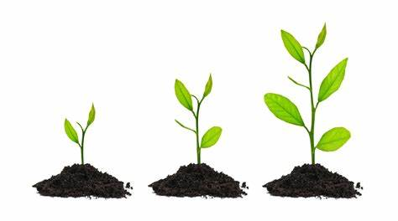
In our passage today, Jesus teaches that a true disciple:
Grows
Knows
Goes

Slide 7
A True Disciple … Grows.
A true disciple grows or as Jesus puts it, a true disciple “hold[s] to [His] teaching” (John 8:31).
This points to an ongoing, dynamic, relational, growing engagement with Jesus; this is what a true disciple craves and pursues.

Slide 8
A True Disciple … Knows.
A true disciple knows the truth.
As Jesus will reveal in John 14:6, He is “the way, the truth and the life”.
Just as we learned last week that Jesus came to be the “bread of life” and not simply to provide it, Jesus came not simply to dispense truth, but to be the truth.

Slide 9
A True Disciple … Goes.
A true disciple goes in the truth; he or she is set free by the truth according to the latter part of verse 31.
Truth, you see, compels motion; just as Jesus reveals in John 8:42 that “God sent me”, we will see in John 17:18 that “as [God] sent [Jesus] into the world, [Jesus has] sent [His disciples] into the world”.

Slide 10
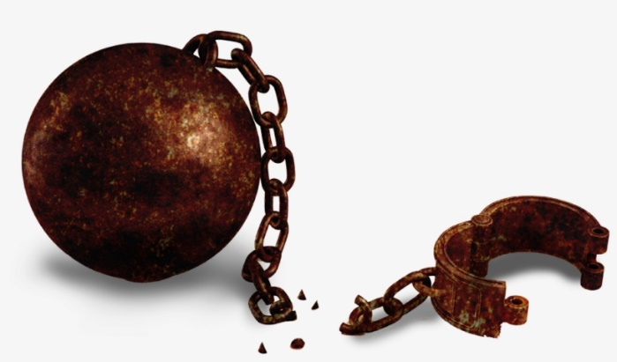
From what or whom is it we require being set free?
It is slavery to sin from which we need freedom.
“When you were slaves to sin, you were free from the control of righteousness.” (Romans 6:20)
Since the Jews in the crowd were not performing the work of God – because they were not believing in Jesus and His word – they must then be joined to another father intent on other works.
Jesus points to a lineage from Abraham that was not physical in nature, not something trackable through a DNA analysis, but faith oriented in nature.

Slide 11
From what or whom is it we require being set free?
It is slavery to Satan from which we need freedom.
Their fruit – plotting to kill Jesus – was clearly bad fruit, rooted in their spiritual lineage of sin and their spiritual father, Satan.
The volume of the voice of sin and Satan in their ears tragically drowned out the voice of Jesus and they evidenced an unwillingness to adjust the volume.
It’s only a small pen stroke difference between believing and belie-ing.

Slide 12
Do we recognize that our sin points to a slavery to that sin and do we recognize that Christ provides freedom from this slavery?
Am I hearing Christ’s voice, am I hearing His word?
Am I making room for Christ’s word?
As a disciple of Jesus, am I growing, knowing and going?

Slide 13
Might we both individually and corporately be a people who are growing, knowing and going, and that we would be this increasingly.
Might God would prompt us to create room for His word in our lives and in our living.
Might we know our freedom from slavery to sin and our adoption as sons and daughter of God through Christ.
Might the words of Romans 6:22 ring true for us: “now that you have been set free from sin and have become slaves of God, the benefit you reap leads to holiness, and the result is eternal life”.

