Slide 3
“When they found him on the other side of the lake, they asked him, “Rabbi, when did you get here?”
Jesus answered, “Very truly I tell you, you are looking for me, not because you saw the signs I performed but because you ate the loaves and had your fill. Do not work for food that spoils, but for food that endures to eternal life, which the Son of Man will give you. For on him God the Father has placed his seal of approval.” Then they asked him, “What must we do to do the works God requires?”
Jesus answered, “The work of God is this: to believe in the one he has sent.”
- John 6:25-29

Slide 4
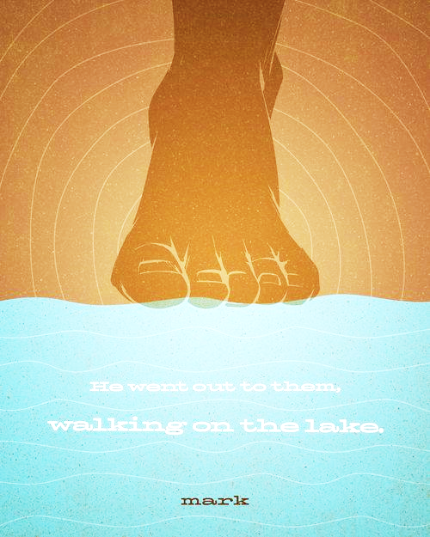
John 6: The Miracles of Jesus
The Feeding of the 5,000
Jesus Walks on Water

Slide 5
John 6: The Miracles of Jesus
The crowd responded to the miracle of the feeding of the 5,000 by demanding more things of Jesus, even attempting to force Jesus into fulfilling their wishes for a king; in response to this incredible miracle, the crowds focussed on the gift they received.
The Feeding of the 5,000

Slide 6
John 6: The Miracles of Jesus
Unable to quite express this reality in words at that moment, through this miracle, the disciples recognized Christ’s divinity and their response was to worship Him. In other words, in response to this amazing act, the disciples focussed on Jesus – the giver of the gift rather than the gift itself.
Jesus Walks on Water

Slide 7
Christ encouraged those following Him not to spend their energy chasing after temporal things, but to instead spend their energy chasing after eternal realities, available only from the Son of Man.
The point of the miraculous feeding was not to simply ensure full bellies, but to reveal to the crowds who Jesus truly was.
The miracle of Christ’s walking on water resulted in a clear focus on Jesus, not upon the miracle itself, an in awestruck worship at who Christ is.
In their following of Jesus, the disciples were truly working for food that endures to eternal life, while the crowds were chasing after food that spoils.

Slide 8
“For it is by grace you have been saved, through faith—and this is not from yourselves, it is the gift of God— not by works, so that no one can boast”. (Ephesians 2:8-9)
Christ’s point it that one cannot earn eternal life through various “good works”, but all can freely receive this gift through faith in Him.

Slide 9
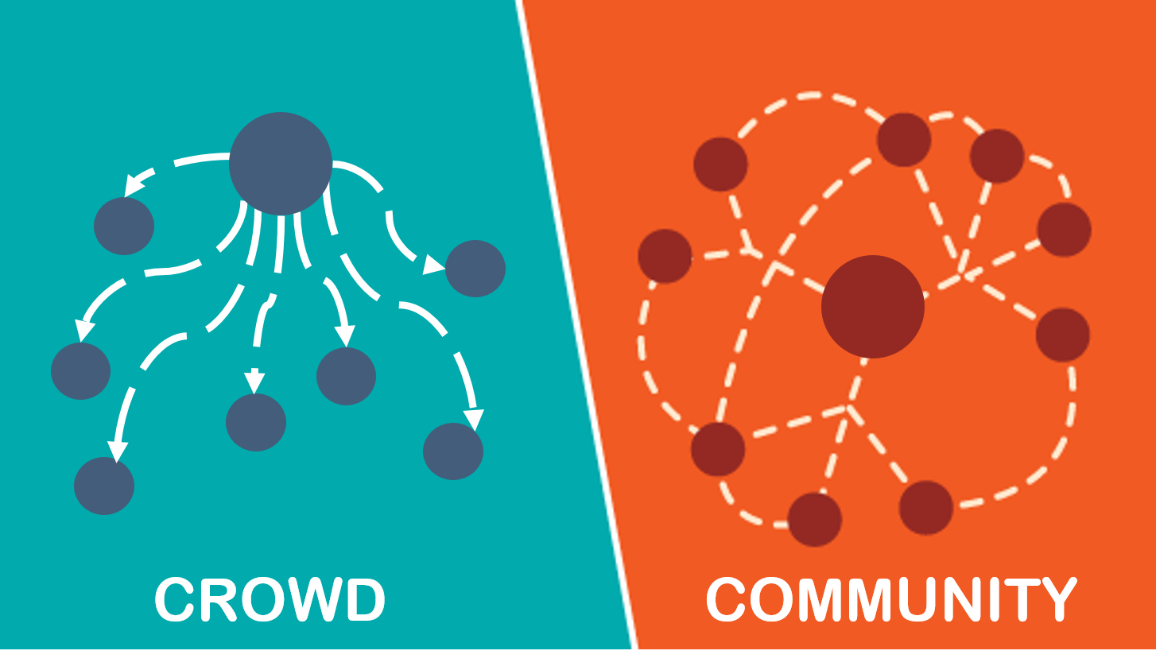
Crowds:
gather to receive something in response to their surrendered attention
focus on transactional realities
key in on the gift
Communities:
gather because of things they share in common, a mutual “giving and receiving
centre on mutually shared identity
centre on the giver

Slide 10
Are you following Jesus because of what He can give to you in a temporal sense or because of who He truly is – the Son of God/ Son of Man?
In knowing Jesus, does He still inspire awe in you for who He is?
If Jesus didn’t do another thing temporally for you from this point forward, would you still follow Him simply because of who you know Him to be?
As you follow Jesus, do you note yourself being pulled out of crowd-like concerns and into concerns associated with community?

Slide 11
Might we truly become a community even more focussed on Jesus, a people who acknowledge His gifts, but pursue relationship with Him even more diligently.
Might we be a people who acknowledge Jesus for who He is and follow Him because of that reality.
Might we be a people who know why we follow Jesus and might we be articulate this well to the world around us.

