Slide 1
The Book of 1 Peter:
Our Living Hope In Turbulent Times

Slide 2
“To the elders among you, I appeal as a fellow elder and a witness of Christ’s sufferings who also will share in the glory to be revealed: Be shepherds of God’s flock that is under your care, watching over them—not because you must, but because you are willing, as God wants you to be; not pursuing dishonest gain, but eager to serve; not lording it over those entrusted to you, but being examples to the flock. And when the Chief Shepherd appears, you will receive the crown of glory that will never fade away.”

Slide 3
“In the same way, you who are younger, submit yourselves to your elders. All of you, clothe yourselves with humility toward one another, because, “God opposes the proud but shows favor to the humble.” Humble yourselves, therefore, under God’s mighty hand, that he may lift you up in due time. Cast all your anxiety on him because he cares for you. Be alert and of sober mind. Your enemy the devil prowls around like a roaring lion looking for someone to devour.

Slide 4
“Resist him, standing firm in the faith, because you know that the family of believers throughout the world is undergoing the same kind of sufferings. And the God of all grace, who called you to his eternal glory in Christ, after you have suffered a little while, will himself restore you and make you strong, firm and steadfast. To him be the power for ever and ever. Amen.”

Slide 5
“With the help of Silas, whom I regard as a faithful brother, I have written to you briefly, encouraging you and testifying that this is the true grace of God. Stand fast in it. She who is in Babylon, chosen together with you, sends you her greetings, and so does my son Mark. Greet one another with a kiss of love. Peace to all of you who are in Christ.”
(1 Peter 5:1-14)

Slide 6
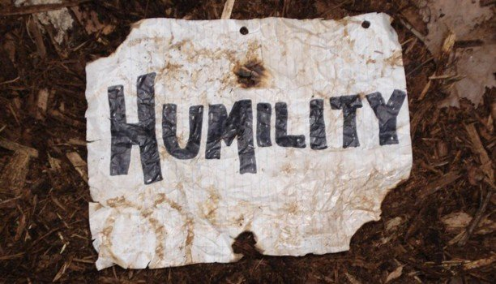
This “second place” orientation manifests in both our approach to God – that we would mirror Christ’s "Father … not my will, but yours be done" (Luke 22:42) attitude – and in our approach to others – that we would “in humility value others above [ourselves]” (Philippians 2:3).

Slide 7
The teaching of our text is that we are to submit in humility to those in spiritual leadership of the church.

Slide 8
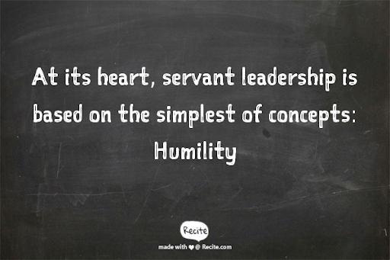

Slide 9
DISHONEST GAIN
If you want glory, notoriety, or to make a name for yourself, please don’t attempt to do this within the church because in the body of Christ, leaders ensure glory is delivered to God alone, that His solely fame is increased and that only His name is made great.

Slide 10
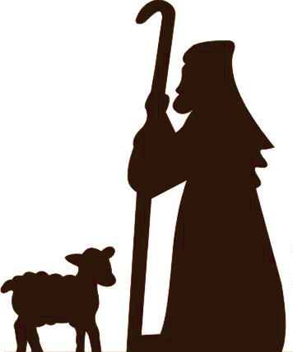
Shepherd, servant, slave … these are certainly not the most glamourous titles, but all are used to develop a picture of leadership within the church.

Slide 11
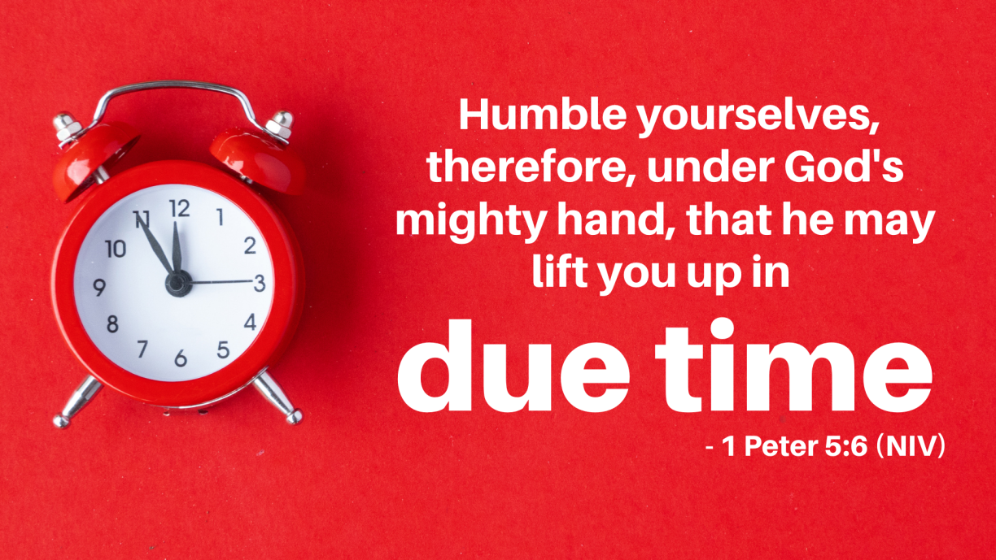
The teaching that it is our job to do the submitting and it is God’s job to do the lifting up “in due time” is highly countercultural.

Slide 12
&
The most difficult aspect of suffering is its seeming power to overwhelm one’s faith with paralyzing fear and pain and it’s ability to obliterate one’s faith that God cares, has any power to intervene or that He even exists.

Slide 13
A knowledge of God’s care ought to banish anxiety, because as we humbly submit to God, we know that “He will lift [us] up in due time”.

Slide 14
“Our enemy the devil prowls around like a roaring lion looking for someone to devour”. (1 Peter 5:8)
Satan desires that experiences of suffering amplify our anxiety to a volume that disrupts our faith, knowing that doing so will sever our only true means to overcoming experiences of suffering.
When we face suffering, our enemy desires it to result in destructive pain, but as we’ve been learning, God desires to see this very same suffering result in constructive growth, holiness and strength.

Slide 15
When we find ourselves in the grip of anxiety, we ought to:
cast all our anxiety on God because he cares for us
be alert for our enemy’s tactics
resist him, standing firm in the faith
carry each other’s burdens, and in this way … fulfill the law of Christ
find support from each other in the present, but also hope for the future, knowing that “the God of all grace, who called you to his eternal glory in Christ, after you have suffered a little while, will himself restore you and make you strong, firm and steadfast”

Slide 16
A CHALLENGE
Let us then embody the humility of Jesus in all that we do.
Let us not be too proud to ask for help, from God or from one another.
Let us commit to carrying each other’s burdens.
Let us frustrate our enemy by refusing to let our pain destroy us, instead, allowing suffering to make us stronger, more firm and more steadfast in our faith.

Slide 17
A PRAYER
Help us, O God, in our weakness and assist us to humbly help the weak among us. In doing so, might our anxiety be banished by the light of Christ’s love and might we be better equipped to serve, in humility, the world around us.

