Slide 1
The Book of 1 Peter:
Our Living Hope In Turbulent Times

Slide 2
WHO IS PETER?
Peter:
shows up as a frustrated and floundering fisherman on the shores of the Sea of Galilee.
becomes perhaps the most prominent – and certainly the most impulsive - of all the disciples.
is a three-time denier of Jesus who founded the Christian communities in Antioch, Rome and potentially Corinth.
was crucified upside down during the reign of Roman Emperor Nero, sometime prior to 68 A.D.

Slide 3
Peter likely wrote this letter from Rome, sometime around AD 64, just as persecution of Christians was ramping up.
Peter wrote to “scattered exiles” or “dispersed strangers” in Pontus, Galatia, Cappadocia, Asia and Bithynia – modern day northern Turkey.
For the Christians of Peter’s day, the world would have seemed to be falling apart at its seams.
Peter wrote this pastoral letter to the scattered followers of Jesus, offering encouragement and hope in the centre of trying times.

Slide 4
“Peter, an apostle of Jesus Christ, To God’s elect, exiles scattered throughout the provinces of Pontus, Galatia, Cappadocia, Asia and Bithynia, who have been chosen according to the foreknowledge of God the Father, through the sanctifying work of the Spirit, to be obedient to Jesus Christ and sprinkled with his blood: Grace and peace be yours in abundance. Praise be to the God and Father of our Lord Jesus Christ! In his great mercy he has given us new birth into a living hope through the resurrection of Jesus Christ from the dead, and into an inheritance that can never perish, spoil or fade.”

Slide 5
“This inheritance is kept in heaven for you, who through faith are shielded by God’s power until the coming of the salvation that is ready to be revealed in the last time. In all this you greatly rejoice, though now for a little while you may have had to suffer grief in all kinds of trials. These have come so that the proven genuineness of your faith—of greater worth than gold, which perishes even though refined by fire—may result in praise, glory and honor when Jesus Christ is revealed.”

Slide 6
“Though you have not seen him, you love him; and even though you do not see him now, you believe in him and are filled with an inexpressible and glorious joy, for you are receiving the end result of your faith, the salvation of your souls. Concerning this salvation, the prophets, who spoke of the grace that was to come to you, searched intently and with the greatest care, trying to find out the time and circumstances to which the Spirit of Christ in them was pointing when he predicted the sufferings of the Messiah and the glories that would follow.”

Slide 7
“It was revealed to them that they were not serving themselves but you, when they spoke of the things that have now been told you by those who have preached the gospel to you by the Holy Spirit sent from heaven. Even angels long to look into these things. Therefore, with minds that are alert and fully sober, set your hope on the grace to be brought to you when Jesus Christ is revealed at his coming.”
(1 Peter 1:1-13)

Slide 8
Peter’s “Thanksgiving” item
Peter is thankful for receiving a living hope through Jesus Christ in the form of a coming inheritance.

Slide 9
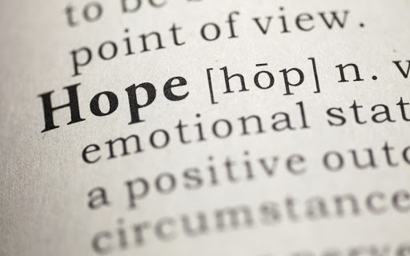
WHAT IS HOPE?
From a biblical position, hope is not a “fingers crossed” sort of thing, but refers to a confidence that God will deliver on His promises. Scriptural hope then is a strong confidence – complete assurance - that God is going to do good to us in the future.

Slide 10
Our hope and inheritance have been given to us in God’s great mercy.
“Jesus Christ himself and God our Father, who loved us and by his grace gave us eternal encouragement and good hope” (2 Thessalonians 2:16).
In our world there are many purported sources of hope and many potential “inheritances”, however, in reality, the only true hope and only secure inheritance comes as a living hope in a promised inheritance through the grace of Jesus Christ.

Slide 11
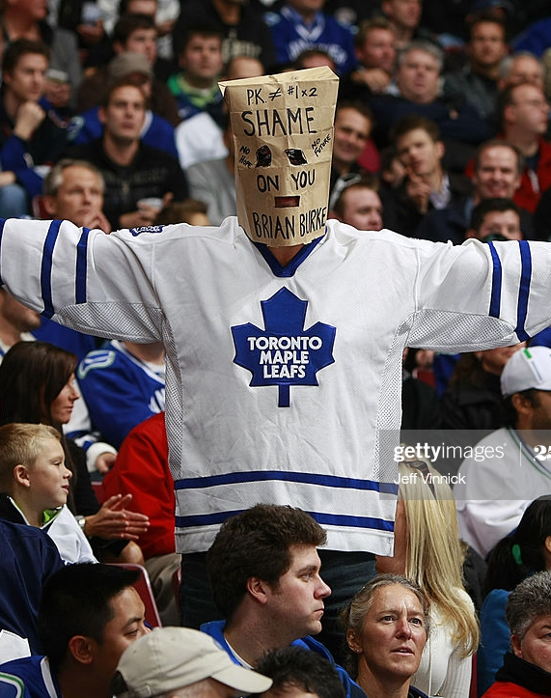
My hope in a Maple Leafs Cup win is little more than wishful thinking because the source of my hope – the often ragtag lineup of the Blue and White – is impermanent, open to wrong influence and insecure; the precise opposite of the hope that Peter declares we have in our inheritance in Christ Jesus.
As Peter reveals, the source of our living hope and our inheritance – Jesus Christ - is of an entirely different quality.

Slide 12
“For God so loved the world that he gave his one and only Son, that whoever believes in him shall not perish but have eternal life”. (John 3:16)
Our inheritance – the salvation of our souls and eternal life through Jesus Christ - is imperishable, because Christ Himself was raised imperishable. We, too, through faith in Jesus look forward to a similar inheritance.

Slide 13
Jesus Himself was sacrificed for us as “a lamb without blemish or defect” (1 Peter 1:19) and is “one who is holy, blameless, pure, set apart from sinners, exalted above the heavens” (Hebrews 7:26).
Because Jesus is free from anything that might defile, our inheritance too is as pure as the driven snow and free from any effect or influence that would cheapen it or cause it to lose its importance or value.

Slide 14
Our inheritance is secure, “kept in heaven [and] shielded by God’s power”, and “no one will snatch [us] out of [Jesus’] hand” (John 10:28). We will be “sanctified through and through, our whole spirit, soul and body … kept blameless at the coming of our Lord Jesus Christ [because] God is faithful, and he will do it”. (1 Thessalonians 5:23-24)
We can count on the security of our inheritance, because Christ promises to securely uphold our qualifications to receive this inheritance.

Slide 15
A LIVING HOPE
Living hope refers to a strong confidence in God which has power to produce changes in how we live; it is hope that results in definitive action of some sort. It is not a useless hope.
Because we know of the permanence, purity and security of our inheritance in Christ Jesus, we live differently.

Slide 16
REFLECTION QUESTIONS
Does the reality of a living hope, graciously extended to you through Jesus Christ, permit you to face your world boldly and confidently?
Is my life based upon a living hope or upon useless wishful thinking?
What is one change in my living that I could make given the knowledge of the living hope in a permanent, pure, and secure inheritance through faith in Jesus?

Slide 17
A PRAYER
My prayer today is that we would be a people who live out these words of Dr. Martin Luther King Jr – might we be a people who accept finite disappointment, but never lose infinite hope – that is, our infinite living hope in Jesus Christ and our promised inheritance through Him.

Slide 18
Discussion Questions
What is the difference between a true hope and wishful thinking?
Discuss a time when a hope of yours was anything but permanent, pure and secure. How did this experience leave you feeling?
Why is it important to realize that our hope in Jesus is a “living” hope and not a “dead” hope? What difference does this make?

