Slide 3
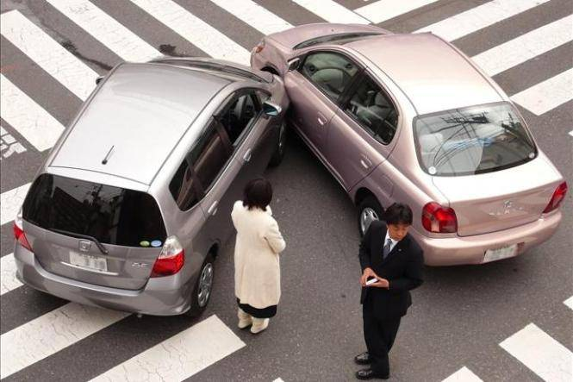
From a spiritual perspective, the failure to acknowledge one of God’s divinely placed stop signs can have equally problematic outcomes; rolling through spiritual stop signs always leads to eventual spiritual ruin and ultimately, spiritual death.

Slide 4
“For the grace of God has appeared that offers salvation to all people. It teaches us to say “No” to ungodliness and worldly passions, and to live self-controlled, upright and godly lives in this present age.” (Titus 2:11-12)
God has put up a spiritual stop sign – oftentimes, repeated stop signs – in our lives to alert us to the foolishness of our ways and to force us to stop and take in the grace He has extended to us.

Slide 5
Sometimes, God will put up a spiritual stop sign to prevent us from heading down a path of ministry or interaction that we believe God will bless, so that He can actually do something far more important in and through us.
Rolling through God’s stop signs is never beneficial to our ministry, the church or to our individual spirituality.

Slide 6
“Be still, and know that I am God”. (Psalm 46:10)
“Be still” = cease striving, stop contending, let go or, colloquially, relax
We cannot will ourselves to be “better Christians”; instead, there is a yielding to Jesus and a partnering with His Holy Spirit that is required if we are to follow Him effectively.

Slide 7
“That day when evening came, he said to his disciples, “Let us go over to the other side.” Leaving the crowd behind, they took him along, just as he was, in the boat. There were also other boats with him. A furious squall came up, and the waves broke over the boat, so that it was nearly swamped. Jesus was in the stern, sleeping on a cushion. The disciples woke him and said to him, “Teacher, don’t you care if we drown?” He got up, rebuked the wind and said to the waves, “Quiet! Be still!” Then the wind died down and it was completely calm. He said to his disciples, “Why are you so afraid? Do you still have no faith?” They were terrified and asked each other, “Who is this? Even the wind and the waves obey him!” (Mark 4:35-41)
Notes:
Mark 4:35-41:

Slide 8
KEY QUESTIONS
The wind and waves obeyed Jesus’ stop sign, do you?
On the other hand, we might ask ourselves what are we saying about who we believe to be in authority over our lives when we choose to roll on through a spiritual stop sign?

Slide 9
How ought we respond to a spiritual stop sign?
We ought to stop, take stock of our spiritual and cultural surroundings and then prepare to proceed safely with a clear view of the conditions around us. As we idle at the stop sign, we might need to address areas of sin in our lives, disordered ministry plans or false understandings of who is truly sovereign over our lives.

Slide 10
Each time you roll up on a stop sign this week, I’d like you to speak a little prayer out loud:
As I stop physically and spiritually at this stop sign Jesus, what do I need to learn about you or myself in this moment?

Slide 11
A PRAYER
Might we become a people adept at recognizing God’s spiritual stop signs in our life and might we become increasingly more obedient to them. Might our awareness and obedience then result in spiritual maturity both individually and corporately so that we can reach out in the power and love of Jesus to the world around us, seeing others drawn into His loving arms.
PRAYER
AHEAD

Slide 12
DISCUSSION QUESTIONS
Can you think of a time when you encountered a spiritual stop sign in your life?
Why do you think we have such a difficult time obeying spiritual stop signs?
What have you learned if your experience of the past six months is nothing more than a huge, global spiritual stop sign of sorts?

