Slide 1
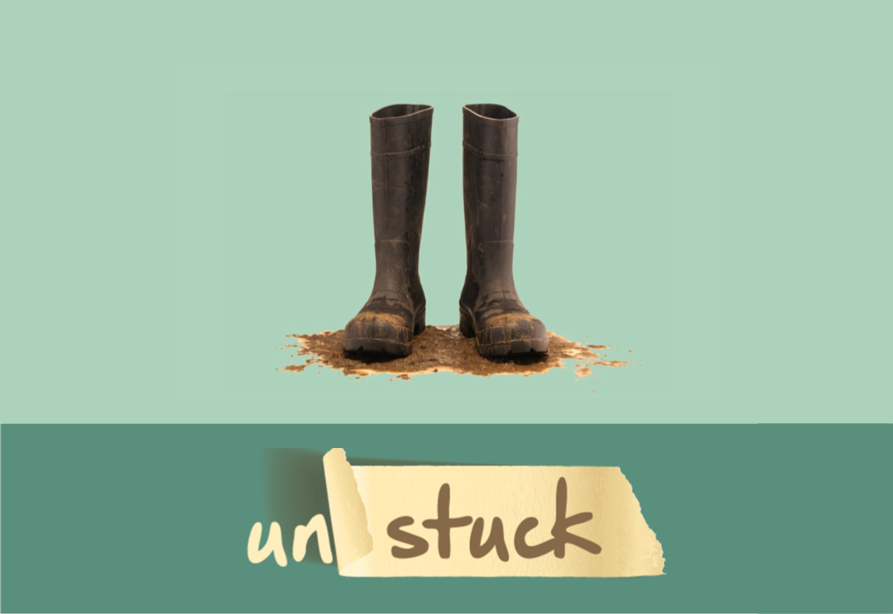
A Study in 1 Samuel

Slide 2
In the Beatitudes, Jesus presents to us a guide for the creation of an “upside-down kingdom”; a community where joy is experienced regardless of circumstances, but what if we’re stuck halfway to upside down?

Slide 3
To get “unstuck”, we often need some creative thinking – a different way to look at the problem.
What if Jesus is directing us to “try something different”? What if God has a divinely ordained “different” in mind to help us navigate our chaotic culture?

Slide 4
“… now appoint a king to lead us, such as all the other nations have.” (1 Samuel 8:5)

Slide 5
The king of Israel was to be unlike the kings that all other nations have. God was to remain sovereign over His people and the king of Israel was to be a representative or an instrument of God.
The Israelite desire for a king was not particularly the issue. The perhaps even righteous desire for a king was skewed over time and morphed into a desire to replace God with a human king.

Slide 6
Saul and the “tipping point”
1 Samuel 13 - rather than wait upon God in obedience, Saul acted disobediently, couching his disobedience in religious terms.
1 Samuel 15 – Saul acts partially obediently, disobeying under the guide of honouring God.
With the full support of the people of Israel, Saul had become a king who went “out before Israel and fought battles”, but at the time and in the way he saw fit.
The rebellion and arrogance found in both the people of Israel and Saul had so infected their kingdom, it was incapable of toppling over and becoming the “upside down kingdom” God desired it to be.

Slide 7
The Crumbling Crown of King Saul
“The Lord has sought out a man after his own heart, and the Lord has commanded him to be prince over his people, because you have not kept what the Lord commanded you” (1 Samuel 13:14).

Slide 8
Application
We ought to seriously question, on both a personal and corporate level, whether we are truly living in an “upside down” kingdom or not. Are we only “halfway to upside down” and stuck in some way?

Slide 9
Application
At the heart of things, am I (are we) more concerned about what we want God to do for us or what God might want from us?
Might our “stuckness” be related to the fact that we aren’t as poor in spirit as we might need to be to prosper in an upside down kingdom?

Slide 10
Application
Let us ask ourselves, what divinely ordained “different” might God be calling us towards?
Have we been focussing on our stuck tire rather than on the freedom that simply shifting our load might generate?

Slide 11
My Prayer
Might God be so at work in and through us, generating immense poverty of spirit, that we might experience freedom from our stuckness and see our kingdom pushed past the tipping point becoming His upside down kingdom here on earth.

