Slide 1
Counter
Cultural
Christmas
“Manger Community”

Slide 2
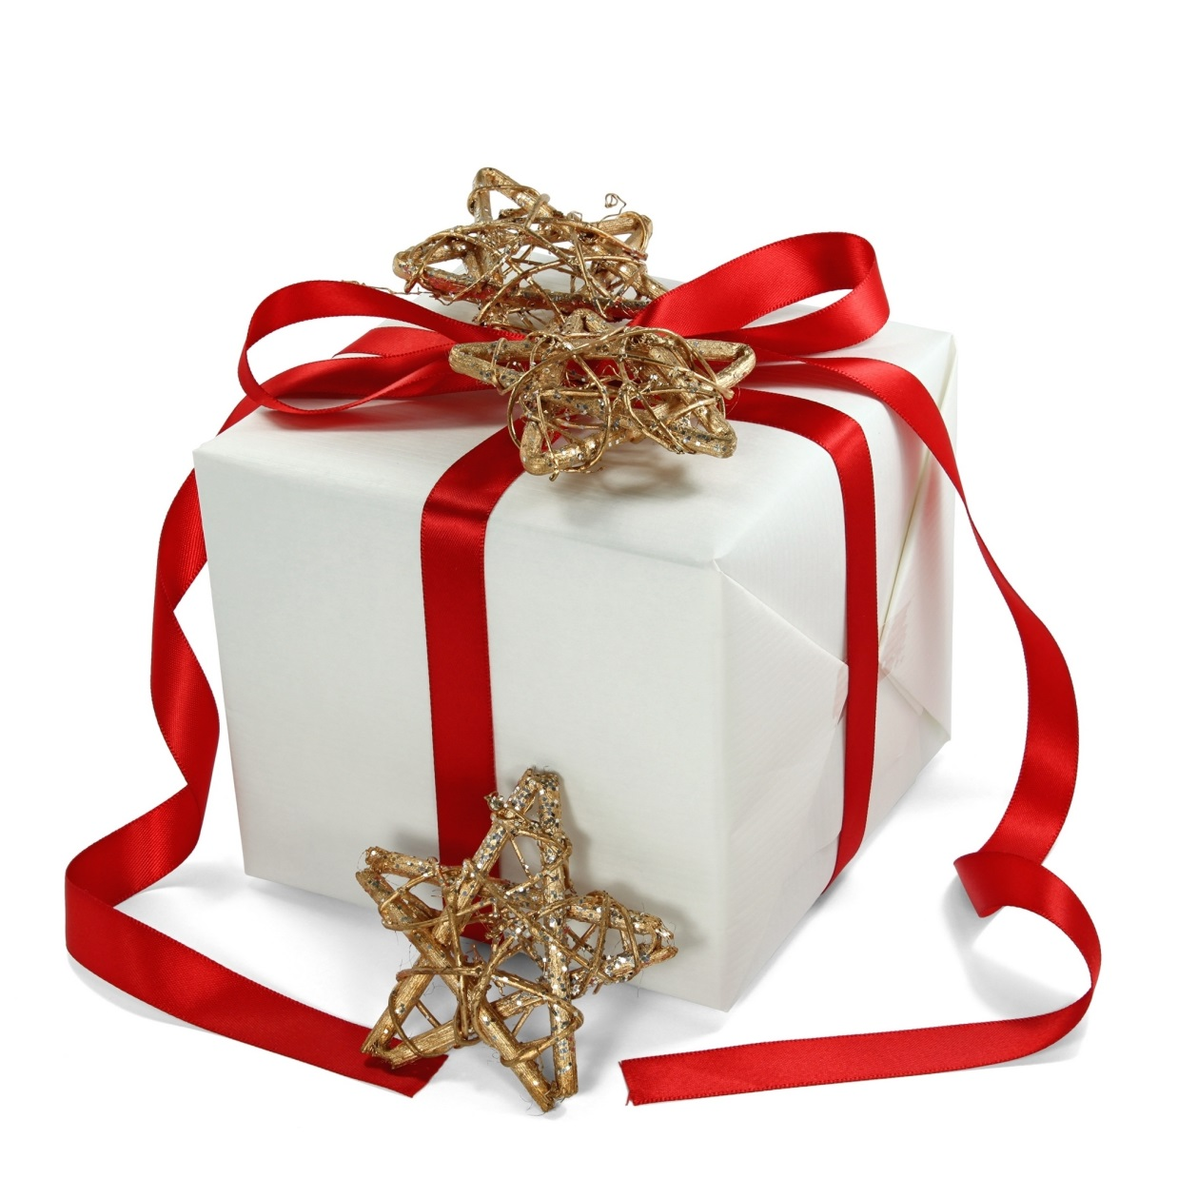
Jesus:
A Gift for “Me” or A Gift for “Us”

Slide 3
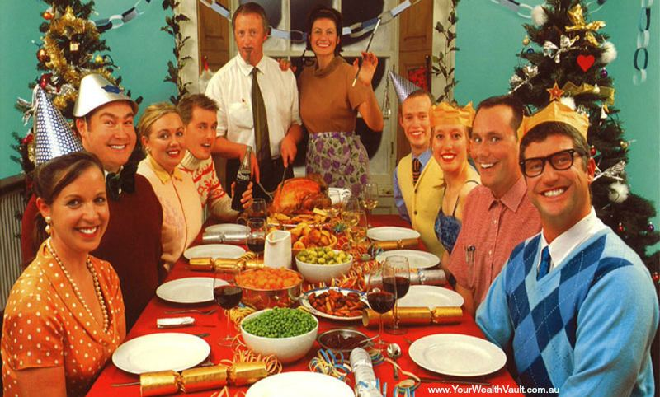
Christmas:
A Time for Odd Community

Slide 4
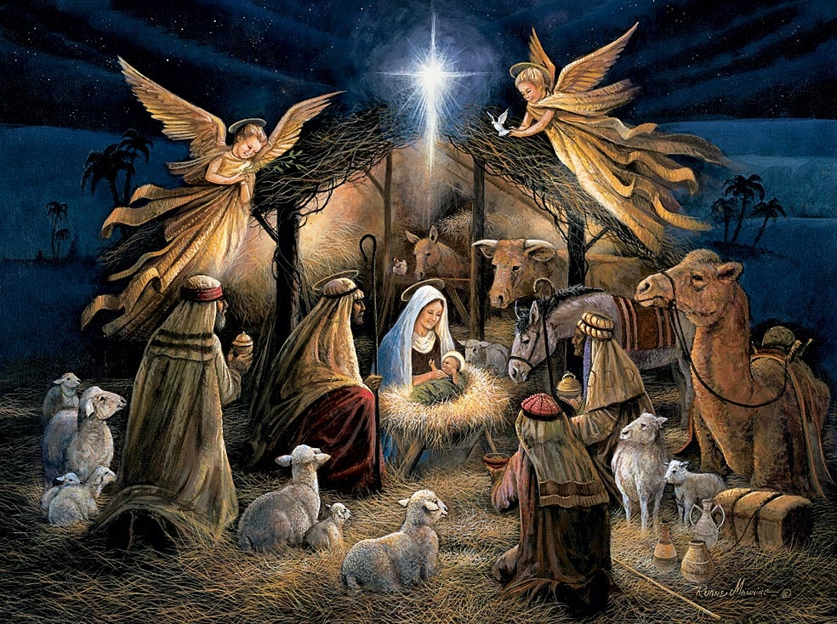
The Nativity:
An Odd Community

Slide 5
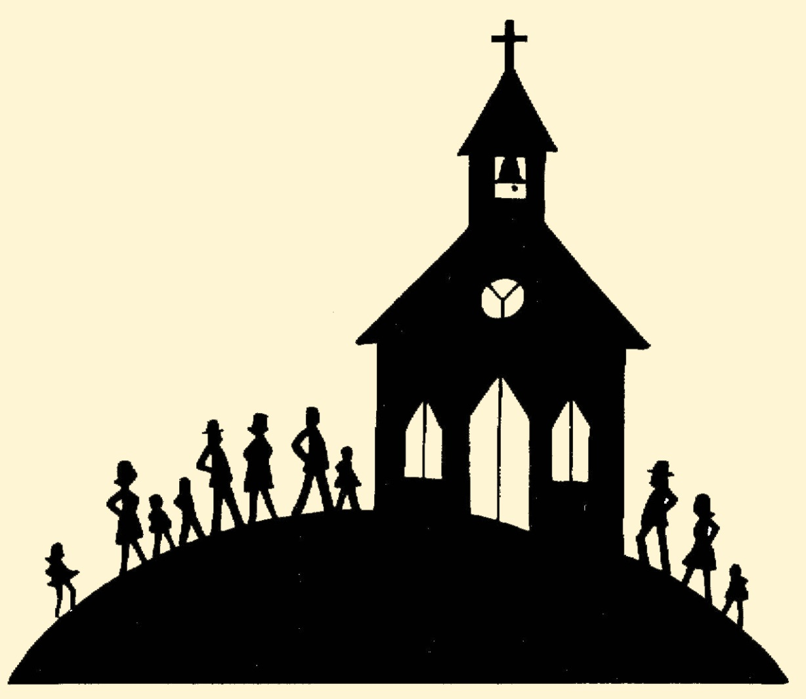
The Church:
An Odd Community

Slide 6
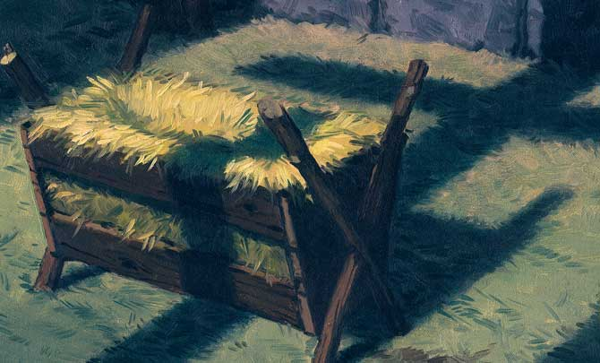
As we gather today, what are we centered around?
What ought we be centered around today ?

Slide 7
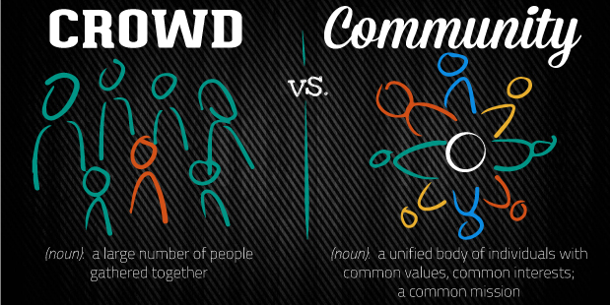

Slide 8
In the community surrounding the manger, we see a treasuring of Jesus.
Mary: “Mary treasured up all these things and pondered them in her heart.” (Luke 2:19)
The Magi: communicate Jesus’ value to them – and to the world – through the opulence of their gifts of gold, frankincense and myrrh.
The Apostle Paul: “I consider everything a loss because of the surpassing worth of knowing Christ Jesus my Lord, for whose sake I have lost all things”. (Philippians 3:7-8)
Jesus is calling out a community where treasuring Him is key.

Slide 9
In the community surrounding the manger, we see the worship of Jesus.
The Magi: “come and worship Him” (Matthew 2:2) and they “bowed down and worshipped Him” (Matthew 2:11).
“A time is coming and has now come when the true worshipers will worship the Father in the Spirit and in truth, for they are the kind of worshipers the Father seeks” (John 4:23).
God is looking for those who will truthfully, earnestly, and humbly worship Him regardless of their track record, preferences or peculiarities.
Jesus is calling out a community that will worship Him together in “spirit and truth”.

Slide 10
In the community around the manger, we see the proclamation of Jesus.
The angels: announce the presence of Jesus in the world, passing on “good news that will cause great joy for all the people” (Luke 2:10).
The shepherds: “spread the word concerning what had been told them about this child and all who heard it were amazed at what [they] said to them” (Luke 2:17-18).
Jesus is calling out a community that will share the good news of Jesus and the promise that, by faith in Him, we might see our sin forgiven and be ushered into new and eternal life.

Slide 11
Will we be a crowd or a community?
Will we be a community where Jesus is treasured, worshipped and proclaimed?
Might others see our joy and amazement at the gift of Jesus Christ and might they be led to share in it with us.

