Slide 3
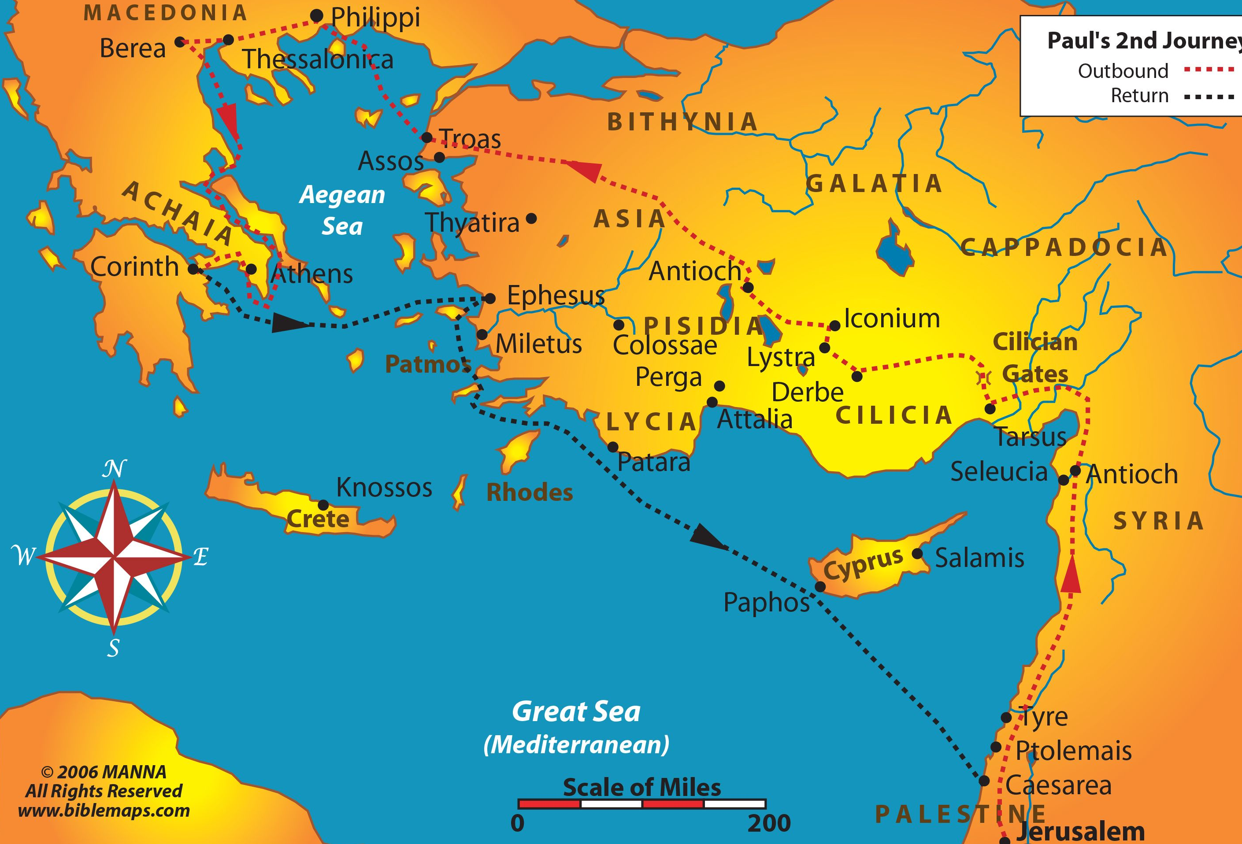
The First-century world of the Church
Colossae
Colossae, located in modern day Turkey, about 160 kms east of the ancient city of Ephesus.

Slide 4
Colossae was:
a cosmopolitan city with many different religious and cultural influences.
mostly Gentile in nature
famous for the production of a dark red wool cloth
Religiously influenced by the worship of the Roman god Diana, the humanism of Greek thought, local animistic practices and to a lesser extent, the tenets of Judaism.

Slide 5
The Key Players
The letter to the Colossians was written by the Apostle Paul, likely during his first Roman imprisonment around AD 60.
Paul trained and equipped Epaphras to plant a church in Colossae sometime around AD 55-56.
Epaphras paid a visit to Paul, while under house arrest in Rome to discuss problems facing the church.
The letter to the Colossian church then is Paul’s attempt to help Epaphras get things back on track.

Slide 6
Paul’s Rationale for Writing Colossians
“I want you to know how hard I am contending for you and for those at Laodicea, and for all who have not met me personally. My goal is that they may be encouraged in heart and united in love, so that they may have the full riches of complete understanding, in order that they may know the mystery of God, namely, Christ, in whom are hidden all the treasures of wisdom and knowledge. I tell you this so that no one may deceive you by fine-sounding arguments.” (Colossians 2:1-4)
Given this rationale for the letter, what problems do you think Epaphras was facing in terms of leading the church at Colossae?

Slide 7
contending
“I want you to know how hard I am contending for you and for those at Laodicea, and for all who have not met me personally. My goal is that they may be encouraged in heart and united in love, so that they may have the full riches of complete understanding, in order that they may know the mystery of God, namely, Christ, in whom are hidden all the treasures of wisdom and knowledge. I tell you this so that no one may deceive you by fine-sounding arguments.” (Colossians 2:1-4)
mystery of God, namely, Christ, in whom are hidden all the treasures of wisdom and knowledge

Slide 8
X + Jesus Formulas in Colossae
Secret knowledge + Jesus = Gnosticism
Ceremonialism + Jesus = Legalism
Angelic mediators + Jesus = Pantheism
The outcomes of these “X + Jesus” formulas is discouragement, disunity, and an woefully incomplete knowledge of God.

Slide 9
JESUS
When Christ, in whom are hidden all the treasures of wisdom and knowledge, is placed in a proper position of centrality within a community, the people will be encouraged in heart and united in love, having the full riches of complete understanding, knowing Christ intimately.
JESUS JESUS
JESUS JESUS JESUS JESUS JESUS
JESUS JESUS JESUS
JESUS JESUS JESUS JESUS JESUS
JESUS JESUS JESUS
JESUS JESUS JESUS
JESUS JESUS
PUT
JESUS
FIRST
JESUS JESUS JESUS
JESUS JESUS JESUS
JESUS JESUS
JESUS JESUS
JESUS JESUS JESUS JESUS JESUS JESUS JESUS
JESUS JESUS JESUS JESUS
JESUS JESUS JESUS JESUS JESUS JESUS JESUS

Slide 10
JESUS
JESUS JESUS
JESUS JESUS JESUS JESUS JESUS
JESUS JESUS JESUS
JESUS JESUS JESUS JESUS JESUS
JESUS JESUS JESUS
JESUS JESUS JESUS
JESUS JESUS
PUT
JESUS
FIRST
JESUS JESUS JESUS
JESUS JESUS JESUS
JESUS JESUS
JESUS JESUS
JESUS JESUS JESUS JESUS JESUS JESUS JESUS
JESUS JESUS JESUS JESUS
JESUS JESUS JESUS JESUS JESUS JESUS JESUS

