Slide 1
Generosity
spend 10% less than you might have intended to spend and find a way to give that 10% away to a worthy cause.

Slide 2
Privileged to Give
Might we “be enriched in every way so that [we] can be generous on every occasion, and … [our] generosity result in thanksgiving to God” (2 Corinthians 9:11)

Slide 3
Scriptural Study
set aside a few units of time each day to practice a daily office.

Slide 4
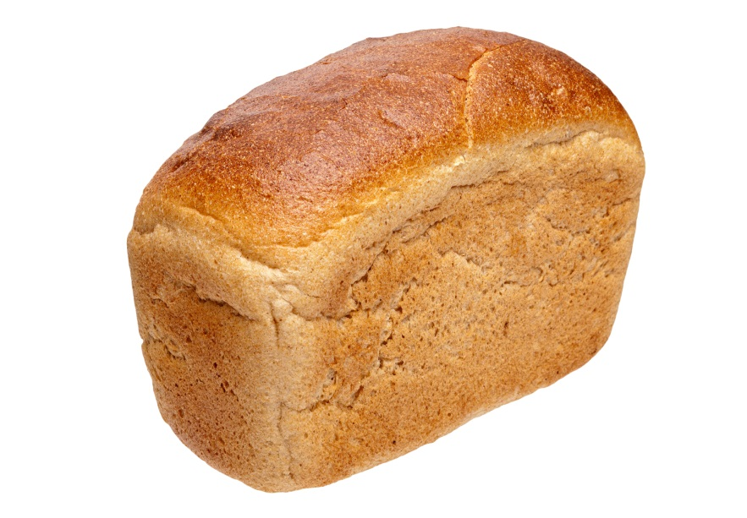

Slide 6
Community
intentionally engage three people at a deeper level than usual each week.

